Slide 1
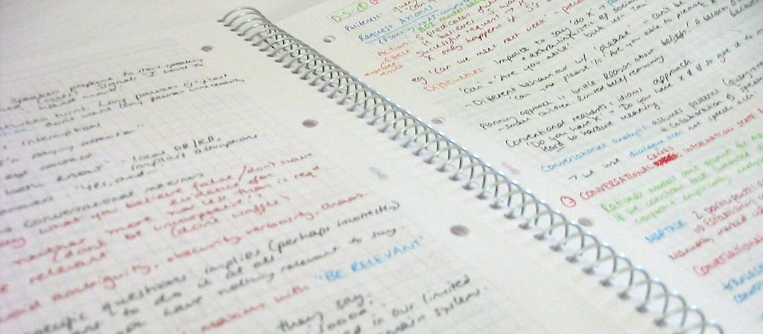
CA S Wolverhampton
How to prepare students for exams
How to prepare students for computer science exams
February 2021
Notes:
"Revision notes" by jez` is licensed under CC BY-SA 2.0

Slide 2
This presentation
How to prepare students for exams
Part 1: What the research says about revision.
Part 2: Craig’n’Dave’s six steps to success.
Part 3: Exemplifying this with Smart Revise plus other ideas.

Slide 3
The research
How to prepare students for exams
Murre, J. & Dros, J., 2015. Replication and Analysis of Ebbinghaus’ Forgetting Curve, https://www.ncbi.nlm.nih.gov/pmc/articles/PMC4492928/
Dunlosky J. et al, 2013. Improving Students’ Learning With Effective Learning Techniques: Promising Directions From Cognitive and Educational Psychology
Weinstein, Y., Sumeracki, M. and Caviglioli, O., 2018. Understanding how we learn. London: Routledge, Taylor and Francis Group.
There are plenty of other studies too: Cepeda et al 2008, Bell & Limber 2010, Lonka et al 1994, Nist & Kirby 1989, Cioffi et al 1986, Gurung et al 2010, Spitzer 1939, Butler 2010, Karpicke & Blunt 2011.
It is important students aren’t just left to revise for themselves. We need to prepare them well in advance and teach them what works.

Slide 4
When do you start revision?
How to prepare students for exams
After Christmas?
After February half term?
After Easter?
When do Craig and Dave start revision?
After the very first topic has been taught, not just at the end of the course!

Slide 5
The research says there is…
How to prepare students for exams
Effective revision
Inefficient revision
Ineffective revision

Slide 6
Ineffective revision
How to prepare students for exams
Rereading work and textbooks
When a student simply reads or rereads their books or notes. It creates an illusion of knowing, when in fact many studies show students get nothing out of it.
Using highlighter pens on notes
Surprisingly highlighting does little to boost performance and it may actually hurt performance on higher-level questions that require inference making.

Slide 7
Inefficient revision
How to prepare students for exams
Making notes
Effective summarising requires extensive training which makes this strategy less feasible. It has some impact for students that are skilled in summarising.
Notes are significantly more effective if they are written as questions and answers. Cornell your work!
Any of the efficient techniques with friends
Many students like to get together with their friends to study. When that happens, the time will be used less efficiently – even if they are using a good technique – than if they were doing it on their own.

Slide 8
Effective revision
How to prepare students for exams
Spaced practice
Attempting to retrieve knowledge frequently. Doing the same practice again and again over a long period of time. Just because you think you have learned something, don’t put it to one side. The forgetting curve is real.
Retrieval practice
Instead of rereading content, e.g., using flashcards passively, challenge yourself to write the definitions instead. This has a much bigger impact on performance than just reading.
Interleaving topics
Recent research has shown mixing up topics that have been previously taught is three times more effective than ‘blocking’ (only looking at one topic at a time). Quiz students on a variety of topics they have learned to date. Explaining the links between concepts is useful. E.g. array > contiguous addresses > index register > static

Slide 9
Effective revision
How to prepare students for exams
Our six steps to success…

Slide 10
How to prepare students for exams
How to prepare students for exams
Redefine revision in your classroom as a continual practice throughout the course and not something you do at the end.
Do as much programming and studying algorithms as you can throughout the whole course.
Lessons need to address questions not outcomes.
Low-stakes questioning on all the previously taught material since the beginning of the course in every lesson and/or for homework.
Keywords: write definitions, don’t simply display them on the wall.
Practice exam questions with students: show them how to answer.

Slide 11
Questioning isn’t always questions!
How to prepare students for exams
Spider diagram frameworks
Low-stakes questioning can also include completing a scaffolded spider diagram writing frame.
Comparing what they wrote with a pre-prepared answer.
State the registers
Central processing unit
State the units in a CPU

Slide 12
Questioning isn’t always questions!
How to prepare students for exams
Spider diagram frameworks
Low-stakes questioning can also include completing a scaffolded spider diagram writing frame.
Comparing what they wrote with a pre-prepared answer.
Program Counter
Control unit
Memory Address Register
State the registers
Central processing unit
State the units in a CPU
Decode unit
Memory Data Register
Arithmetic logic unit
Accumulator

Slide 13
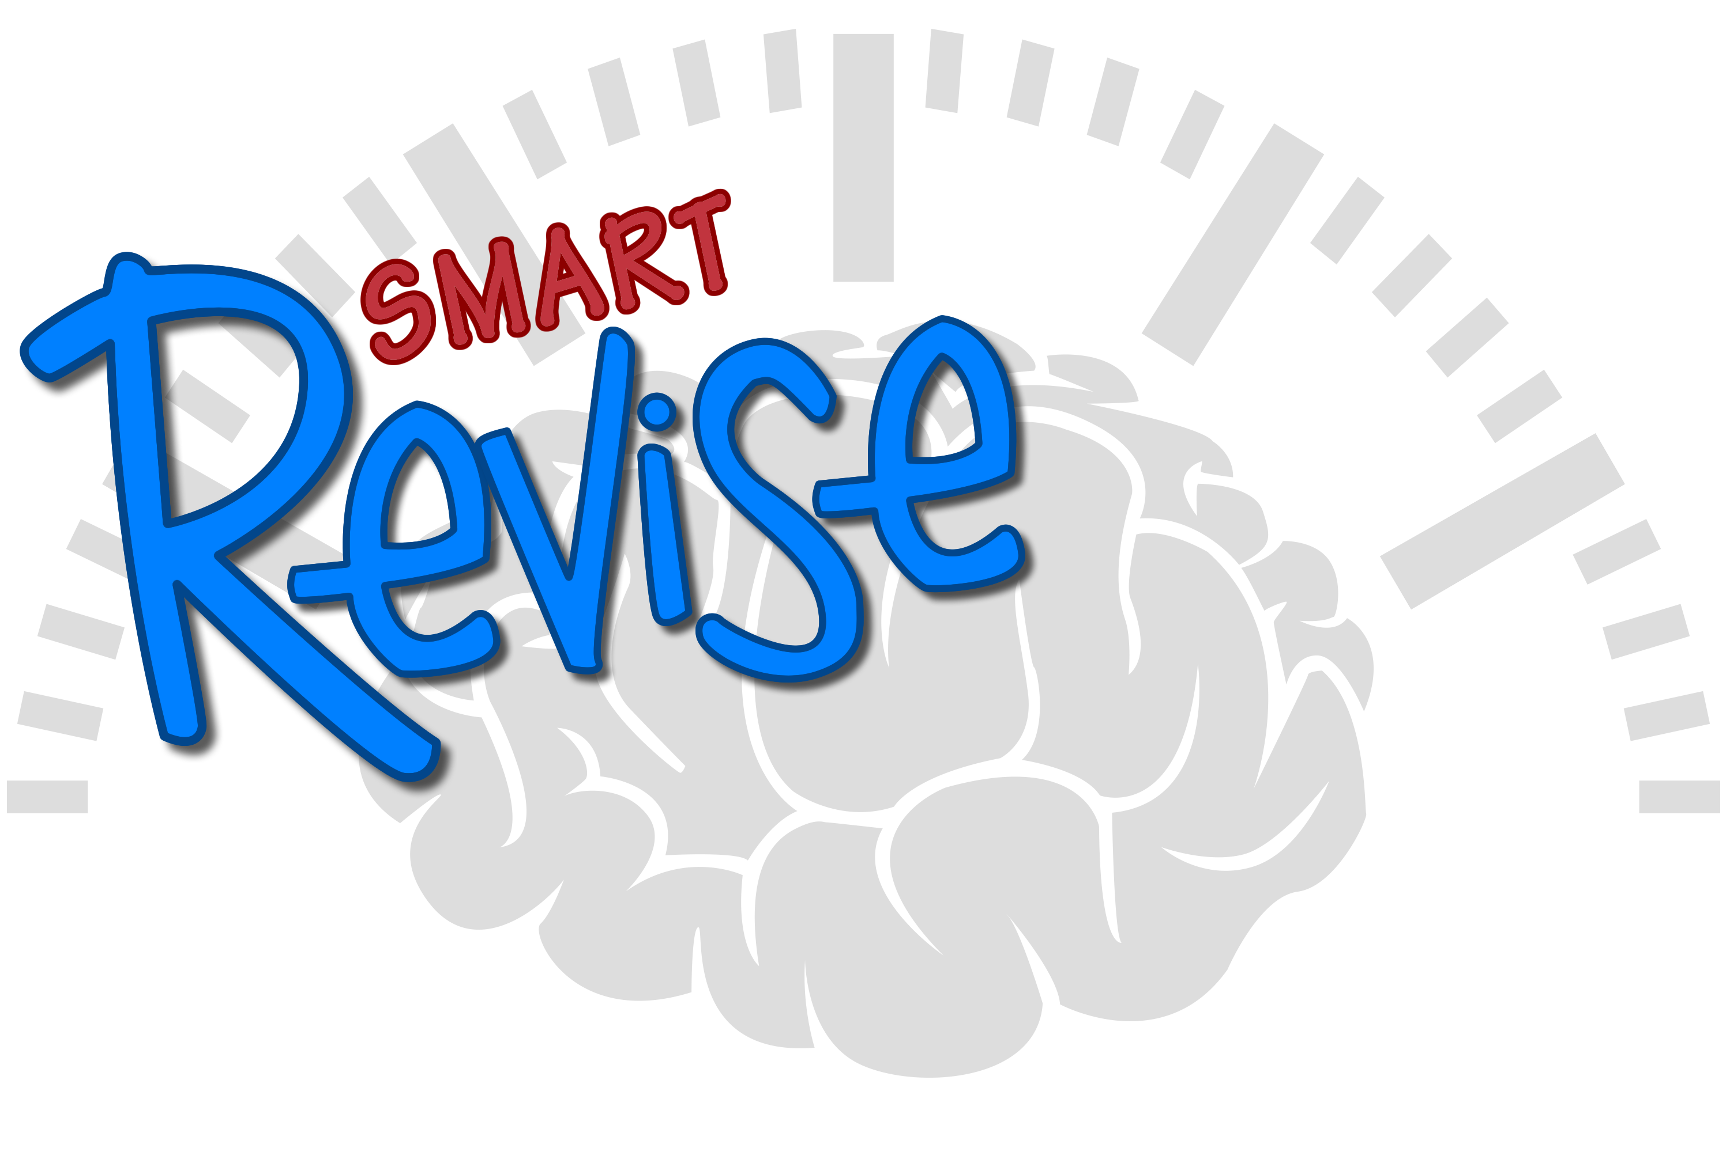
Smart Quiz
How to prepare students for exams
Spaced, retrieval and interleaving practice.
Spending time each day to remember information will greatly decrease the effects of the forgetting curve.
Increase the number of topics that are unlocked over time, don’t just focus just on what has been recently taught.

Slide 14
Smart Terms
How to prepare students for exams
Don’t use as simple flashcards, interactive mode is far more powerful.
Confidence indicators allow you to see the topics that need to be retaught.

Slide 15
Smart Advance
How to prepare students for exams
Know what the command words mean.
Know how mark schemes work and how to structure answers using the command words.
Do walking-talking questions, especially for algorithms.
Engaging with the mark scheme is as important as answering the question. Online revision tools that only do the marking for the student are not helping. It is too passive.

Slide 16
Analytics reports
How to prepare students for exams
Use data to inform your revision.
Find out more here: https://smartrevise.craigndave.org/

Slide 17
How to claim your free Smart Revise vouchers
How to prepare students for exams
For years 11 and 13.
You must have registered to attend the meeting.
Complete an order within Smart Revise using the purchase order option and enter “CAS Wolverhampton” as the PO number.
Ignore the cost quoted.
If you have already purchased Smart Revise vouchers for your Y11 and Y13 class, drop us an email at admin@craigndave.co.uk using the same address as the registered teacher account.

