Slide 1
Curriculum Assessment Review Key Implications for Secondary Schools
Focus on Computing, Digital Literacy, and Curriculum Reform

Slide 2
Purpose of this briefing
Summarise key recommendations from the 2025 Curriculum Assessment Review and the Government response.
Highlight changes that will affect Computing, assessment and school accountability measures.
Support teachers in understanding the upcoming reforms and to prepare for implementation.

Slide 3
Key take aways for Computing teachers
GCSE Computer Science to be replaced by GCSE Computing that better reflects the breadth of the curriculum: Foundation Computer Science plus developing digital skills - effective, critical application and creation of technology.
Explore introducing a new level 3 qualification in Data science and AI.
Academies will be required to teach the new national curriculum alongside maintained schools.
Non-examined assessment (NEA) should continue to be used if it is the only valid form of assessing content.
Clarity about what should be taught with a focus on essential digital literacy required for future life and work.

Slide 4
Key take aways for Computing teachers
2028
New National Curriculum KS 1-4 PoS released by spring 2027, first teaching 2028.
2029 or 2030
First teaching of new Phase 1 GCSEs 2029, exams in summer 2031.
First teaching of new Phase 2 GCSEs 2030, exams in summer 2032.
2031
First teaching of new Phase 1 A levels 2031, exams in summer 2033.

Slide 5
Curriculum shape, design and assessment reform

Slide 6

Curriculum design principles
Official response
Maintain knowledge-rich approach.
Strengthen horizontal links (e.g. literacy, numeracy, digital literacy).
Broaden perspectives while retaining disciplinary depth.
Mastery of core concepts supports long-term learning and progression.
Ensure that high standards and opportunities means high standards for all.
We are legislating through the Children’s Wellbeing and Schools Bill so that academies will be required to teach the refreshed national curriculum alongside maintained schools.
This will ensure that parents and carers have certainty over the core concepts in their child’s education and that there is a floor beneath which this cannot slip.

Slide 7
Assessment reform
Official response
Externally marked exams remain the fairest and most reliable method.
Coursework expansion rejected due to risks from generative AI.
Emphasis on safeguarding disadvantaged students from bias and malpractice.
Proposal:
Reduce GCSE exam volume by 10% (2.5 - 3 hours on average) via subject-by-subject review.
Limit each GCSE subject to two exam papers.
We agree with the Review that exams provide a fair and reliable indication of what young people know, understand and can do. However, some subjects include content that cannot be wholly assessed by exams. We therefore agree with the Review that non-examined assessment (NEA) should continue to be used if it is the only valid form of assessing this content.
We also agree with the Review that new technologies, such as generative AI, carry risks and implications for some forms of NEA.
We will work closely with Ofqual and the sector to understand the risks and mitigations needed – including exploring alternative assessment methods where necessary – in order to ensure GCSE, AS and A level assessments remain fair, valid and reliable.

Slide 8
Digital assessment & SEND
Official response
The Review acknowledged that on-screen assessment may deliver some benefits but evidence of the potential for wider implementation is still in its early stages.
We want to realise the benefits and opportunities that on-screen assessment may present, and we will work with awarding organisations and Ofqual on this so that any wider use of on-screen assessment in GCSEs and A levels is introduced in a way that is fair, proportionate and manageable.
We want to allow space for innovation, but we must also manage the risks, maintain public confidence and protect the quality and integrity of qualifications.
DfE and Ofqual encouraged to innovate with digital assessment.
Accessibility for SEND students highlighted as a priority.
Balance needed between innovation and reliability.

Slide 9
Curriculum shape & subject choice
Official response
EBacc structure limits student choice at KS4: 7–8 subjects pre-selected.
Religious-designated schools often mandate GCSE RS, further narrowing options.
Computing, arts, and vocational subjects frequently excluded.
Recommendation:
Scrap EBacc as a headline performance metric.
Rename EBacc bucket to “Academic Breadth” in Progress 8.
No structural changes to Progress 8 buckets — but shift in framing for both Progress 8 and Attainment 8.
Reflecting the importance of a curriculum that supports high standards, we will develop and consult on an improved version of Progress 8 and Attainment 8 that balances a strong academic core with breadth and student choice.
We will remove EBacc headline and additional measures at key stage 4.

Slide 10
Key Stage 5 reform — V Levels
Streamline the confusing landscape of hundreds of different qualifications at 16-19.
New “V Levels” proposed alongside A Levels and T Levels.
Sector-based, applied qualifications with clear progression routes.
Small format (360 GLH) and larger options for creative/vocational areas.
Content to be nationally set and aligned with occupational standards.
Designed to meet employer needs and broaden subject access.
A Levels
academic
Key Stage 5 reformed offer
T Levels
technical
V Levels
vocational

Slide 11
Computing curriculum reform

Slide 12
Computing curriculum reform
Official response
We will rebalance the computing curriculum as the Review suggests, to ensure pupils develop essential digital literacy whilst retaining important computer science content.
Through the reformed curriculum, pupils will know from a young age how computers can be trained using data and they will learn essential digital skills such as AI literacy.
Teaching time has declined: KS3 (4% → 3%), KS4 (5% → 2%).
KS4 Computing often taught only to GCSE CS students (80%).
Programme of Study at KS4 is vague — just 3 bullet points.
Recommendation:
Update curriculum for clarity, consistency, and progression.
Ensure all students access Computing to end of KS4.

Slide 13
GCSE reform — A broader computing qualification
Official response
GCSE CS seen as narrow and specialised.
Girls underperform and under-enrol (20% boys vs 6% girls).
Students score lower in CS than other subjects (−0.72 grades on average).
Proposal: Replace GCSE CS with broader GCSE in Computing.
Includes CS, IT, digital literacy, and real-world applications.
Supports progression to A Level and careers.
Designed to appeal to a wider student population.
We will replace the computer science GCSE with a GCSE in computing that better reflects the breadth of the curriculum.
We will also explore introducing a new level 3 qualification in data science and AI, to ensure that more young people can secure high value skills for the future and that we cement the UK’s position as a global leader in AI and technology.

Slide 14
Cross-curricular integration
Official response
Computing skills to enrich other subjects:
GIS in Geography.
3D modelling in D&T.
Online safety in RSHE.
Misinformation in Citizenship.
Curriculum coherence and alignment recommended.
References to Computing in other subjects should match key stage expectations.
National curriculum revised programmes of study will prioritise core concepts in each subject and make sure they are coherent within and across subjects.
An online and machine-readable national curriculum which visually represents the links within and between subject areas and gives connections to prior learning, helping teachers to contextualise learning across traditional subject boundaries.

Slide 15
Digital literacy and AI in the curriculum

Slide 16
Digital literacy — A national priority
Official response
29% of skills-shortage vacancies linked to digital skills.
17% relate to advanced digital skills.
Assumption that young people “just pick it up” is incorrect.
Curriculum must offer robust, explicit digital education across all key stages.
We agree with the Review that the computing curriculum should be the main vehicle for teaching about digital literacy, and we are confident that delivering the computing recommendations will provide more pupils with valuable digital skills that are essential for the future.
It is also clear that, in some subjects, digital methods now influence the content and how it is taught. We will work with experts to assess the validity of digital practice in these subjects, the evidence of whether this can be done robustly and whether it merits inclusion in the new curriculum.
Where it does, we will include a requirement for the relevant digital content in those subjects’ programmes of study and we will ensure that it aligns with the computing curriculum, to reduce the risk of duplication.

Slide 17
Digital literacy — What is it?
Encompasses the knowledge, behaviours and confidence required to use technologies and computer systems creatively, safety and effectively.
The ability to make well-informed critical judgements about the implications, risk and impact of how digital technology is used.

Slide 18
AI in the curriculum
Official response
AI literacy essential: understanding, using, questioning.
Current curriculum lacks AI coverage.
Students should learn how AI works, its limitations, and ethical implications.
Recommendation:
Embed AI into Computing and update regularly.
We understand the importance of future-proofing the curriculum, whilst reflecting the reality of today. The refreshed curriculum will teach pupils AI literacy, how to use data to complete tasks and solve problems, as well as learning about bias in technology.
We will also replace the computer science GCSE with a broader offer that reflects the entirety of the computing curriculum whilst continuing to uphold the core principles of computer science such as programming and algorithms, and explore the development of a level 3 qualification in data science and AI.

Slide 19
Other interesting points of note
With a lenses on the computing teacher

Slide 20
Media literacy
A note from Craig ‘n’ Dave
Defined as critical engagement with media messages (including AI-generated).
Students vulnerable to misinformation and conspiracy theories.
Over half of students report encountering conspiracy beliefs in class or online.
Teachers and parents express concern about pupils’ ability to fact-check.
Recommendation: Strengthen media literacy in English and Citizenship.
Emotive language, multimodal texts, and critical enquiry.
Fact-checking and source evaluation from primary onwards.
Although this is being highlighted as a focus in English and Citizenship there is overlap here into the Computing subject.
We have all been teaching fact-checking and bias in sources for years, this is just a more modern extension of that considering the increased presence and risk that is presented in the form of fake news, bots and amplified by social media.

Slide 21
Financial education
A note from Craig ‘n’ Dave
Shift from Maths to Citizenship.
KS1–KS4 sequencing recommended.
Focus on budgeting, debt, digital tools, and responsible practice.
Financial literacy seen as essential for life skills and economic wellbeing.
Although this is being highlighted as a focus in Citizenship the concepts of budgeting etc would sit very well in being applied in practice via spreadsheets and other similar data manipulation software and so could easily find a home in Computing.

Slide 22
Curriculum as a teacher tool
National curriculum should be an active, navigable online product.
Help teachers sequence learning and identify prior knowledge.
Improve usability and coherence for planning and delivery.

Slide 23
What this means for schools
Prepare for Computing curriculum reform and GCSE changes.
Review KS4 provision — ensure all students access Computing.
Strengthen digital and media literacy across subjects.
Engage with consultation opportunities in 2026.
Consider staff CPD needs and infrastructure readiness.
Challenges: no recommendations for what is removed from the current National Curriculum.
In addition, when refreshing our national curriculum and GCSEs in individual subjects, we will identify where subject-specific disciplinary skills are not clearly described or not emphasised adequately, and ensure these are properly reflected in those subjects’ programmes of study, for example, creative thinking in computing, critical thinking in history or problem solving in maths.

Slide 24
Future curriculum reviews
We will consider how best, in line with the Review’s recommendations, to conduct light-touch updates in between longer-term holistic reviews, listening to young people, teachers, employers and the wider sector, especially in subjects which may require more frequent changes, such as computing.
Holistic reviews every 10 years.
Light-touch updates for fast-evolving areas (e.g. digital tech).
Aim: keep curriculum current, coherent, and deliverable.

Slide 25
Timeline

Slide 26
CAR report and Government response published
Consultation on how to implement changes
New National Curriculum PoS KS 1-4 released by spring
First teaching of new Phase 1 GCSEs
First teaching of new Phase 2 GCSEs
First teaching of new Phase 1 A levels
First teaching of new Phase 2 A levels
2026
2027
2028
2029
2030
2031
2032
2033
2034
2025
2022
Response published on changes to Progress 8 and Attainment 8
Subject choices for students taking GCSEs in 2027 will need to consider new performance measure changes
First teaching of new National Curriculum
First exams of new Phase 1 GCSEs
First exams of new Phase 2 GCSEs
First exams of new Phase 1 A levels
First exams of new Phase 2 A levels

Slide 27
Progress 8 and Attainment 8
An explanation of the proposed improve model

Slide 28
Progress 8 and Attainment 8 proposed model
English
Maths
Science
Breadth
1
2
Double weighted
Double weighted
3
4
5
6
7
8

Slide 29
Progress 8 and Attainment 8 proposed model
English
Maths
Science
Breadth
1
2
Double weighted
Double weighted
3
4
5
6
7
8
This slot will continue to follow the same rules as the current Progress 8 and Attainment 8 English slot. That means it will be based on the higher point score of a pupil’s GCSE English language or GCSE English literature (or relevant AS level). It will be double-weighted provided a pupil has taken both qualifications.
The lower grade of English language or English literature can count in slots 7 or 8 of the ‘breadth’ slots.
The vast majority of pupils take both GCSE English literature and English language (in 2025, 94% of pupils in state-funded schools entered GCSEs in both English language and English literature). Therefore, one of the English GCSEs will likely fill a breadth slot for most pupils.
If only one of GCSE English literature or English language is taken, this qualification will count in the English slot but will not be double-weighted.

Slide 30
Progress 8 and Attainment 8 proposed model
English
Maths
Science
Breadth
1
2
Double weighted
Double weighted
3
4
5
6
7
8
This slot will continue to follow the same rules as the current Progress 8 and Attainment 8 maths slot. That means it will contain the point score of a pupils’ GCCSE maths (or relevant AS level). It will be double-weighted.

Slide 31
Progress 8 and Attainment 8 proposed model
English
Maths
Science
Breadth
1
2
Double weighted
Double weighted
3
4
5
6
7
8
These two slots are new. They will take the two highest point scores from GCSE (or relevant AS level) science qualifications. This includes combined science GCSE (double award), the single science GCSEs (biology, chemistry, and physics), and computer science or computing.
The points for combined science are averaged, which means that, for example, a combined science grade of a grade 6 and a grade 5 would be averaged to two 5.5 points to fill either one or two of the science slots as appropriate (computer science could fill one of the slots if it was the higher grade). This averaging of points only applies to combined science as it is equivalent to two GCSEs – averaging is not applied to single sciences or computer science.

Slide 32
Progress 8 and Attainment 8 proposed model
English
Maths
Science
Breadth
1
2
Double weighted
Double weighted
3
4
5
6
7
8
These two slots must be filled by GCSE (or relevant AS level) qualifications from two of the three categories below (the two slots cannot be filled by subjects from the same category). These slots will take the two highest point scores from qualifications that satisfy this requirement.
Category A | Category B | Category C | Category D
Humanities | Creative | Languages | Science
geography, history, religious studies | art and design, music, drama, dance, design and technology | modern foreign languages and ancient languages | combined science, biology, chemistry, physics, computer science

Slide 33
Progress 8 and Attainment 8 proposed model
English
Maths
Science
Breadth
1
2
Double weighted
Double weighted
3
4
5
6
7
8
We are interested in views and will consult on an additional category for science subjects. It would include GCSE (or relevant AS level) qualifications in biology, chemistry, physics, combined science and computer science.
We also propose that design and technology could move from the creative category to the science category. The inclusion of a science category would not affect the rules relating to Slots 3 and 4 – the dedicated science slots.
We recognise that a fourth category would allow more pupil choice and specialisation in science but are also mindful that it may weaken the incentives to study a broad curriculum and subjects from the other three categories. We know that most pupils in state-funded schools studying three separate sciences already study more than eight GCSEs.

Slide 34
Progress 8 and Attainment 8 proposed model
English
Maths
Science
Breadth
1
2
Double weighted
Double weighted
3
4
5
6
7
8
These two slots will take the two highest point scores in any two other subjects, including English language or literature (if not counted in the English slot), other GCSE qualifications (including those eligible for Slots 3, 4, 5 and 6), or any technical awards from the Department for Education (DfE) approved list. For more information, refer to the list of qualifications included in the key stage 4 performance measures.
If a pupil has not taken the necessary qualification to fill each slot, then they will receive a point score of zero where a slot is empty.
Discounting rules will remain the same so that where a pupil has taken two or more qualifications with a significant overlap in content, performance measures only give credit once for teaching a single course of study. For more information, refer to the Key Stage 4 discounting and early entry guidance.

Slide 35
Progress 8 and Attainment 8 proposed model
English
Maths
Science
Breadth
1
2
Double weighted
Double weighted
3
4
5
6
7
8

Slide 36


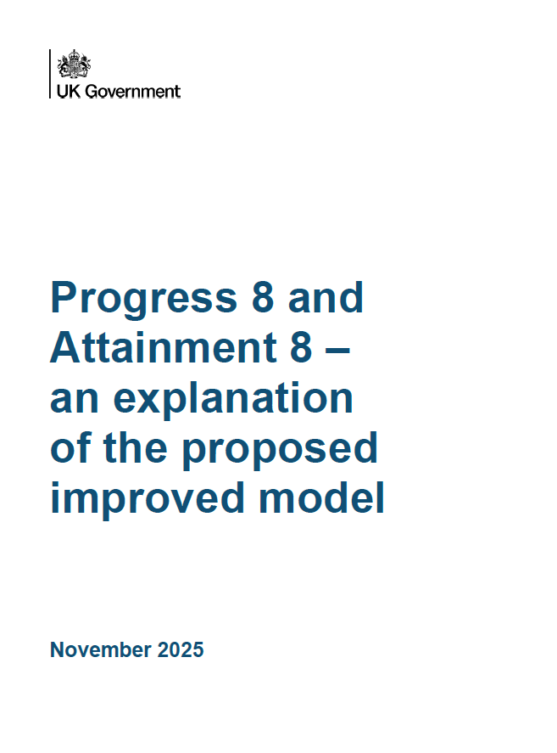
Useful documents
https://www.gov.uk/government/publications/curriculum-and-assessment-review-final-report
https://www.gov.uk/government/publications/curriculum-and-assessment-review-final-report-government-response

