Slide 1

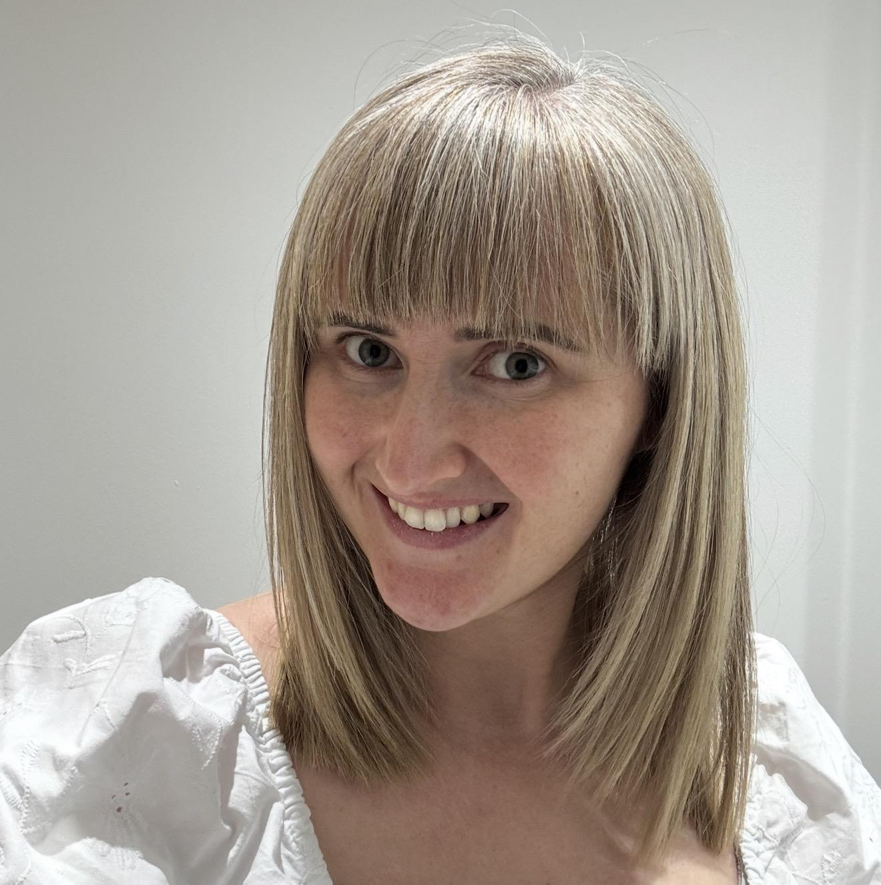
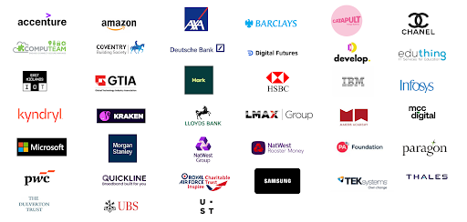


Craig ‘n’ Dave Festival of Computing
techshecan.org
@Tech_She_Can
#TechSheCan
1st July 2026
Becky Patel
Head of Education, Tech She Can
@beckypatel86
Rebecca Patel
Notes:
Good afternoon everyone. My name is Becky Patel and I am Head of Education and Learning for a charity called Tech She Can. I am also a teacher, I trained initially as a primary teacher and worked in the primary school sector for 8 years and then moved into secondary school teaching for around 3 years.
For the past 8 years I have worked with the Tech She Can team to design and develop our Tech We Can educational resources to inspire the next generation to consider the technology careers of the present and future.
Tech She Can is an industry funded charity. Thanks to all of our funding partners here on the slide, everything we do and all of the things I am going to talk to you about today are at no cost at all to teachers or students.

Slide 2
“”
For women to be equal in creating and developing the new technology businesses, products, and services that shape our world, ensuring technology works for all.
Notes:
Every charity exists to solve a problem. I definitely don’t need to explain to this room why charities like Tech She Can exists but here is our goal. Our goal and our mission as a charity is for women to be equal in creating and developing the new technology businesses, products, and services that shape our world, ensuring technology works for all.

Slide 3
The UK’s critical technology skills gap could be solved today if we had the same number of women as men in technology
+£60bn
is the digital skills gap’s annual cost to the UK economy, in potential GDP
3%
of women say a career in tech is their 1st choice
10%
women leaders in technology
<20%
studying tech subjects at school, college, university and in apprenticeships identify as female
25%
Workers in technology are women
80%
of working women are employed in occupations deemed susceptible to AI
Notes:
The statistics on the slide here highlight further WHY we exist. In particular the statement at the top. We do have a significant skills gap in the UK, especially related to technology roles but this would be solved if we have the same number of women as men working in tech.
The main reason we NEED more women working in tech is because we need diversity of voices, opinions and experiences feeding into the design and creation of the technology we use. Our use of technology as a society has grown rapidly and is set to continue to grow. Technology such as AI will become further integrated into our daily lives. Designers can try to put themselves into the shoes of others and design with them in mind but we can never really truly understand the experiences of someone who is different to us, not only in gender, but race, sexuality, socio economic background etc.
This is why events such as this meet up today are so important so together we can build a support network to help change these statistics.

Slide 4
Tomorrow’s Jobs Don’t Exist Yet –
But We Must Prepare Children and Teachers Today
65%
of children today will do jobs that currently do not exist.
65% of today’s children will work in jobs that don’t yet exist, requiring tech skills they’re not currently being taught. Our education system risks failing a generation.
Tech She Can bridges the gap — inspiring and educating children, especially girls and disadvantaged students, through inclusive, curriculum-aligned programmes for ages 5–18.
By raising aspirations early, we empower better choices, better outcomes, and brighter futures.
AI
has leapt from fifth to the most in-demand tech skill in just 18 months
71%
of teachers believe gender stereotypes around STEM careers start before the age of 11
Our research shows that Gender and disadvantage have a negative multiplying effect
Notes:
Also, if we take a moment to focus in on the next generation. The reason our work at Tech She Can is so important is because as adults, teachers, parents, aunties, uncles etc... Our role when it comes to children is to help prepare them to go out into the adult world with the skills, knowledge and confidence they need to pursue any future roles and careers they would like to.
The ever growing challenge now is how rapidly technology is advancing and therefore how fast the world of work and opportunities available to the students is changing. 65% of children in Years 7 and below for example are likely to work in a job which doesn't even exist yet in its current format.
Our research at Tech She Can also shows that gender and disadvantage have a negative multiplying effect on the career aspirations of the students and how teachers believe that gender stereotypes start right down in primary school so this is where we need to be inspiring the students about careers and challenging stereotypes.

Slide 5
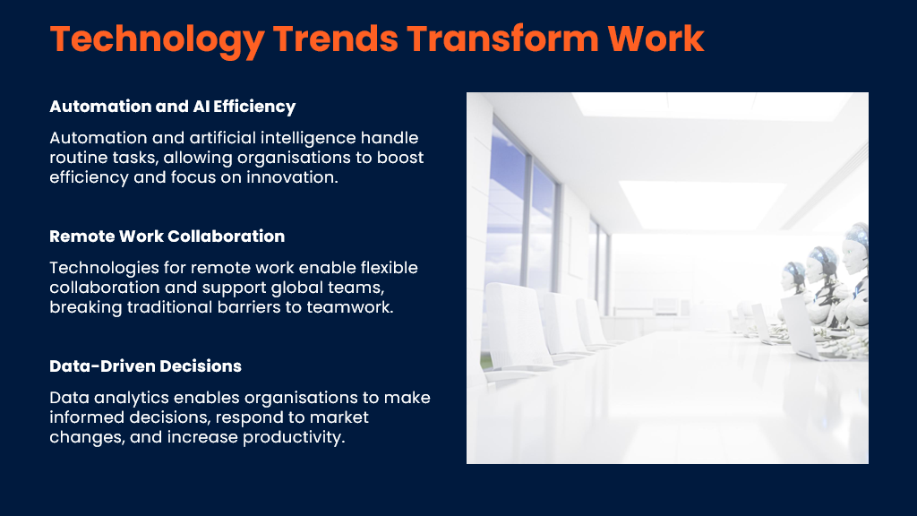
Notes:
The way people work is hugely influenced by tech trends.

Slide 6
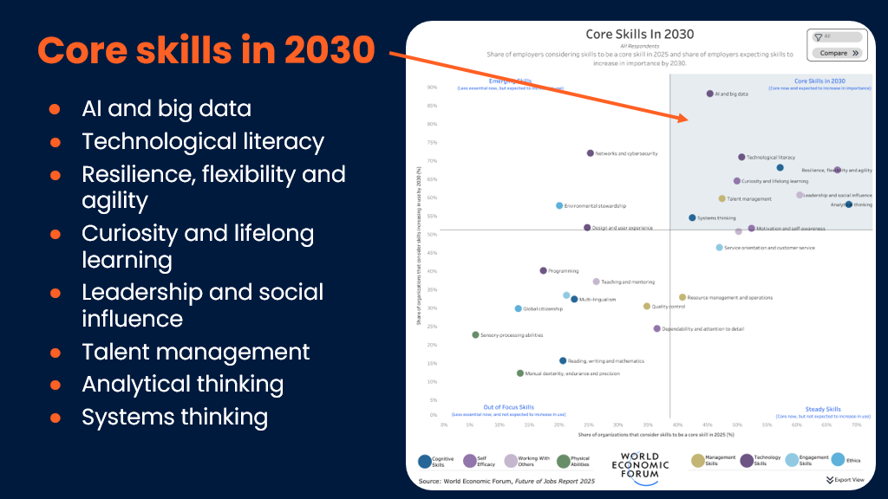
Notes:
In your secondary teaching, ‘skills’ will already be a big focus, but let’s look at how employability and useful skills are changing.​
​
The graph on the screen is from the World Economic Forum’s 2025 ‘Future of Jobs’ Report. It shows the core skills that employers are predicting will be most important in 2030. ​
​
Interestingly, skills like reading, writing and maths are considered ‘less essential’ by employers. We know students will still need these but it’s interesting that employers are considering them less essential. Same for speaking other languages, and programming.​
​
A shift is happening where employers are increasingly valuing ‘key’ or soft skills because many technical tasks can be automated or supported by AI, while skills like communication, adaptability, and problem-solving are uniquely human and essential for working effectively with others in a rapidly changing workplace, and will be relevant whatever the jobs of the future are. ​
​
Tech often gets pigeonholed into computing lessons but we know skills such as these are developed by utilising technology effectively across the curriculum.​

Slide 7
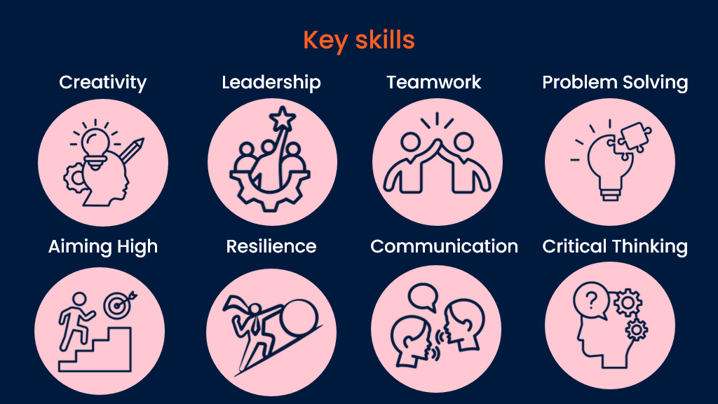
Notes:
We don’t know what the jobs of the future are yet, but we do know that the key skills you continuously support students to build and develop will be needed in students’ future careers, and many of them are expected to increase in importance. ​
​
We know there are lots of ways of developing these skills, your students will play musical instruments or sports, and work on group projects and presentations.​
​
WIth our TWC workshops and careers insight days, we do this through using technology in cross curricular lessons and activities. Tech often gets pigeonholed into computing lessons, but by sharing some of the activities which we use with students, we hope to demonstrate that elements of tech can be used in many lessons. Tech will be integral to your students’ futures no matter what subjects they are passionate about. ​
​

Slide 8
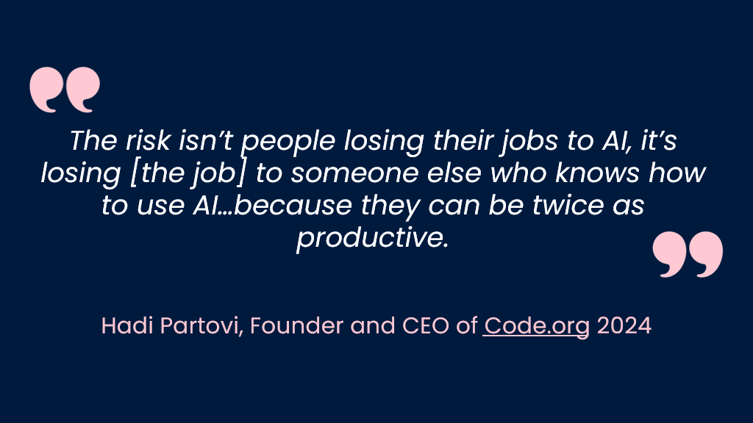
Notes:
AI is an example of technology having a huge impact on the world of work as we know it. But why does all this matter to our students?​
AI literacy is becoming a key skill in the workplace.​
Future jobs will need students to be working with AI, not competing against it.​
Code.org is a nonprofit dedicated to expanding access to computer science and AI education to underrepresented groups across the primary and secondary age ranges. There are some great, classroom ready resources that are well worth exploring.​
​
Definition: AI literacy is the ability to understand, use, evaluate, and interact responsibly with artificial intelligence technologies.​
It includes:​
Understanding what AI is and how it works at a basic level​
Knowing the benefits and limitations of AI​
Using AI tools effectively and safely​
Evaluating whether AI-generated information is accurate or biased​
Understanding ethical issues such as privacy, copyright, and misinformation​
​
​
​
​
​
​

Slide 9
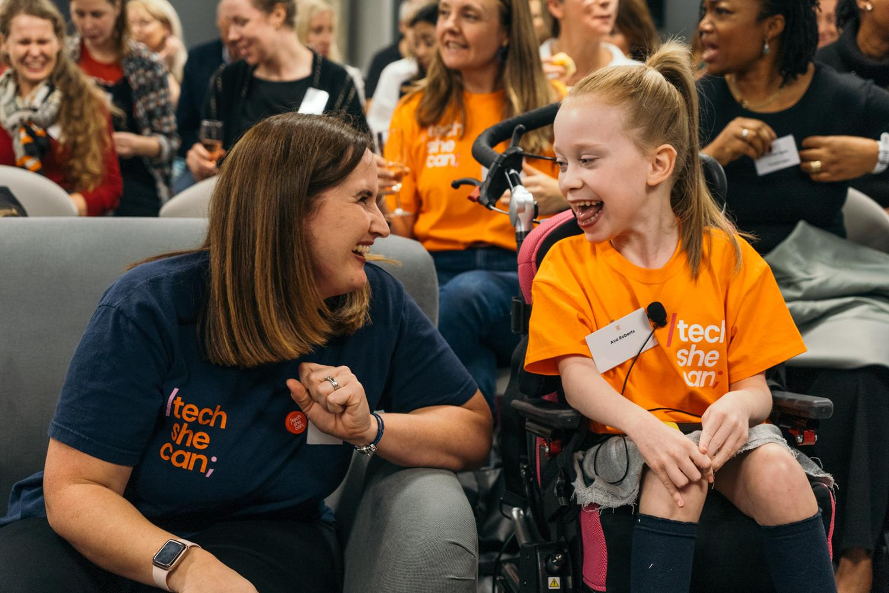
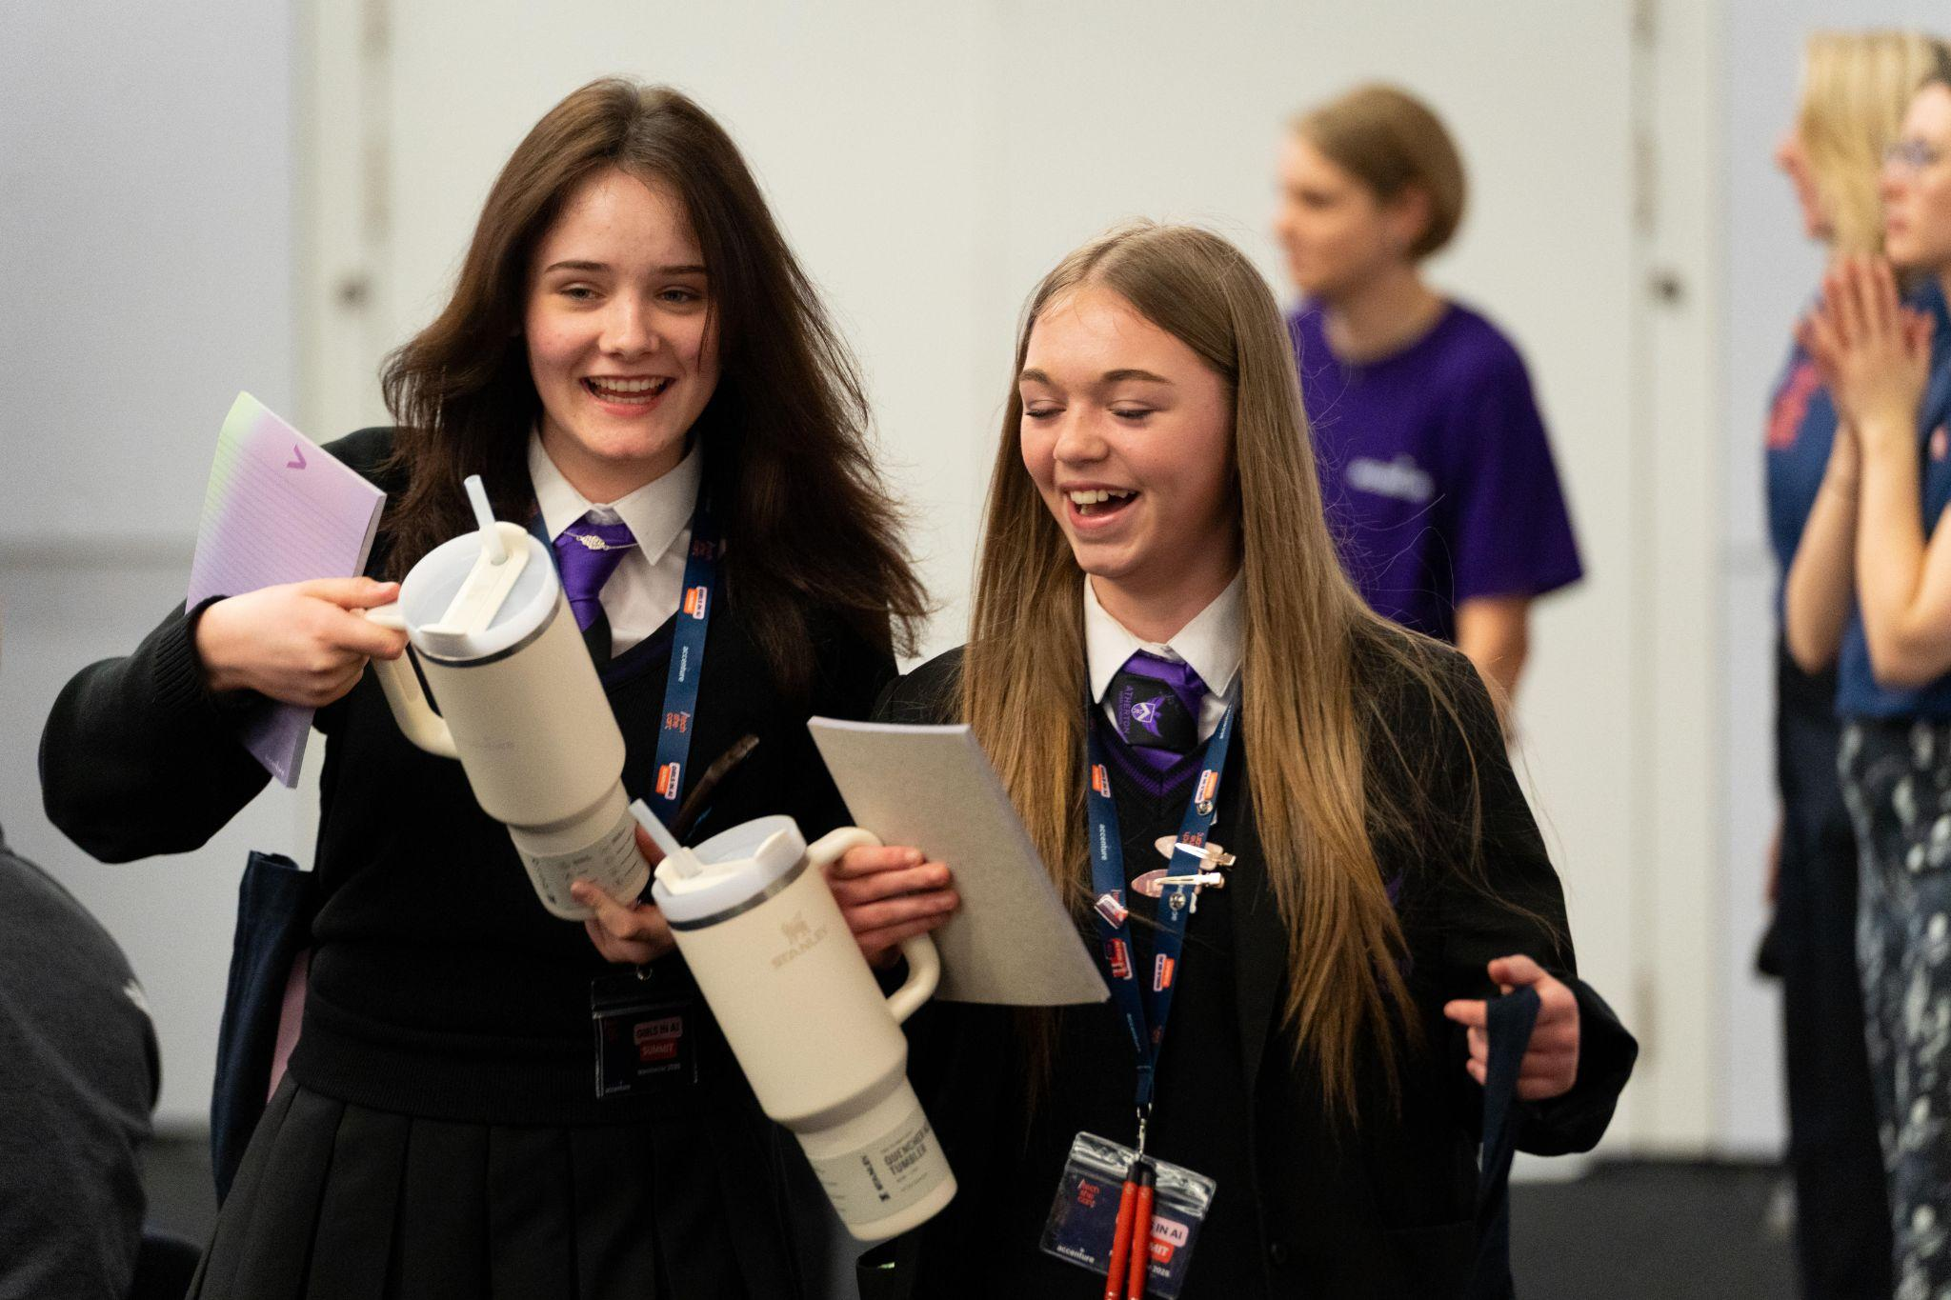
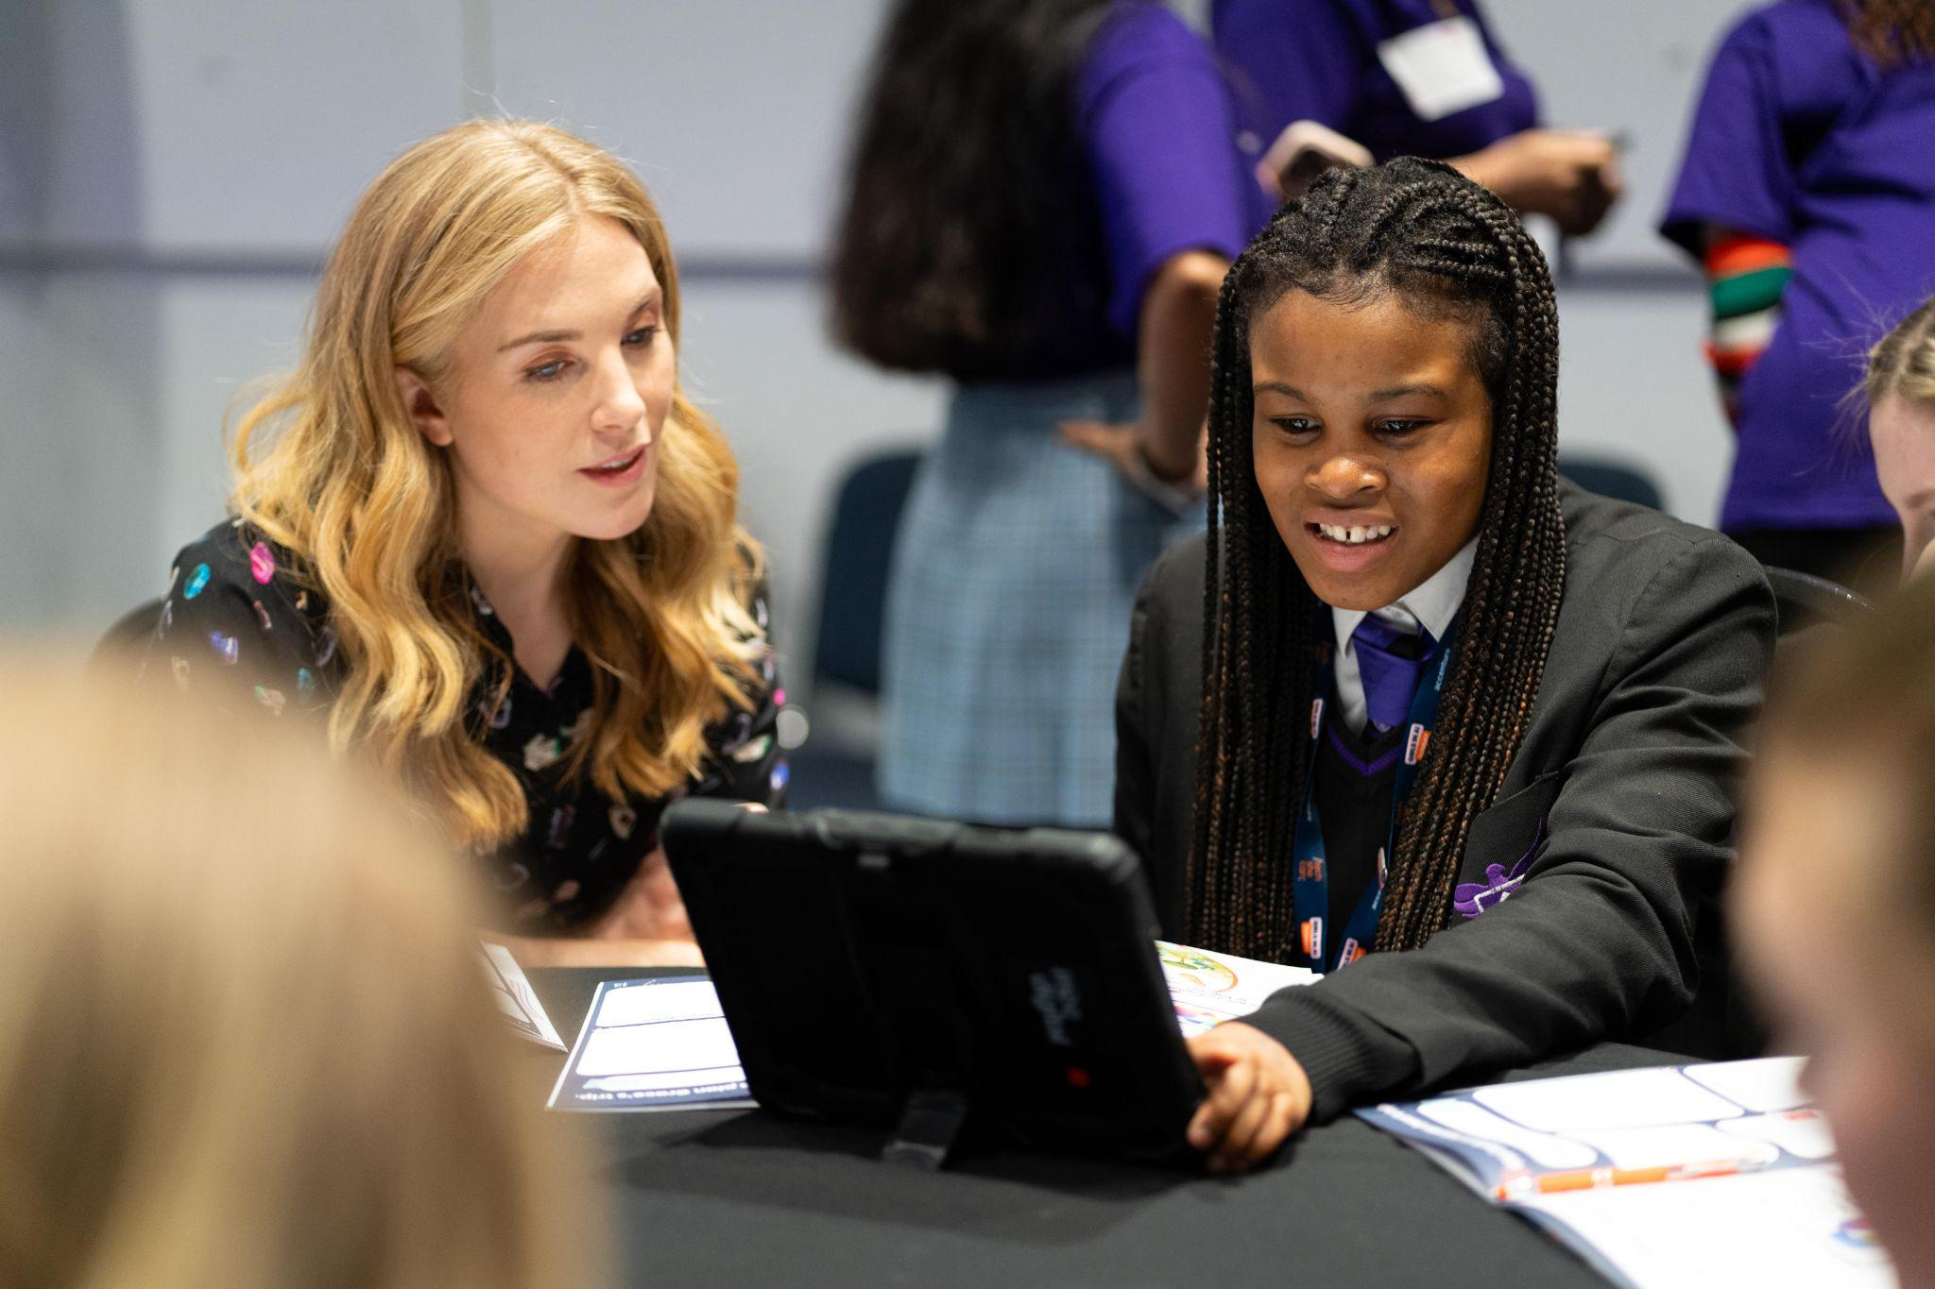
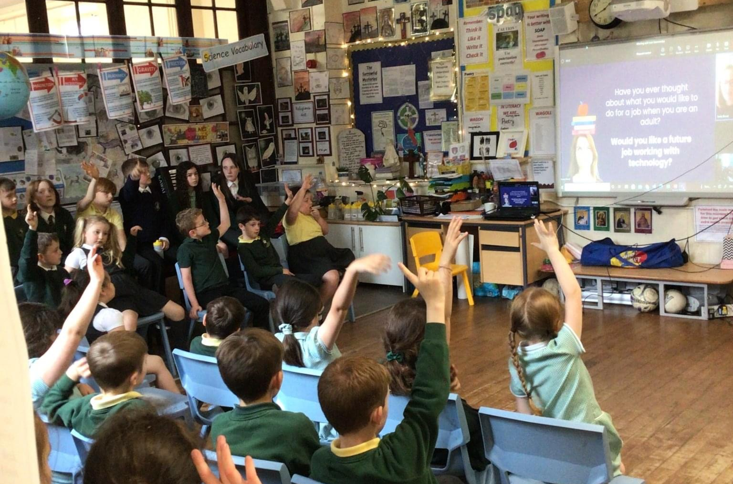
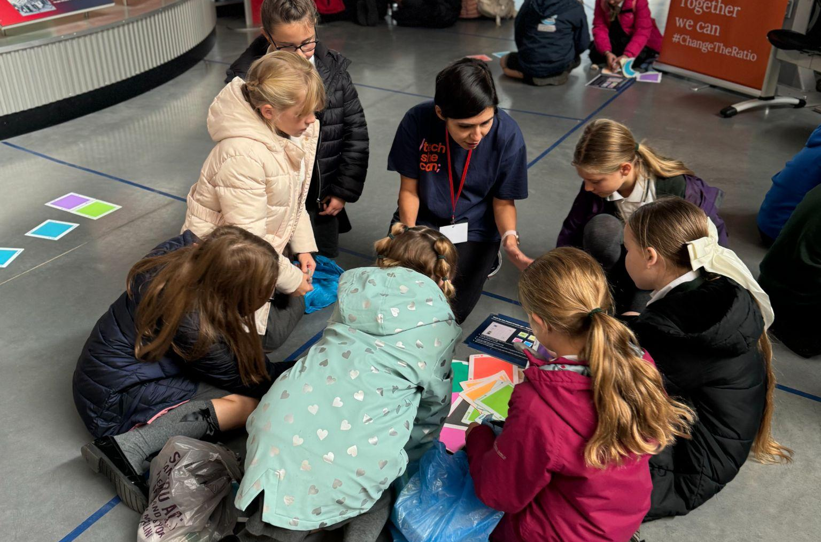
Tech She Can is a UK charity on a mission to make technology careers more inclusive and accessible for all.
We believe technology should be shaped by diverse voices and used to solve society’s biggest challenges.
By working with industry, educators, and government, we create engaging, real-world experiences that inspire and equip everyone - especially women, girls, and underrepresented groups, to pursue technology careers.
With a strong focus on social mobility and UK-wide impact, we are building a future where everyone has the opportunity to work in technology.
Notes:
At Tech She Can, as a charity in our 5th year, and 8th year as an organisation, we have now worked with thousands of schools and hundreds of thousands of students to design and create ready made solutions to help inspire the next generation to consider tech careers. Our resources and experiences help keep teachers and students up to date with the ever changing world of work and the exciting opportunities available.
Our team at Tech She Can is a unique blend of industry expertise and highly experienced teachers this means we are best placed to also of course help our industry partners understand and communicate with the educational system and their next pipeline of talent.

Slide 10
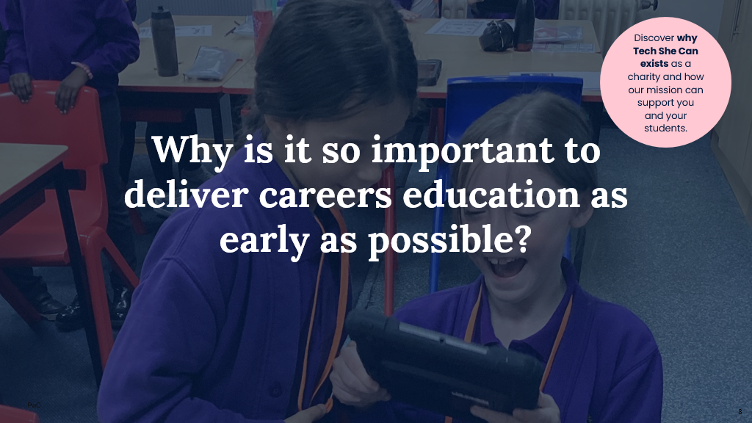
Notes:
So we have now covered the why we exist, I would like to explore why we choose to do this so early and why we chose to create Tech We Can resources and experiences. ​

Slide 11
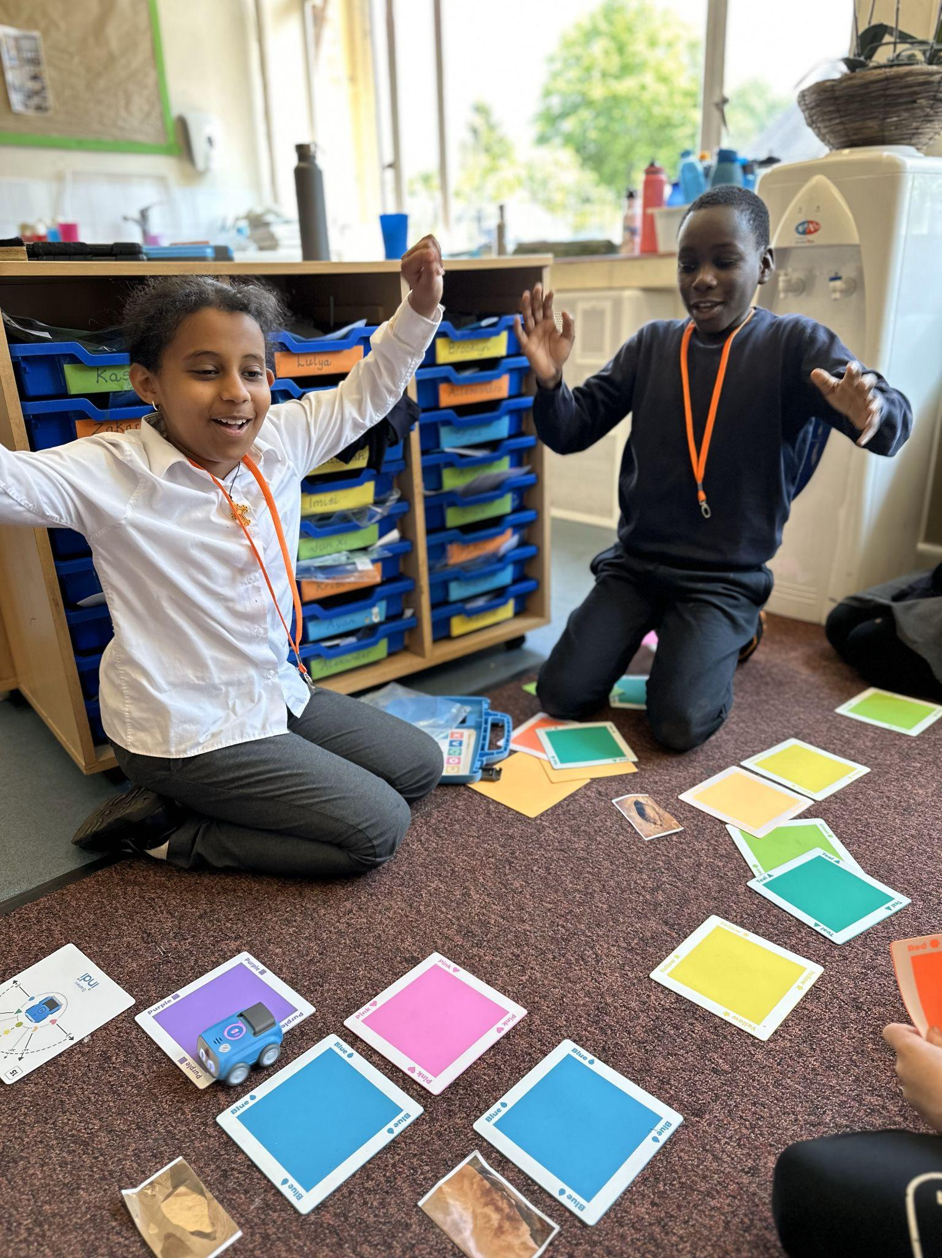
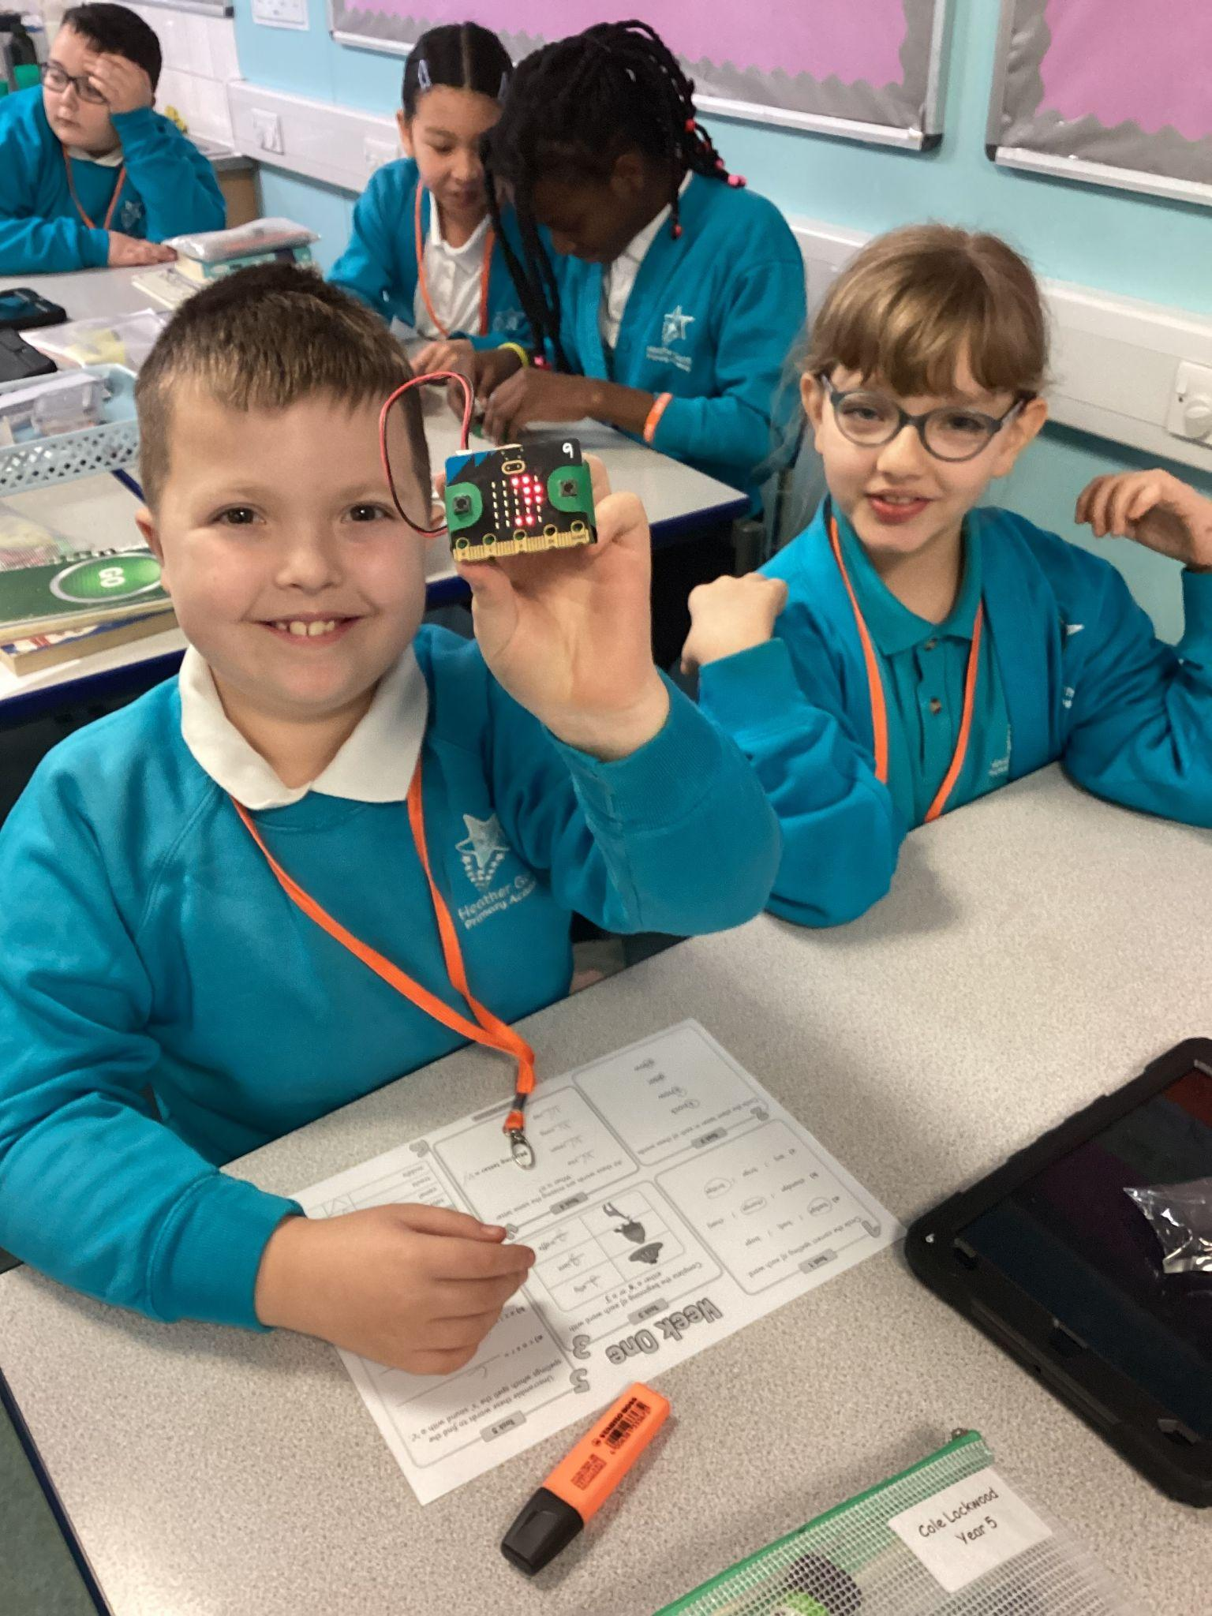
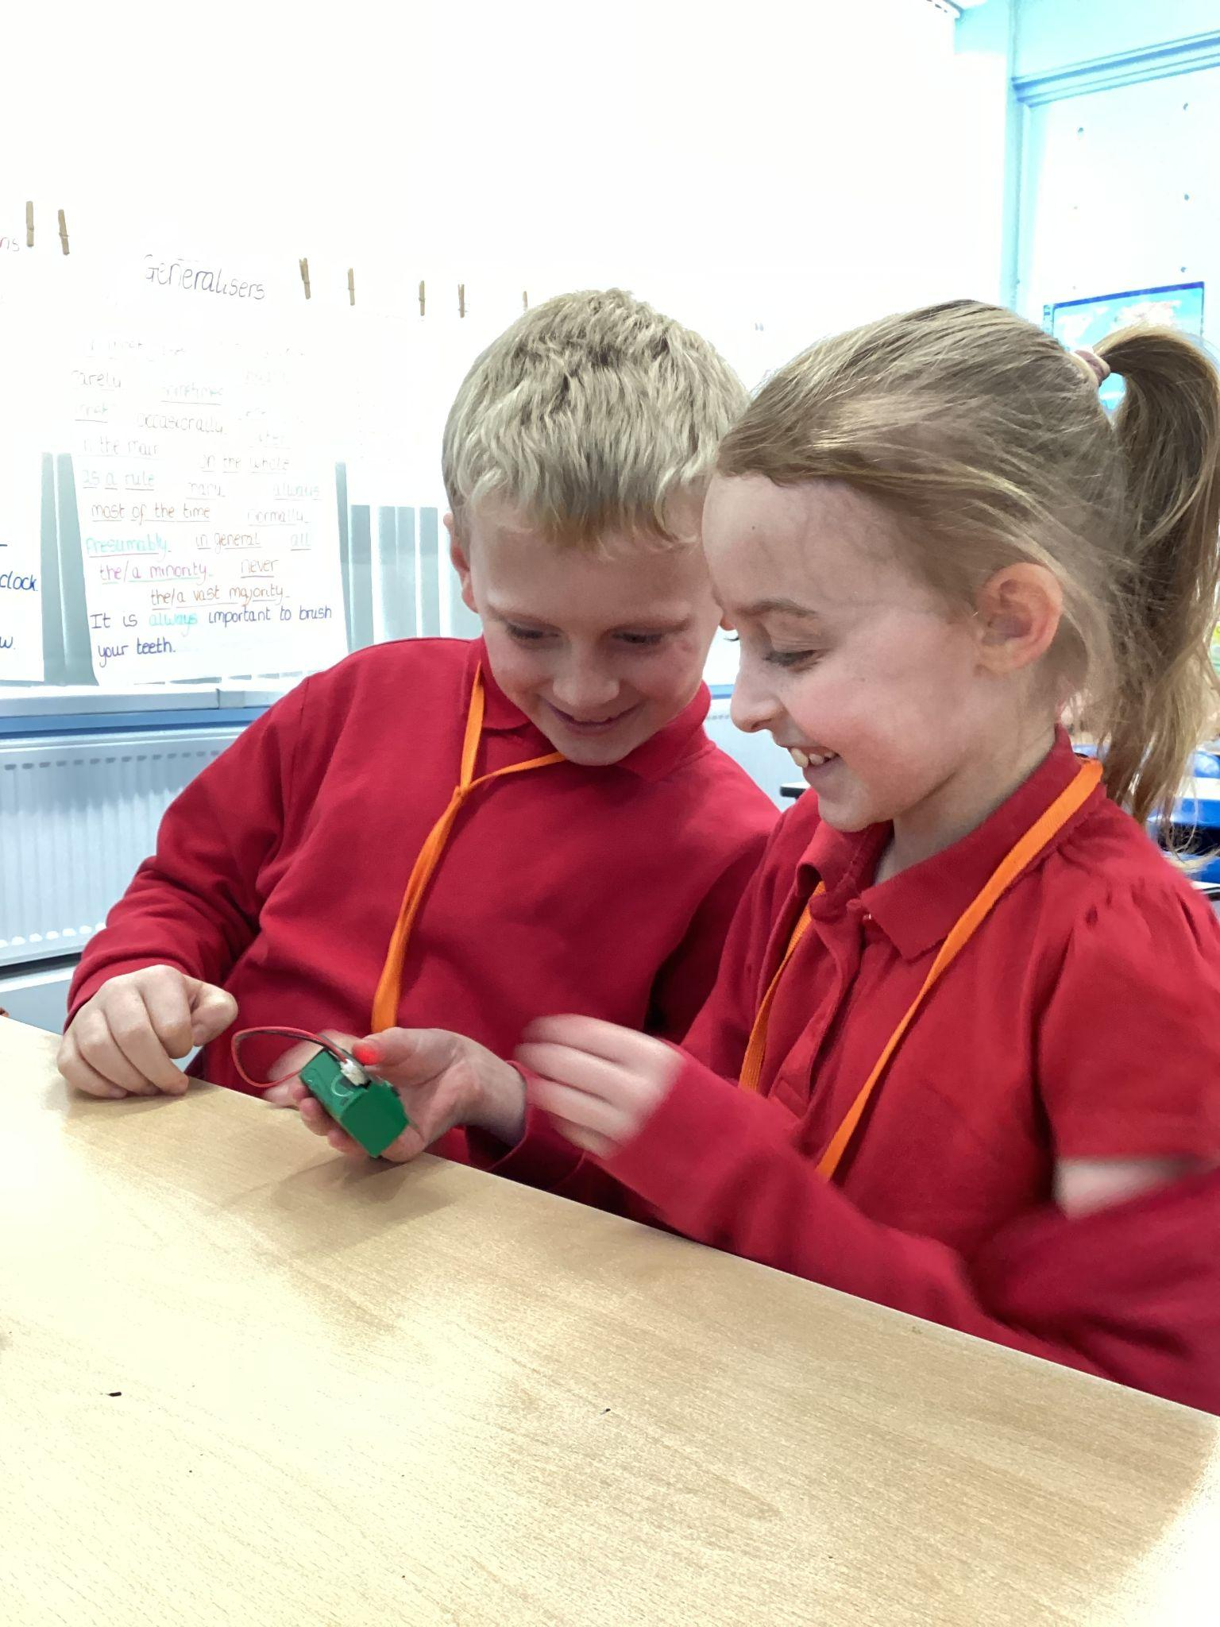
Why is it so important to start careers inspiration as early as possible?
Everything we do for students aims to help support and prepare them to have a happy and successful future.
The children can’t aspire to be what they don’t know exists.
A large percentage of the students we teach today will be graduating and working in jobs which don’t even exist yet.
No matter the future or career path the children choose, technology will play a significant role in all aspects of their lives.
Rather than simply be users of technology, we need a diverse range of children aspiring to be the designers and creators of technology.
Children need to see how technology relates to their existing passions and hobbies.
Notes:
Many careers focussed organisations soley work with the older students providing advice and inspiration when they're ready to make their career or next step in education choices. At Tech She Can we deliver careers aspiration resources for students as young as 5 years old.
There are multiple pieces of research which highlight that gender stereotypes start very early, as early as before children even actually enter the school system. This includes the toys boys and girls believe are more masculine or feminine, the language used towards boys and girls such as “you look pretty’ and “aren’t you strong” and even who can dress up as the nurse and who will be the firefighter for example. Although at an early stage these stereotypes can seem quite harmless and part of growing and learning, they do limit children's confidence, aspirations and learning choices. These opinions then continue to solidify as they grow unless they are challenged.
On the slide are a few key points I would like to talk through:
One point there you may have heard before said in perhaps a number of different ways such as “You can’t be what you cant see”. Basically, the children can’t aspire to have future technology roles if they don’t even know about them. Children and students often aspire to have roles where they have physically seen that person doing their job, for example police officers, teachers, doctors etc. With technology, children use technology everyday but the people who work in the jobs designing and creating that tech are invisible to them. You don’t see someone walking down the street and say “oh look at that smart UX designer”. It’s therefore important that we expose the children to role models in a wide range of jobs. It’s of course brilliant if they would still like to become a teacher or doctor in the future but we want to ensure they are making a fully informed choice.
And if they do go on to choose a more traditional role like teaching, healthcare etc, then the fourth point on this slide also reinforces the fact that it’s still important the students learn about how technology will affect the day to day working life for these people.
And finally and I feel most importantly actually, children need to see how their varied hobbies and passions relate to future roles in technology. They might love sport, dancing, drama, art or even pandas if you’re my daughter - there are technology related roles for almost all hobbies and passions. I’m actually still awaiting the day a student tells me something they are passionate about and I can’t find a potential future tech role for them using that passion or skill.

Slide 12
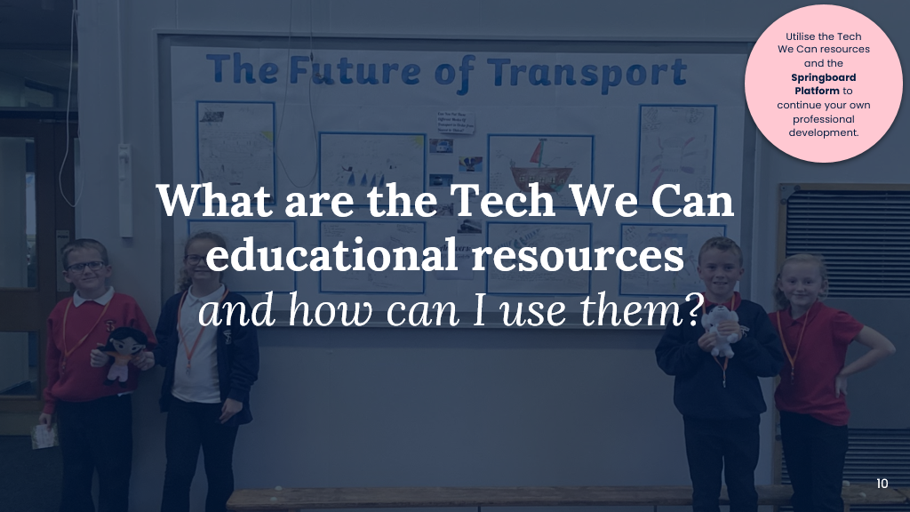
Notes:
​
I’m not here today to tell you all of the challenges and give you another thing to add to your to do list. ​
​
We have worked with schools and industry partners to design and create ready made solutions to help you to inspire your students to consider technology careers.​
​
Our work is funded by over 250 member organisations from over 40 sectors, this means that that all of our resources are free for schools.​
​
Working closely with our industry partners also means that our resources and experiences accurately reflect the world of work at that time. ​

Slide 13
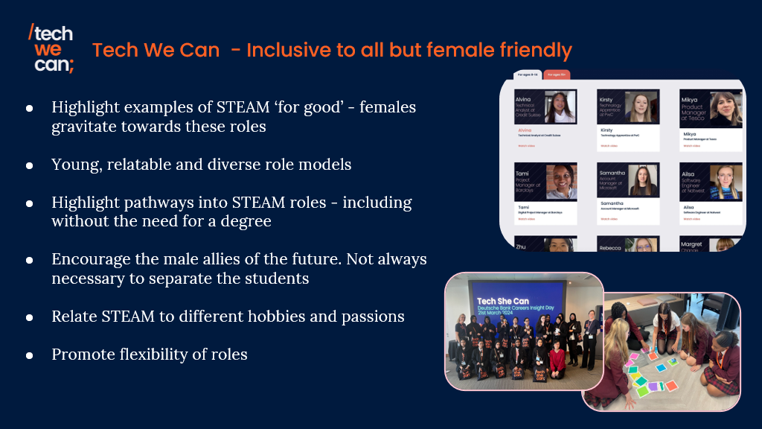
Notes:
As a charity we focus on gender but also on social mobility and we want to ensure we inspire all students to consider future careers in technology. ​
​
Our Tech We Can resources are female friendly but delivered to all. ​
​
What we mean by female friendly is we:​
​
We highlight how technology is used for good, so to help people or the planet, as statistically more women gravitate towards these roles ​
​
We include young, relatable and diverse role models - a high percentage of which are female so the students can see people who look or sound like them or have shared experiences​
​
We highlight different pathways into technology careers including apprenticeships, internships and college courses as well as university​
​
And we encourage the male allies of the future. By delivering to boys too, they not only are inspired themselves but they also do not limit their thinking of what the girls could potentially be in the future. As they will be their future colleagues, employers and employees. ​
​

Slide 14
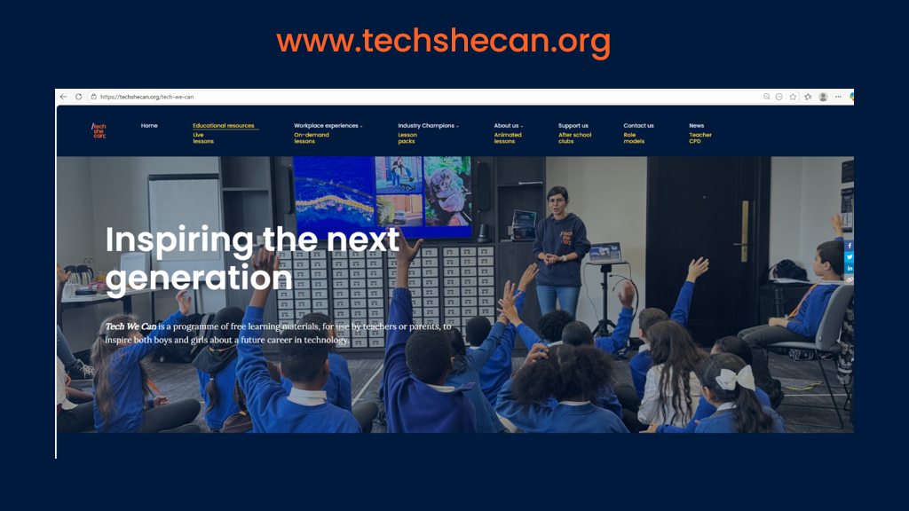
Notes:
I’m now going to show you our website, where you’ll find a wide range of resources available to explore. ​
​
There is no registration or login to our website, simply navigate to techshecan.org and select the ‘Educational Resources’ tab.​
I’m now going to walk you through some of these. I’ve selected a few that I think will be particularly useful—resources that you can hopefully start embedding into your teaching straight after this session.​
​

Slide 15
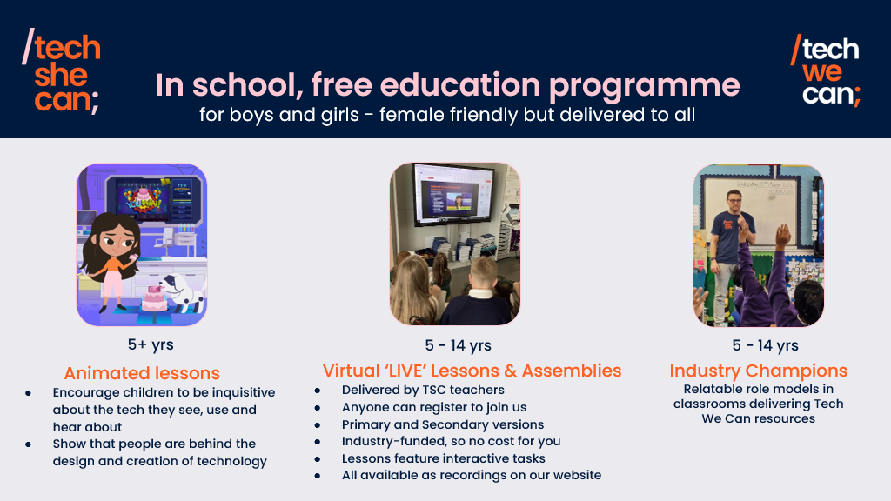
Notes:
Animated Lessons​
​
For students ages 5+, we have our animations featuring the super popular characters of Katie and Tex. The animations encourage children to become inquisitive about the technology they use, see and hear about on a daily basis and most importantly introduce them to the fact that people are behind the design and creation of technology. ​
​
LIVE Lessons and Assemblies​
​
Next are our incredibly popular and ever growing LIVE lessons and assemblies. They are industry-funded, so free for you to access, and anyone can register for a live session.​
​
These virtual sessions are delivered by our Tech She Can teachers, and we have lessons and assemblies for both primary and secondary students available.​
In these, we explore different areas of technology, tell the students about interesting tech in this area, and also about careers that the students could aspire to have in the future. ​
Live lessons also include a range of pencil and paper activities and partner talks for students to join in with.​
​
The success of these resources, the reach they are having and the overwhelming feedback from teachers is the product of years of teacher feedback and evaluation by our team to find the perfect mix of being able to speak to tens of thousands of children at once on a live Teams webinar but still ensure they are active participants in their learning. ​
​
All of our live lessons and assemblies are also available as recordings, so you can watch them with your students at anytime. ​
​
​
Champions ​
​
Our Industry Champions are anyone, of any gender, from any organisation who simply share our passion for inspiring the next generation.​
​
They are real life role models in the classroom armed with our resources and training. ​
​
Schools can request a Champion visit for free on our website in the ‘contact us’ section, and they can deliver one of our ‘Tech We Can’ lessons to your students.

Slide 16
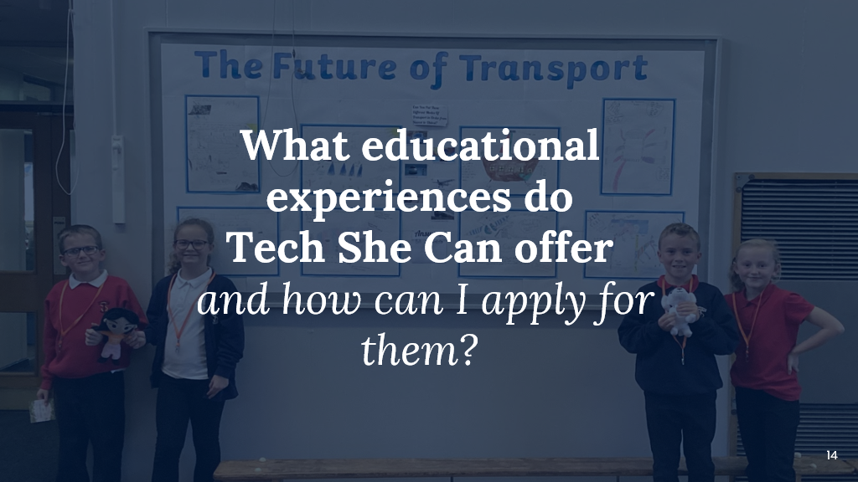

Slide 17
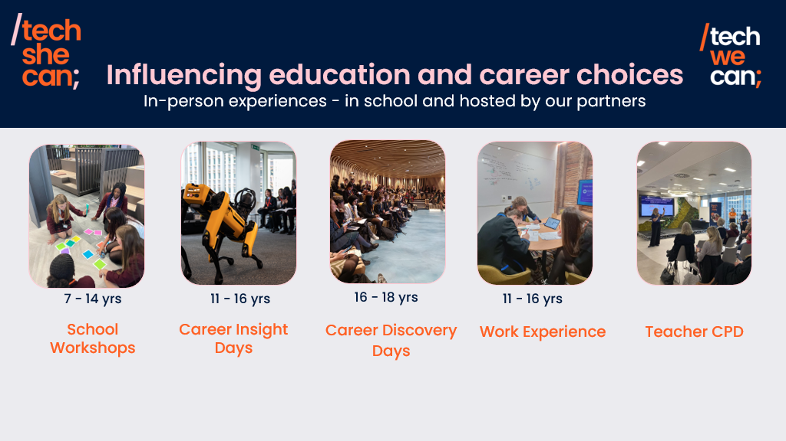
Notes:
School Workshops ​
​
Over the past year, we’ve rapidly expanded our in-school workshops. These sessions engage students in interactive, hands-on activities, while introducing a range of tech careers, and are often delivered alongside industry role models.​
​
Career Insight Days ​
​
During our Career Insight Days, we open the doors to workplaces for immersive, creative, hands-on experiences exploring technology careers. These opportunities are targeted at students in social mobility cold spots, often giving them their first chance to connect with industry professionals in this way.​
​
We spend these days changing students perceptions of tech careers, with an average of 80% of the female students attending stating that the day has changed their thoughts about their next steps.​
​
Career Discovery Days​
We also run Career Discovery Days for 16–18 year olds—immersive, hands-on experiences exploring technology careers. They also create a pipeline into early careers and apprenticeships, helping organisations diversify their talent pools and support students from low social mobility backgrounds. ​
​
Work Experience​
​
As many of you will be aware, work experience guidance for schools has recently changed and rather than a traditional 2 week placement in year 10 or 11, schools are being encouraged to spread opportunities to engage with industry from Year 7 onwards. All of the resources and experiences I have spoken through so far will help you be able to provide this for your students. ​
​
Teacher CPD​
And of course, we create resources, events, and experiences for you as teachers. You are key influencers of students’ future career choices—but we simply cannot expect you to keep up with the rapidly evolving world of technology careers on top of everything else you have to do. That’s where we step in, helping to bridge that gap.​
Earlier this year, we delivered our first Tech Careers Teacher CPD Day in collaboration with Infosys, who have also funded today’s session. Hosted at their Canary Wharf office, the day gave teachers the opportunity to explore the importance of diversity in tech, understand key trends shaping the future of work, discover emerging technologies and career pathways, and connect with inspiring industry role models.​
All of these experiences are regionally sponsored and funded, so to be the first to hear about opportunities like these please sign up to our newsletter. You can also find out about the latest opportunities on the News tab on our website.

Slide 18
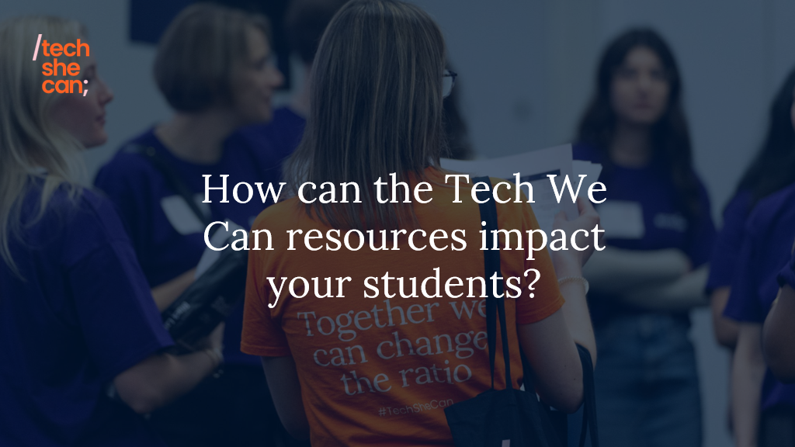
Notes:
Now moving on to how the Tech We Can resources can impact your students.

Slide 19
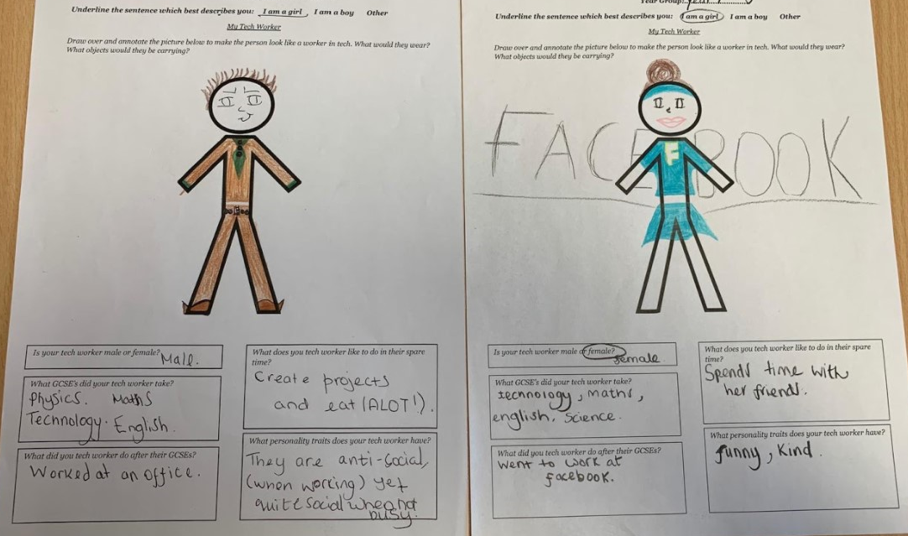
Tech We Can
Our impact
changing perceptions, inspiring and making tech roles visible
Before
After
Tech We
Can lesson
Notes:
This is probably my favourite picture of my career. These are two images drawn by a young lady in my Year 8 class. The one on the left was before I delivered any Tech We Can lessons to the class and the one on the right was after 3 lessons over a half term.
I simply asked all of the students to draw what a tech worker looked like, describe them, describe their hobbies etc.
Before she said and quote “miss this is a white guy who lives in his Mum’s basement, he’s antisocial, eats a lot, has no friends and hacks into the Pentagon”. I definitely think she had watched a few too many Marvel movies.
After only 3 lessons I asked them all to do the same and she said:
“Miss this is me, here I am with my afro hair and super cape, i’m funny, kind, spend time with my friends and love tech and english. I’m a social media manager. ”
There are 3 things she highlighted which showed the resources where having the impact we wanted:
First she saw the strong connection between technology and english and the potential for a future combining these subjects - something she hadn’t considered before
Secondly she named a career - social media manager - which she had no idea before the lessons was a possibility for her.
And finally she drew herself, this was a mixed race young lady who had a eureka moment when she saw a video in the lesson from an incredible black women working in tech. I saw her poke her classmate next to her and point at the screen - clearly in shock that the lady talking looked like her. A very powerful and emotional experience as a teacher to see students have those key influential moments.

Slide 20

Notes:
And finally, late last year Tech She Can celebrate our fourth year as a charity. Before I draw to a close today, explain next steps and open up for questions, I have a 2 minute video to show you our work in action.

Slide 21

Notes:
A free CPD platform for you to explore including brilliant downloadable Tech Careers posters for your classroooms

Slide 22
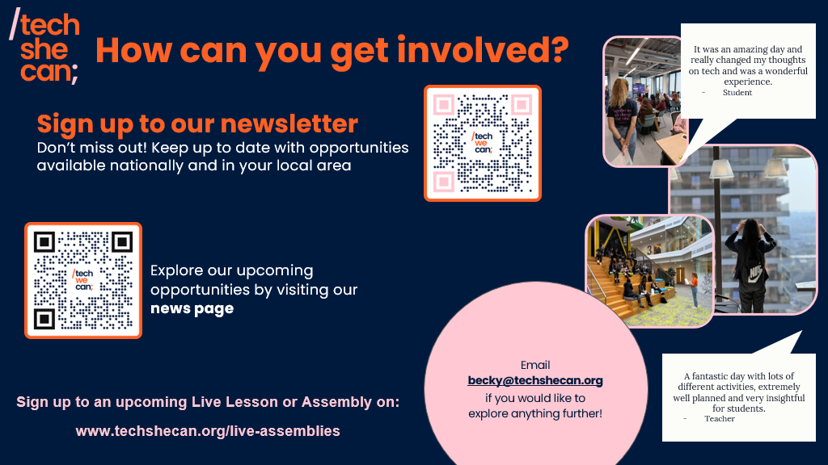

Slide 23
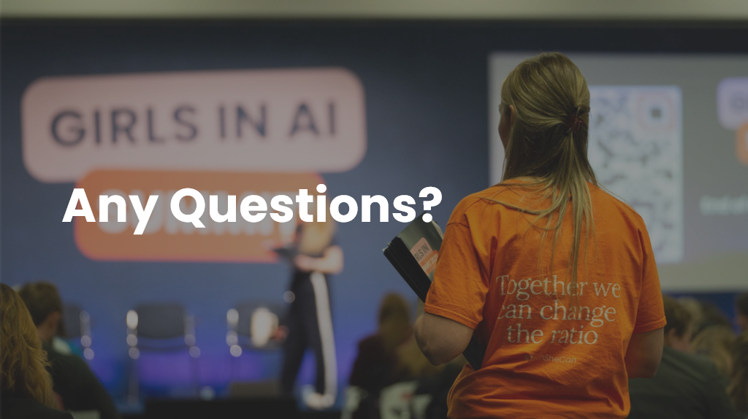

Slide 24
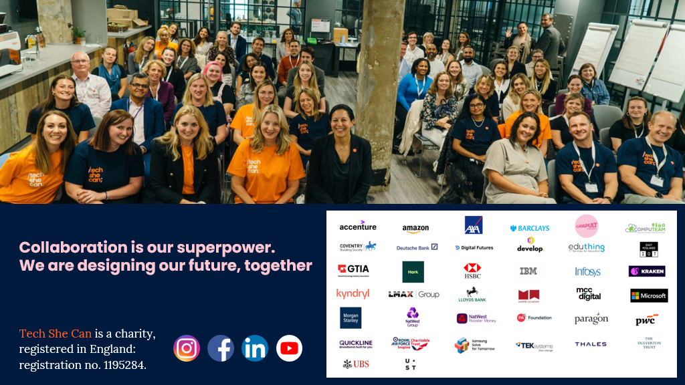
Notes:
Thanks for joining today’s CPD today, have a great rest of the day and hopefully I’ll see you and your students soon for a Tech We Can lesson or assembly! ​

