Slide 1
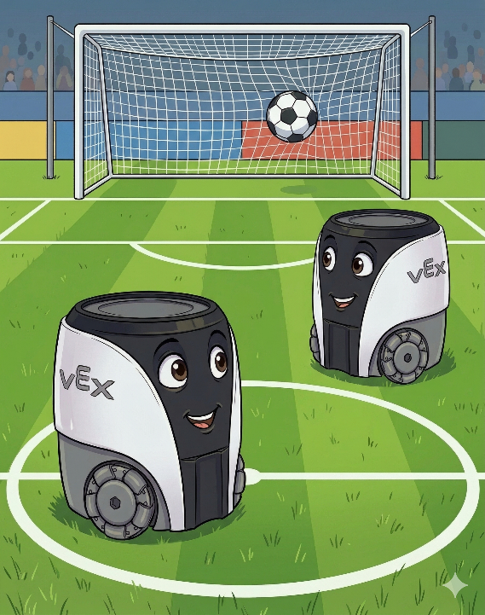
AI Vision in Robotics
World Cup Fever Edition!
chris_calver@vexrobotics.com
Copyright © 2024. All right reserved. VEX Robotics, Inc. is a subsidiary of Innovation First International, Inc.
All other product names/marks of others are the property of their respective owners.

Slide 2




Slide 3
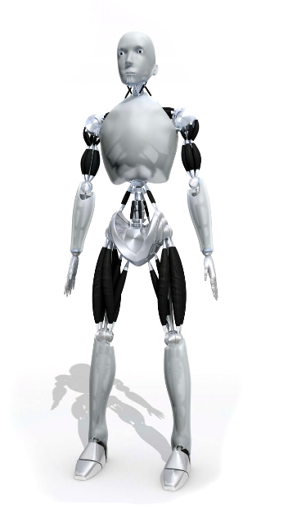
When will VEX robots have AI?

Slide 4





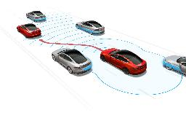


Slide 5
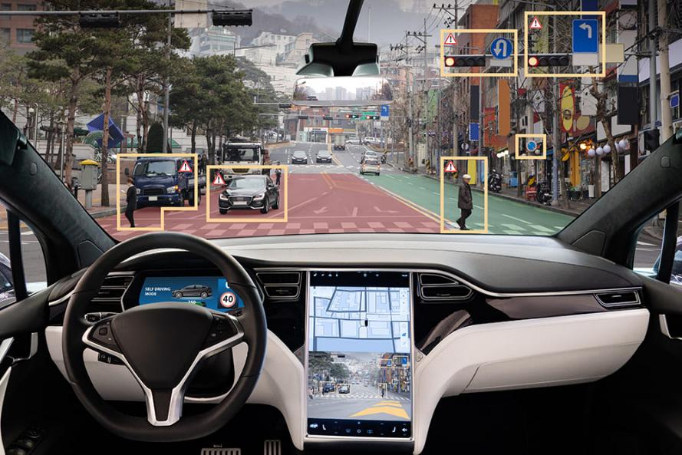

Slide 6
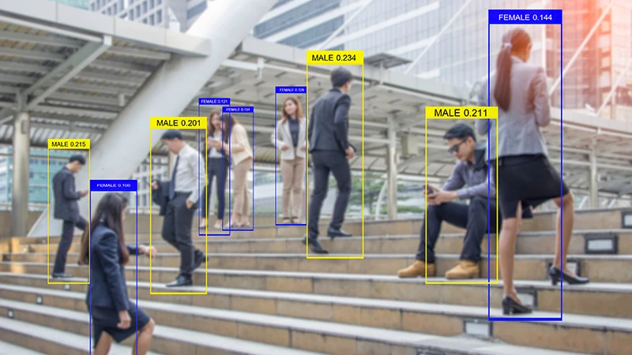
What is Computer Vision?

Slide 7
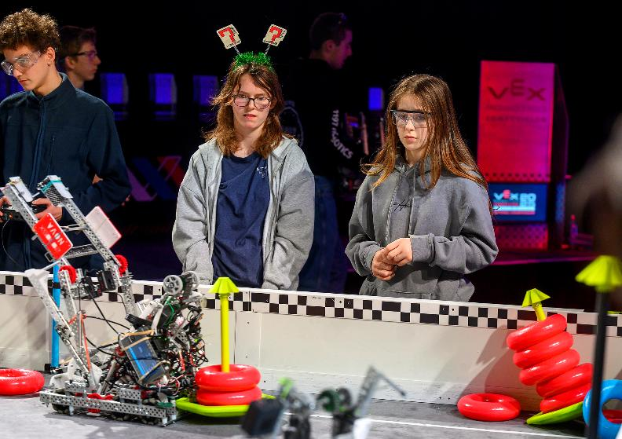

Slide 8
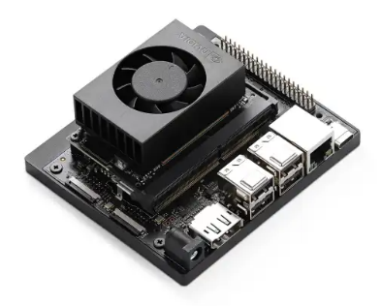
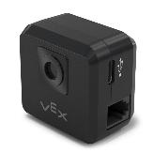
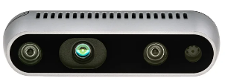
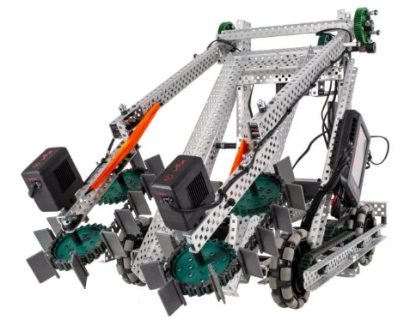

Slide 9
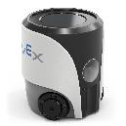

Slide 10
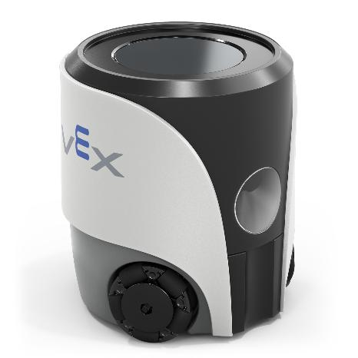

Slide 11

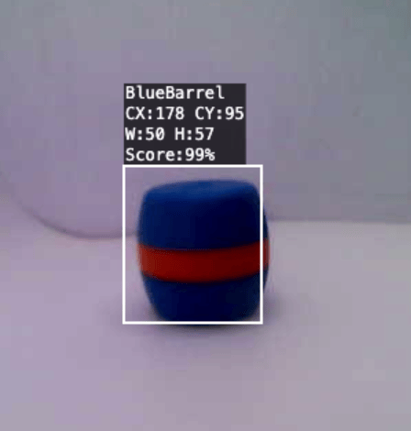
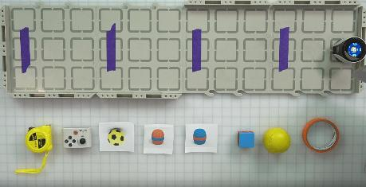

Slide 12
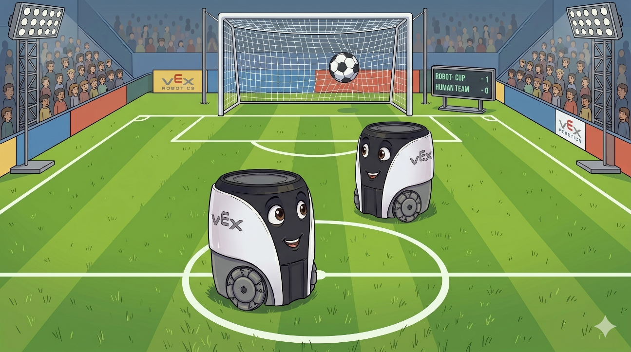
GAME ON!

Slide 13
chris_calver@vexrobotics.com
Notes:
NF32

