Slide 1
The 10 commandments of good programming
*
Richard Pawson
* There are hundreds of rules for good programming!
This is my choice of the 10 most important to learn as early as possible

Slide 2
The 10 commandments of good programming
Thou shalt not define any global variable
Thou shalt fix the type of every variable
Thou shalt not permit any null reference
Thou shalt not exit any loop, nor method, before the end
Thou shalt create only pure functions
Thou shalt make all classes, and methods, abstract or final
Thou shalt write unit tests for every function
Thou shalt keep thy methods short & sweet
Thou shalt refactor thy code
Thou shalt separate thy concerns

Slide 3
These commandments are best learned implicitly not explicitly
  Don’t teach pupils to break them
  Never require pupils to break them to gain full marks
  Use tools that enforce those commandments that can be,
  and encourage the rest
Yes, it is possible to identify situations where breaking a commandment could be logically justified
  These are very rare, and unlikely to be encountered in school
  Mostly, the rules are broken out of ignorance, laziness, or obstinacy
  It is best to learn them initially as universal rules

Slide 4
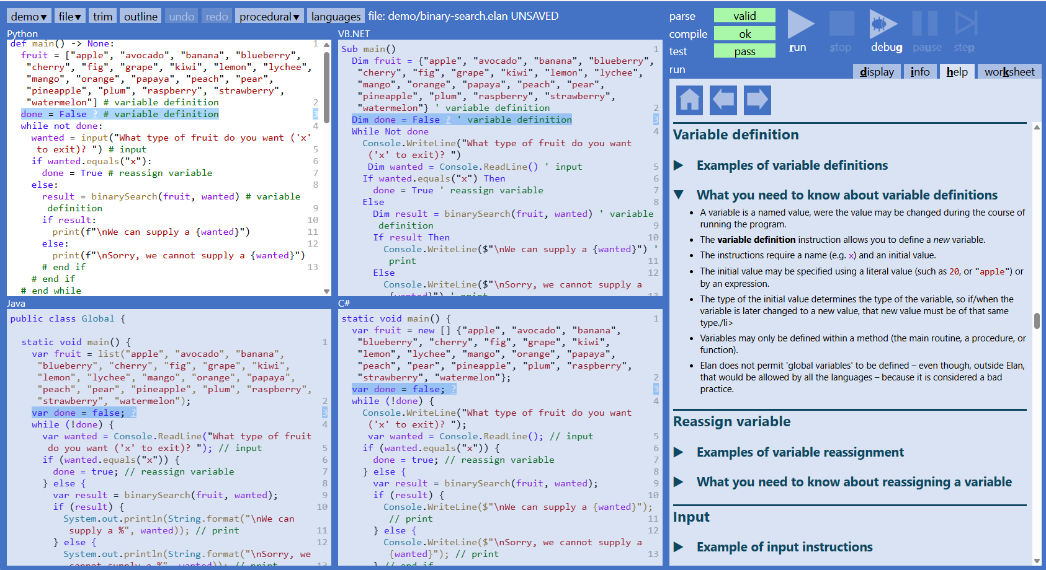

Slide 5
The 10 commandments of good programming
Thou shalt not define any global variable
Thou shalt fix the type of every variable
Thou shalt not permit any null reference
Thou shalt not exit any loop, nor method, before the end
Thou shalt create only pure functions
Thou shalt make all classes, and methods, abstract or final
Thou shalt write unit tests for every function
Thou shalt keep thy methods short & sweet
Thou shalt refactor thy code
Thou shalt separate thy concerns
Enforced by Elan
for all languages
Encouraged by Elan
for all languages

Slide 6
Thou shalt not define any global variable
If the idea that global variables are bad is new to you:
  read: https://wiki.c2.com/?GlobalVariablesAreBad
And if not, why teach pupils to write them at all?
  reluctance to force pupils to create a ‘main’ method
  because the exam boards still use them!
Coding with Elan (in any language)
  Empty main routine is auto-created in a new file
  Variables may only be defined within a method
    Constants must be global
    Elan enforces the distinction even when the language doesn’t

Slide 7

Thou shalt fix the type of every variable
Most languages are statically typed or support static typing
  Python introduced ‘type hints’ in v 3.5
  TypeScript has almost completely displaced JavaScript in prof. circles
Why not dynamic typing?
  It adds no value
  It leaves students with a weak understanding of types
  It does not scale up for complexity
Coding with Elan (in any language)
  Every variable must be given initial value, and that fixes its type
  Parameters and function return types, must be explicit
Anders Hejlsberg:
www.youtube.com/
shorts/NzaNeWeI31Y

Slide 8
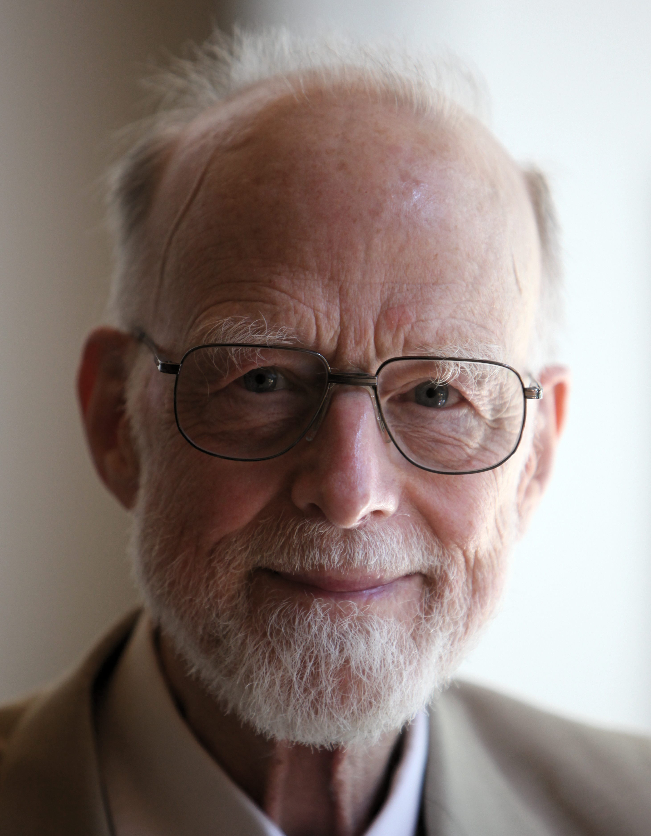
Thou shalt not permit any null reference
Why?
  Tony Hoare described null references as his ‘Billion dollar mistake’
Coding with Elan (in any language)
  A null reference cannot arise
  Every variable, and every property (OOP) must be initialised to a value
  Cannot be reassigned to null
    because null (or equivalent) is not recognised
  (in OOP optional associations are handled through the Maybe type)
Tony Hoare video:
tinyurl.com/keeed24k

Slide 9
Thou shalt not exit any loop, nor method, before the end
Why?
  Every block of code should have one entry and one exit
    https://www.cs.man.ac.uk/~pjj/cs2111/ho/node11.html
  break goes back to when there were no conditional loops
  Structured programming languages made it redundant
  Having multiple exits makes changes riskier…and debugging harder
Coding with Elan (in any language)
  No break instruction
  You cannot add a return instruction anywhere
    procedures always run to the end
    functions are created with return as the last (immovable) instruction
    this often requires a result variable to be defined up-front – which aids readability

Slide 10

Thou shalt create only pure functions
Why?
  A procedure is a command; a function is a query
    ‘asking a question should not modify the answer’ *
  Proper functions:
    are always safely combinable
    may be reasoned about, like mathematics
    may be safely tested
    are a necessary step toward functional programming
Coding with Elan (in any language)
  Function and procedure are distinct instructions, called in distinct ways
  In a function you cannot
    have any dependency on I/O or state of the system
    call any procedure
    mutate any reference type
* Bertrand Meyer

Slide 11
Thou shalt make all classes, and methods, abstract or final
*
Why?
  Encourages use of delegation rather than inheritance
  Facilitates debugging
  Kicks the ‘circle-ellipse problem’ into touch!
Coding with Elan (in any language)
  A concrete class cannot inherit from another concrete class
  An abstract class may define abstract and/or concrete methods
    But you cannot override any concrete method
  You can define an abstract method and a private default implementation
    to which subclasses may delegate
* a final class cannot be inherited from; a final method cannot be overridden

Slide 12
Thou shalt write unit tests for every function
Why?
  a core principle of ‘eXtreme Progamming’, and of agile development
  unit tests give you
    an immediate high when the tests ‘go green’
    confidence in code (even if came from somewhere else)
Coding with Elan (in any language)
  unit tests are extremely easy to write
  they run automatically every time your code compiles
  they give feedback within your code
  they don’t stop at the first failed assert

Slide 13
Thou shalt keep thy methods short & sweet
Within a method (main, procedure, or function) aim for:
  no more than 20 instructions
  no more than 2 levels of indentation from the start of the method body
Why?
  should always be able to see the whole method on the screen
  when you write a program
    don’t think of it as just instructions for a computer to execute…
    …but as an essay for a programmer to read
Coding with Elan (in any language)
  The editor makes it easy to move code with lower risk of corruption

Slide 14
Thou shalt refactor thy code
Why?
  eliminate duplication – the ‘DRY’ principle
  improve readability and ‘intentionality’
  generalise your code
    So that the same program, or method, can be applied to a wider class of problems
Coding with Elan (in any language)
  unit tests (of functions) gives you confidence to refactor
    without worrying that you have unknowingly broken existing program
  the editor makes it easier to move code around
    with less risk of corruption
  (Specific refactoring patterns will be supported in future versions)

Slide 15
Thou shalt separate thy concerns
Separate, using clean interfaces:
  input/output from …
  formatting of output data, or the interpretation of input data, from …
  core manipulation of data
Why?
  easy to change one without impacting the others
  allows operation without a user interface
  (both can have big payoff even in an NEA project)
Coding with Elan (in any language)
  enforced separation of procedures and functions
  easy unit testing of core logic (as function) gives an immediate reward

Slide 16
Please:
Tell others here at the FoC about what you have learned here
Email me with comments or questions: rpawson@nakedobjects.org
Email your exam board subject advisor(s) & ask them to commit to
not breaking the 10 commandments in their exam questions
  It’s hardly a big ask of them, is it?
5 minute video on each of the 10 commandments:
https://tinyurl.com/4mznhm6y

