Slide 1

AI in education - research update 2026 - teaching programming with AI tools
Jane Waite
Festival of Computing 2nd July 2026
rpf.io/festivalofcomputing2026
Notes:
Plan https://docs.google.com/document/d/1FN_7jdJqQhNMOOeCa7vByWJHFCBE7j54D6L0yowp_J0/edit?usp=sharing

Slide 2
AI for
teacher productivity
Teaching about AI
Using AI to help teach any subject
Notes:
I always start with my pancakes … its a good way to make sure we are all on the same page

Slide 3
AI for
teacher productivity
Teaching about AI
Using AI to help teach
any subject
programming
2025
2026
Feedback literacy
AI interaction literacy
Equity and over-reliance
Critical thinking and problem solving
New teaching approaches needed and new tools
Doing tasks vs learning
PRIMM +AI
IDE vs LLMs
Agency
Industry update
University Consortium
Notes:
In 2025, I spoke here about teacher productivity, teaching about AI and the bubble on using AI to help teach programming, I am focusing just on the the help teach programming and I have some new research and ideas to share with you.

Slide 4
Impact on skill formation of new developers of AI use
Anthropic study (not peer-reviewed)
52 mostly junior software engineers
Introduced them to a Python library, Trio, half used an AI tool to help complete a set of tasks using the library, half did not.
Found that AI use impairs conceptual understanding, code reading, and debugging abilities, without delivering significant efficiency gains on average.
Participants who fully delegated coding tasks showed some productivity improvements, but at the cost of learning the library.
(Shen & Tamkin, 2026)
Notes:
Read out

Slide 5
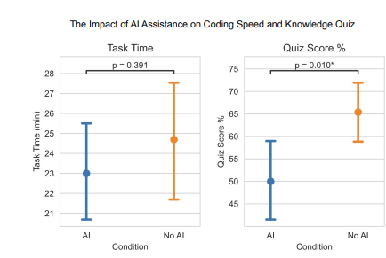
Impact on skill formation of new developers of AI use
Those who used AI were not much quicker and learned way less about the library.
(Shen & Tamkin, 2026)
Notes:
Point out

Slide 6
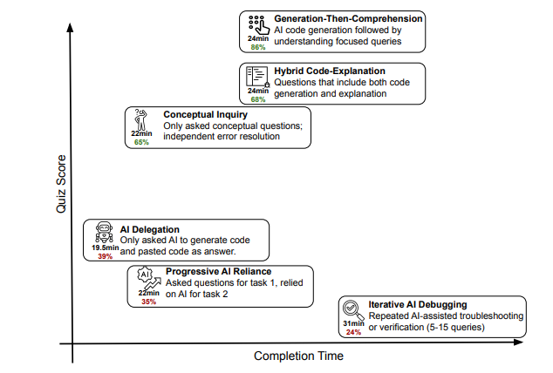
Participant behaviours where they used AI to do the tasks.
👍
👍
Effective learning behaviours during constructionist experiences
👎
👎
Ineffective learning behaviours during constructionist experiences
Jane’s colouring and interpretation.
(Shen & Tamkin, 2026)
Notes:
I am starting with some very hot off the press 2026 research. I’d like you to consider this research findings.

Slide 7
What can we learn from this?
Are you surprised about the findings?
Are your students using AI tools for programming?
In a 👍 or 👎way?
What do we need to do?
👍
Effective learning behaviours
👎
Ineffective learning behaviours
(Shen & Tamkin, 2026)
Teach students
  how to use AI tools to learn, not just to do a task;
  about cognitive offloading.
Pedagogy needs to be carefully designed
  not to offload, and to use effective learning approaches.
Reconsider learning about notional machine/ constructionism/ scaffolding in AI-mediated learning contexts.
Notes:
Click through

Slide 8
Task completion activities versus learning activities
A student completing a task when using an LLM
The objective is to use the LLM tool to complete the task.
The LLM tool ‘completes’ the task, the person offloads the task to the LLM.
A student
learning
when using an LLM
The objective is for the person to learn.
The person completes the task, the LLM tool supports.
Notes:
We are starting to teach students about the difference between completing a task and learning with AI tools.
I have created a little activity for you to learn about this - based on some of the research we are doing.

Slide 9
Example tasks and learning tasks (let’s match)
A. Using an LLM tool to suggest steps for designing test cases
B. Using an LLM tool to explain coding error messages
C. Using prompt engineering to create a range of programs with different levels of efficiency and compare these
D. Evaluate the difference between code I wrote and LLM-generated code for the same requirements
E. Investigate LLM-produced trace tables for code and algorithms
Effective learning activities
👍
Match the tasks
Using an LLM tool to
Task completion activities - offloading
1. Fix all the bugs in my code
2. Predict what code will do when it runs (by producing a trace table)
3. Write a program for requirements
4. Design and create test cases
5.Give efficiency improvements for my code
👎
Notes:
A - 4
B - 1
C - 5
D - 3
E - 2

Slide 10


Research: PRIMM + effective AI learning tasks
When teaching programming, we often first ask students to read code, to predict what it will do when it runs (as in P of PRIMM). This develops code comprehension. You have to be able to read code, before you can write it.
What would an effective AI augmented learning activity look like - for predict?
If we prompt an LLM to create a trace table for a program will it be correct
1 - 100% of the time
2 - 75% of the time
3 - 50% of the time
I don’t know - shrug your shoulders
What do you think students will think?
Do you think - students think 100% as they think an LLM is an IDE?

Slide 11
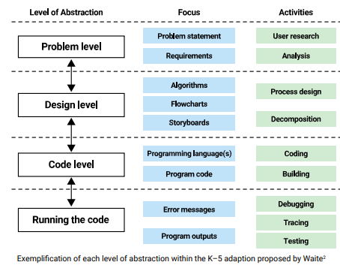
About IDEs and LLMs
Prompt (created by a human)
LLM tool
IDE
LLM outputs code
Execution?
An LLM tool is NOT a compiler/ interpreter, it is not a runtime environment, it is not IDE.
An LLM predicts output (code) based on training data.
Notes:
Using levels of abstraction, discuss the differences between running a step-by-step execution in an IDE or prompt an LLM to generate a trace table
An LLM does not execute code. It just predicts what the output, based on common patterns of words, programs, code traces, etc.
In programming, we can predict with certainty what a code snippet will do. Even if we are not sure, there is one right answer. It is deterministic.
When an LLM generates text, it is predicting based on probability. This means that there is uncertainty about the output.
https://static.raspberrypi.org/files/curriculum/quickreads/24-Pedagogy_Summary_Levels_Of_Abstraction_2025.pdf

Slide 12
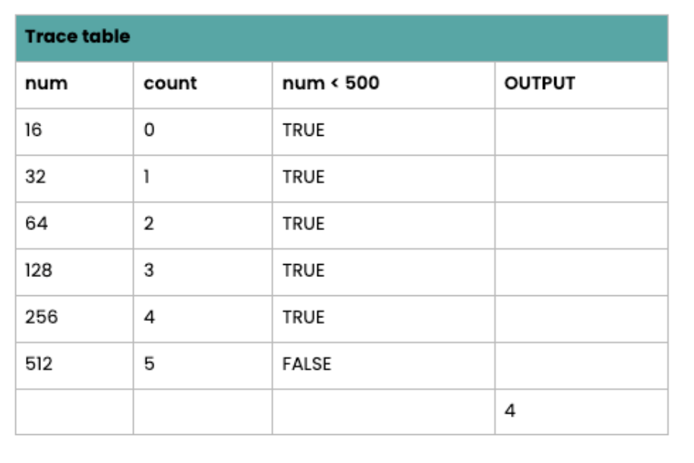
Give students code or algorithms to trace
PROCEDURE main()
input_value = INPUT("Enter a number: ")
num = INT(input_value)
count = 0
WHILE num < 500
num = num * 2
count = count + 1
ENDWHILE
PRINT (count - 1)
ENDPROCEDURE
Student produces a trace table for a provided input of 16
Pseudocode from Ada CS
rpf.io/pepllmpseudo
Notes:
As per the Ada platform guidance. Edit as appropriate based on your own trace table teaching.

Slide 13
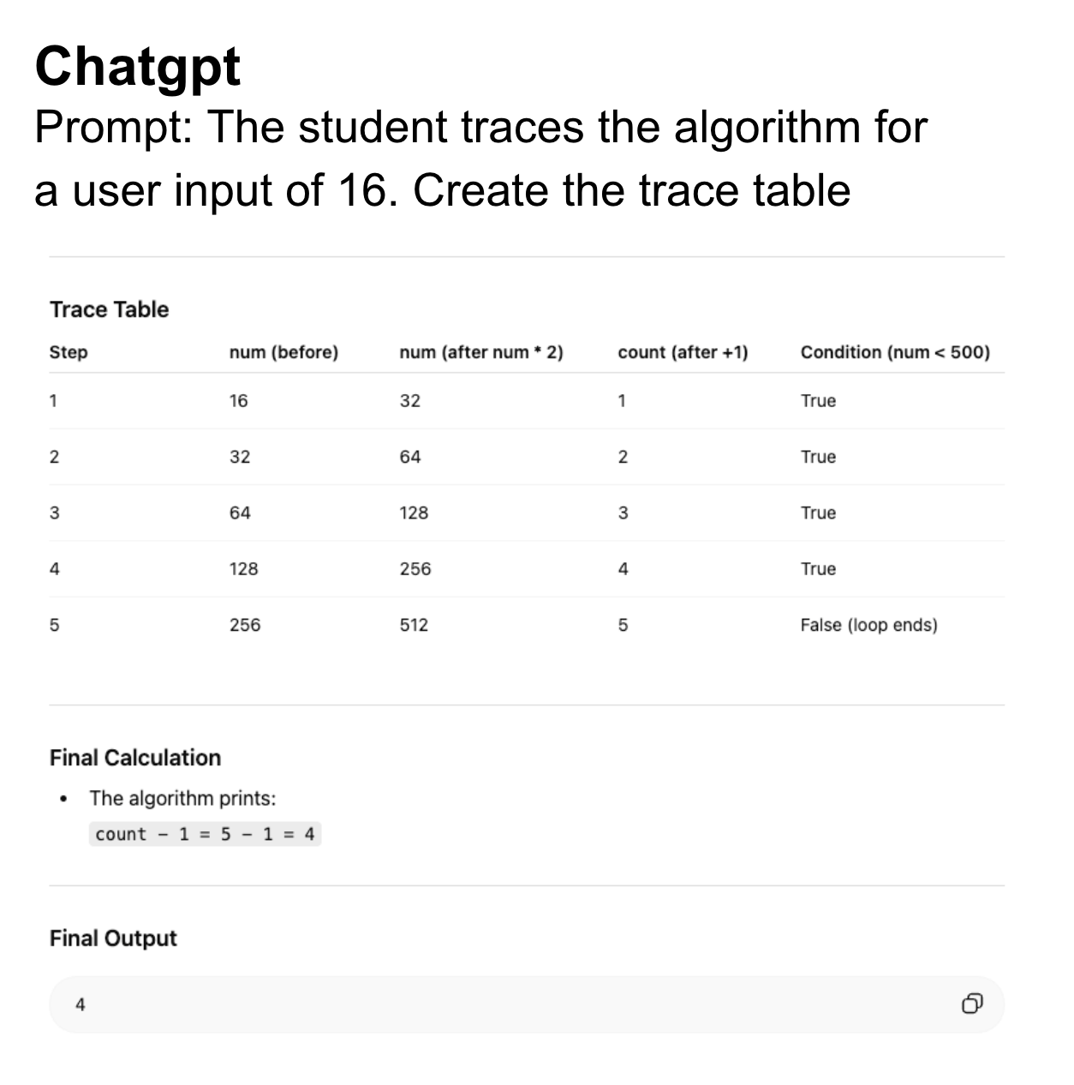
Student prompts an LLM to create the trace table and compares
Doesn’t explicitly trace that count is initialised to 0
Adds a ‘step’ column which is not required
This is incorrect. The algorithm only prints once the WHILE loop is complete
Value of num is traced twice (before and after multiplication)
Output is reported separately rather than as part of a trace table

Slide 14
Potential investigate questions
Task: Using an LLM, what do I want to investigate around LLM tools and code tracing?
Example questions - pick one or think of your own!
How accurate are the LLM traces for
  complex code / pseudocode (e.g for recursion)?
  different / less common programming languages (e.g JavaScript, assembly)?
  different paradigms (eg: OOP vs procedural)?
  code with bugs?
Can I use an LLM tool to trace what objects go out of scope in an object-oriented programming context? What about tracing runtime errors / stack tracing?
Can we create code/ pseudocode that will be inaccurately traced by LLM tools?
Implications - how does this task improve my code reading?

Slide 15
Our research: Agency to learn programming with AI tools
We are researching student agency to LEARN programming with AI tools.
When you use LLM tools (like chatbots or coding assistants) in computing, it’s important to have agency of your own learning. This means having control over how and for what purpose you use the LLM tool, and ensuring you use such tools to support your thinking, rather than simply finishing tasks without really learning.
What is “agency”?
“the ability to take action or to choose what action to take”
Cambridge Dictionary
“the power to originate action”
Bandura (2001)

Slide 16
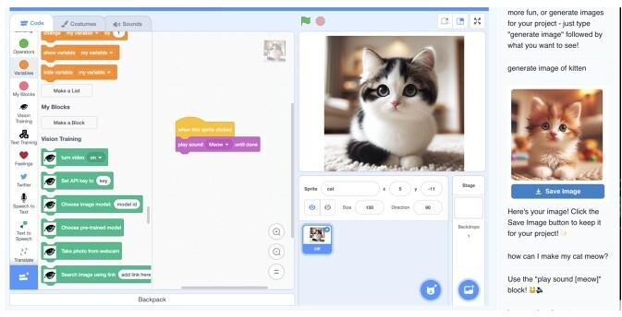
Is this just for secondary? AI copilot for Scratch
A new pane
(Druga & Ko, 2025)
Notes:
https://dl.acm.org/doi/10.1145/3713043.3727051#fig1

Slide 17
Research on an AI copilot for Scratch
Code | Definition | Example | #
Conceptual Support | Helps generate project ideas | “What about adding secret levels …” | 12
Design Support | Visual design support & asset generation | “Generate a crab image... make the maze background less complex” | 33
Code Support | Provides coding & debugging help | “Use ’forever loop’ with ’move 10 steps’ for continuous motion” | 46
Positive Encouragement | Offers motivational feedback | “Great idea! Let’s try making the ghost character green” | 8
Platform Navigation | Guides interface exploration | “Find the ’switch backdrop’ block in the Looks category” | 12
AI Failure | Unsuccessful or misleading suggestions | “Generated maze with unwanted portals despite ’simple’ request” | 20
Child Agency | Child chooses not to use AI / prefers to work independently | “I don’t need the AI for this part, I want to figure it out myself” | 9
Notes:
Only 18 participants

Slide 18
Research on an AI copilot for Scratch
Potential over-reliance on AI and difficulty navigating AI errors
Some children initially appeared to assume AI suggestions were always correct.
But, encountering AI generated incorrect code, misunderstood context, unusable images, or incomplete responses meant
  Could derail those who over trusted
  But was a learning opportunity!
Designing AI tools for transparency and encouraging critical evaluation of AI outputs seem crucial for mitigating risks like the uncritical acceptance of potentially flawed suggestions.
Agency, ethical considerations, and learning from failure
The study sessions showed children had a clear understanding of AI as a tool for learning, while expressing the need to not rely too heavily on the tool, to maintain agency and control over their learning experience.
👍
Effective learning activities
Learn the difference between completing a task and learning
(Druga & Ko, 2025)
Notes:
Examples of AI failure included:
(1)
Misunderstanding Intent: The AI Copilot Tool often struggled with understanding the user’s underlying intention, especially with vague questions
Generating unusable or unexpected images: At times, the AI generated images that did not align with the user’s expectations, such as creating a maze with portals, even after the child tried to get the maze to be less complex, or generating an image of a character that looked like a Minecraft world, instead of a Roblox avatar:
“Generate image of Roblox” — L., age 7 (Jamaica)
(3)
Incomplete responses: Although AI Copilot Tool provided helpful solutions, it sometimes gave incomplete instructions on how to achieve that specific step.
“I don’t know where the “hide” block is."— T., age 7 (Romania)

Slide 19

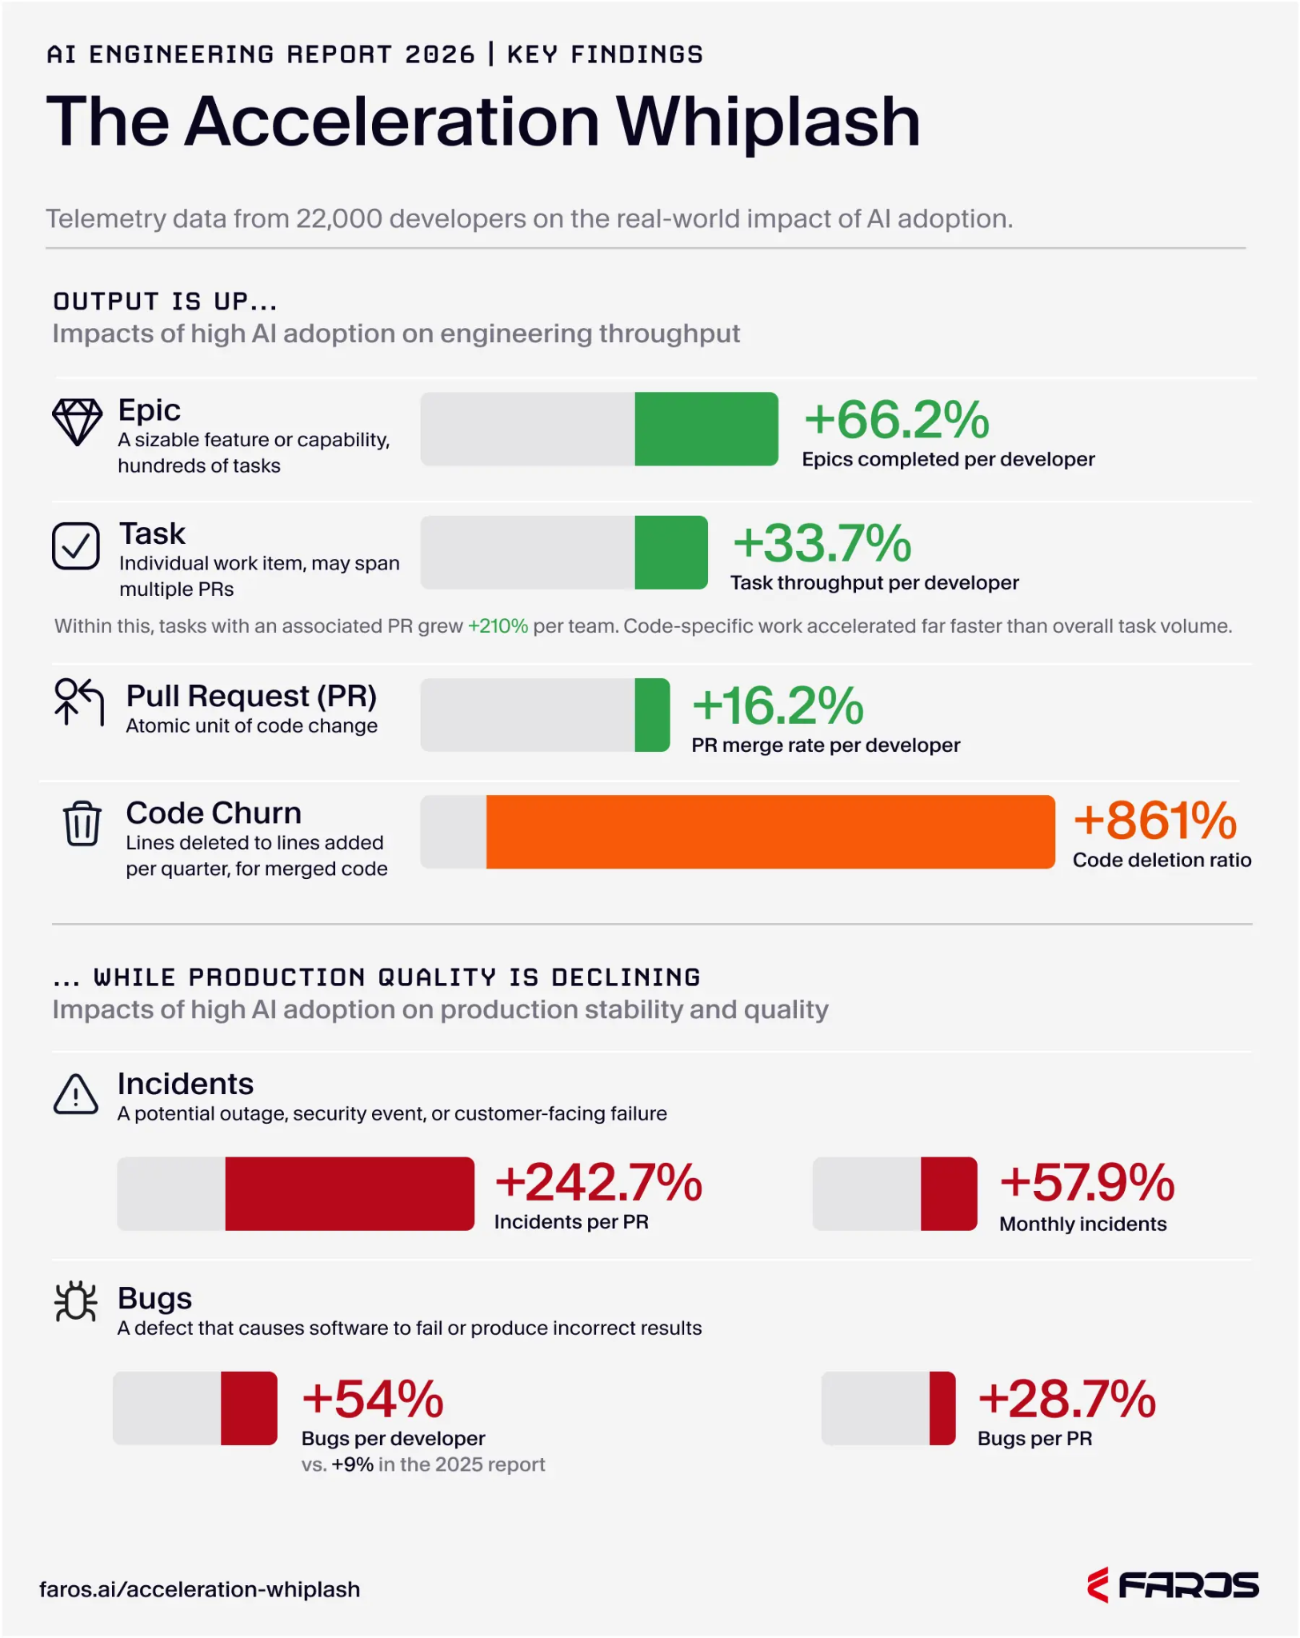
Industry - state of play (with a caveat)
AI is now claimed to be the primary author of code.
Throughput of code production has increased.
More code is entering production with no review at all.
But for every code change merged, the probability of a production incident has more than tripled.
Bugs are accelerating, not stabilising.
AI made it easy to start work. It did not make it easy to finish it.
The most experienced people are being buried: senior engineer tax.
https://www.faros.ai/research/ai-acceleration-whiplash
Notes:
Cursor, claude code,
The Faros platform (Faros AI) is an engineering operations and intelligence platform designed to centralize, normalize, and analyze data across the entire software development lifecycle (SDLC) - includes GIT, Jira
Token efficiency
Productivity
Code quality
Context window and report understanding
Privacy security and data control

Slide 20
Software development life cycle (SDLC) is/ has changed
Specification and Prompt Design
Autonomous Build
Adversarial Testing and Evaluation
Governed Deployment
Runtime monitoring and output drift
Gemini 2026
Should we be teaching about this in CS classrooms?
They are at undergraduate level,
as well as using AI to learn how to program.
Notes:
Lovable

Slide 21
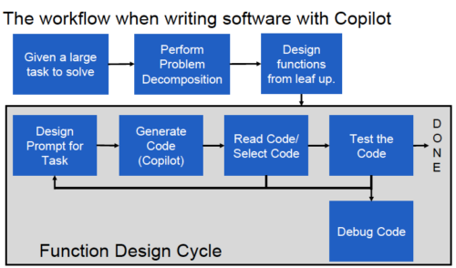
University work on teaching programming with AI
The GENAI in CS education consortium (led by Leo Porter, Dan Zingaro and Beth Simon). https://www.teachcswithai.org/ is doing brilliant work (1 year old)
Example courses and materials
Introduction to Programming in Python with GitHub Copilot
Hands-on labs provide students practice towards utilizing Generative AI effectively.
Learn AI-Assisted Python Programming, Second Edition: With Github Copilot and ChatGPT (Porter & Zngaro, 2024/2025)

Slide 22
Leo Porter and Dan Zingaro’s work (Jane’s summary)
Students learn to use AI in learning programming through:
A. Problem decomposition
Decompose problems for
functional & technical requirements. (Spec driven design?)
B. Prompt engineering
Developing the skills to effectively prompt AI systems for specific outcomes.
C. Code evaluation
Read AI produced code to:
Evaluate accuracy
Select optimal options
Spot useful patterns
D. Library discovery
Use AI to discover and integrate useful libraries into their projects.
E. Testing & debugging
Manually design test cases for AI code; practice testing and debugging manually.
F. Ethical reflection
Reflect on the ethical use of AI and how they use it to learn.
Notes:
Problem decomposition: Breaking down large projects into smaller functions is essential. For instance, when designing a text-based game, students might separate tasks into input handling, game state updates, and rendering functions.
Prompting and function design: Students learn to articulate precise prompts for AI tools, honing their ability to describe a function’s purpose, inputs, and outputs, for instance. This clarity improves the output from the AI tool and reinforces students’ understanding of task requirements.
Code reading and evaluation/selection: AI tools can produce any number of solutions, and each will be different, requiring students to evaluate the options critically. Students are taught to identify which solution is most likely to solve their problem effectively.
Discover patterns for reuse: Students explore new programming domains and identify useful libraries through interactions with Copilot. This prepares them to solve problems efficiently and creatively.
Code testing and debugging: Students practise open- and closed-box testing, learning to identify edge cases and debug code using tools like doctest and the VS Code debugger.
Develop ethical and metacognitive skills: Students engage in discussions about responsible AI use and reflect on the decisions they make when collaborating with AI tools.

Slide 23
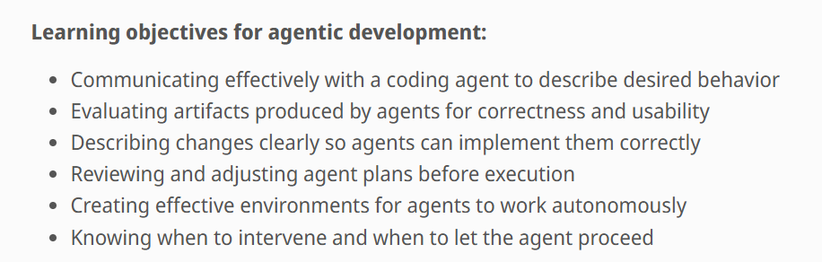
Geoff Challen’s work
https://www.cs124.org/educators#teaching_conversational_programming Geoff Challen’s fabulous lesson materials for a whole unit of introducing the use of GenAI in program learning
Notes:
https://www.cs124.org/educators#teaching_conversational_programming
Claude Code records detailed session logs (timestamped JSONL files) that students commit alongside their code. An LLM (GPT-52) reads each week’s session transcript and estimates active development hours—time the student spent thinking, prompting, and reviewing, not idle wall-clock time. Each estimate averages three independent samples and is constrained by computed active time as a sanity check.
Students earn full project credit by accumulating 20 hours of estimated effort across the semester, with a target pace of roughly 4 hours per week and a cap of 8 credited hours per week. The weekly cap discourages cramming and encourages sustained engagement. Students control the process: push logs, request a new estimate, and immediately see a bar chart of weekly hours with target and cap lines, plus a history of estimation runs. The grading criteria are completely transparent—invest the time, earn the credit.

Slide 24
Geoff Challen’s work
Effective AI augmented learning tasks
Design
Simplify something: Identify complex parts and simplify them
Screen flow redesign: Reduce steps in the main workflow
UI style exploration: Create variations and test with users
Development
Error state design: Graceful handling for common app failures
Deploy your app: Run on external devices and document setup
Evaluation
Security audit: Find and fix issues like sensitive data in logs
Outside tester: Observe new users and implement observed improvements
Notes:
Some of the targeted tasks included in the lessons - that get students to think critically about output they have created with AI assistance
Design:
Simplify Something: Identify the most complex or cluttered part of your app. Simplify it—remove unnecessary options, combine steps, or break it into something clearer. Explain what you removed and why the app is better without it.
Screen Flow Redesign: Map out every screen and tap in your app’s main workflow. Find at least one way to reduce the number of steps needed to complete a common task. Implement the improvement.
UI Style Exploration: Create 2–3 visual variations of your main screen. Show them to at least 2 people, get their preference, and keep the winner. Document what you tried and why you chose what you chose.
Development:
Error State Design: Identify 3 things that could go wrong when someone uses your app (no network, invalid input, empty data, missing permissions). Design and implement graceful handling for each—no crashes, no blank screens.
Deploy Your App: Deploy your app and any backend it requires so that it can run on another person’s device—not just your emulator. Document your deployment setup and have at least one other person successfully run your app.
Evaluation:
Security Audit: Review your app for common security issues: hardcoded secrets, missing input validation, cleartext network traffic, sensitive data in logs, or insecure storage. Identify and fix at least 3 issues.
Outside Tester: Have someone outside CS 124 try your app without any instructions from you. Document what happened—where they got stuck, what they misunderstood, what surprised you. Implement at least one change based on what you observed.

Slide 25

Thanks for listening, we look forward to your questions!
Agency Survey
Contact us at jane.waite@raspberrypi.org
Follow our work at: computingeducationresearch.org
rpf.io/agency-survey-2026
Notes:
So I am going to finish there, we have a whole set of other research activities that we are now working on related to this area, and if anyone would like to find out more about resources and research - please come and chat with me in the conference.
But for now, I am very much looking forward to your questions and let me leave you on the SEAME slide.
15 minutes

Slide 26
Please complete the agency questionnaire
rpf.io/agency-survey-2026
Notes:
Based on this framework we’ve developed a questionnaire that you can use to self-assess your own agency to learn when using AI. At the start of the lesson we asked you to self-assess against one aspect of the framework.
Now we’re asking you to self-assess against all aspects by completing the questionnaire above.
This is not a test for us to measure your agency. This is designed as a self-assessment tool to help you become more aware of what it means to have agency over your own learning when using LLM tools.

Slide 27
References
Druga, S., & Ko, A. J. (2025). Scratch Copilot: Supporting youth creative coding with AI. Proceedings of the 24th Interaction Design and Children (IDC '25), 140–153. https://doi.org/10.1145/3713043.3727051
Faros AI. (2026). AI engineering report 2026: The acceleration whiplash. https://www.faros.ai/research/ai-acceleration-whiplash
Madani, M., Neumann, K., Nahhas, A., Chernigovskaya, M., Walia, D. S., & Turowski, K. (2025). Towards the integration of Large Language Models into the software development life cycle: A systematic literature review. 2025 3rd International Conference on Foundation and Large Language Models (FLLM), 773–781. doi: 10.1109/FLLM67465.2025.11390990
Mohanlal, A., Alaswad, F., & Aljaddouh, B. (2026). The Generative SDLC: A Systematic Review of Integrating Modern LLMs in Software Development Life-Cycle. International Journal of Scientific Research and Technology, 3(6), 911–921. https://doi.org/10.5281/zenodo.20701463
Shen, J. H., & Tamkin, A. (2026). How AI impacts skill formation. arXiv preprint arXiv:2601.20245. arxiv.org - Work done as a part of the Anthropic Fellows Program

Slide 28



Some of our AI/ ML activity (much informed by this work)
Formal
KS3: Experience AI lessons with DeepMind
KS3: Y9 Introduction to Data Science
KS5: Machine learning, Big data, Impacts of technology
Non-formal
AI challenge in the Experience AI project with DeepMind
Four Scratch machine learning projects
A five project beta machine vision learning journey in Python (using TensorFlow and Teachable Machine)
Machine learning projects using Wolfram Mathematica: Facial recognition, Face swap, and Sentimental 8-ball
The Astro Pi competition has seen emerging skills in machine learning
Educators and other adults
Educator support aspects of the Experience AI project with DeepMind
An online course, Introduction to Machine Learning
Research
A series of AI and DS research seminars with the Alan Turing Institute (proceedings chapters)
A series of seminars about teaching programming with AI for 2024 NOW
Systematic literature review of AI empirical studies
An analysis of learning resources (FIE 23)
A small-scale survey of teachers’ attitudes to AI (ITiCSE 22)
Using large language models to explain programming error messages (ITICSE 24)
Evaluation of a range of teaching and learning projects about AI/ML with DeepMind
AI in schools in the UK and Ghana (in progress)
Developing AI guidelines for CS teachers
Experience AI lessons
Our AI research at the Raspberry Pi Computing Education Research Centre

Slide 29
Student agency to learn with LLM tools
Student competencies
Interaction and prompting skills
Responsible and ethical use
Working with others
Context aspects (programming)
Knowledge of LLM tools for learning
Setting learning standards
Evaluating and adjusting interactions
Reflection of learning
Personal aspects
Motivation
Self-efficacy (confidence)
Self control
Relatedness
Notes:
Framework that students can use to self-assess their agency to learn using AI tools.

Slide 30
Software development lifecycle (SDLC) further work needed
Further work needed to integrate LLMs into the SDLC
Customisation and Fine-Tuning
  Tailored datasets and iterative refinement to increase contextual accuracy and reliability of outputs
Lightweight Architectures
  Pruned/quantised models to improve scalability and accessibility for smaller teams.
Ethical Governance
  Policies, bias checks, and fairness audits to build trust and accountability.
Training and Development
  Upskilling in prompting, evaluation, and responsible use to support effective integration.
Madani et al, 2025
Notes:
https://ieeexplore.ieee.org/stamp/stamp.jsp?tp=&arnumber=11390990
Towards the Integration of Large Language Models into the Software Development Life Cycle
M. Madani, K. Neumann, A. Nahhas, M. Chernigovskaya, D. S. Walia and K. Turowski, "Towards the Integration of Large Language Models into the Software Development Life Cycle: A Systematic Literature Review," 2025 3rd International Conference on Foundation and Large Language Models (FLLM), Vienna, Austria, 2025, pp. 773-781, doi: 10.1109/FLLM67465.2025.11390990.

Slide 31
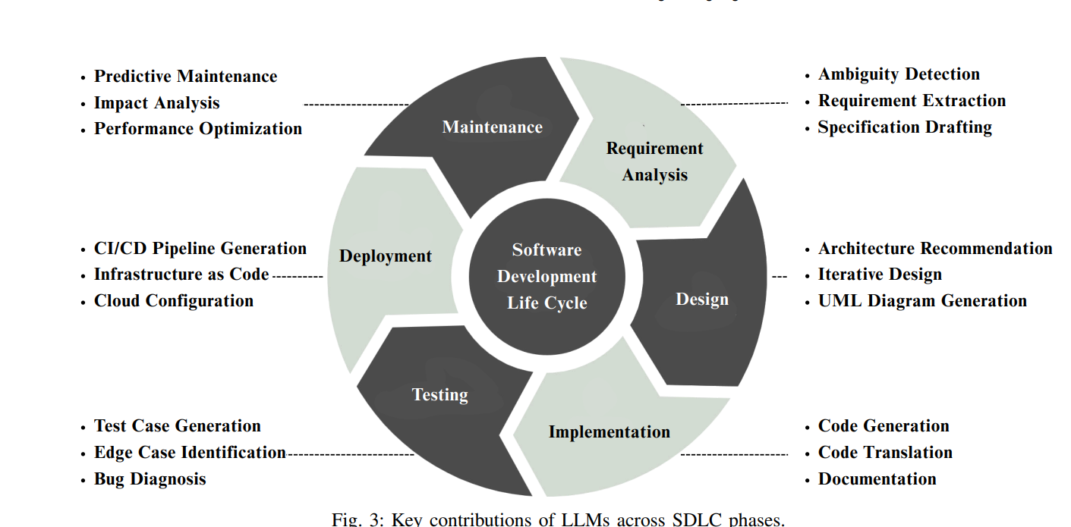
Software development life cycle (SDLC) is/ has changed
Madani et al, 2025
Notes:
https://ieeexplore.ieee.org/stamp/stamp.jsp?tp=&arnumber=11390990
Towards the Integration of Large Language Models into the Software Development Life Cycle
M. Madani, K. Neumann, A. Nahhas, M. Chernigovskaya, D. S. Walia and K. Turowski, "Towards the Integration of Large Language Models into the Software Development Life Cycle: A Systematic Literature Review," 2025 3rd International Conference on Foundation and Large Language Models (FLLM), Vienna, Austria, 2025, pp. 773-781, doi: 10.1109/FLLM67465.2025.11390990.
Further work needed to integrate LLMs into the SDLC
Customisation and Fine-Tuning
Tailored datasets and iterative refinement to increase contextual accuracy and reliability of outputs
Lightweight Architectures
Pruned/quantised models to improve scalability and accessibility for smaller teams.
Ethical Governance
Policies, bias checks, and fairness audits to build trust and accountability.
Training and Development
Upskilling in prompting, evaluation, and responsible use to support effective integration.

Slide 32
Our research lesson objectives are
Lesson 1
What does it mean to learn with LLM tools?
Lesson 2
Get stuck in with an LLM tool - Comparing code trace tables
Lesson 3
Investigate code reading & tracing with LLM tools
LO1: Explain some of the main features of an LLM tool
LO2: State some of the impacts of using LLM tools for learning
LO3: Explore what agency to learn is
LO4: Self-assess your agency to learn using LLM tools
LO1: Self-assess one aspect of agency to learn using LLM tools
LO2: Create a trace table for a given piece of code/pseudocode
LO3: Spot the differences between the trace you created and a trace generated by an LLM tool
LO4: Discuss how an LLM tool may be useful (or not) for learning how to trace code/pseudocode
LO5: Know that an LLM does not execute code
LO1: Investigate how LLM tools can be used for code tracing to improve code reading
LO2: Describe three different prompt strategies
LO3: Self-assess your agency to learn using LLM tools

