Slide 1
How can the Computing Quality Framework (CQF) support the development of your computing department?
Simon Roberts
Secondary Education Lead

Slide 2
Learning outcomes
By the end of this session, you will be able to:
understand the requirements of level 4 across each benchmark
identify the challenges within the benchmarks for my school setting
create an action plan on how to achieve the Computing Quality Mark

Slide 3
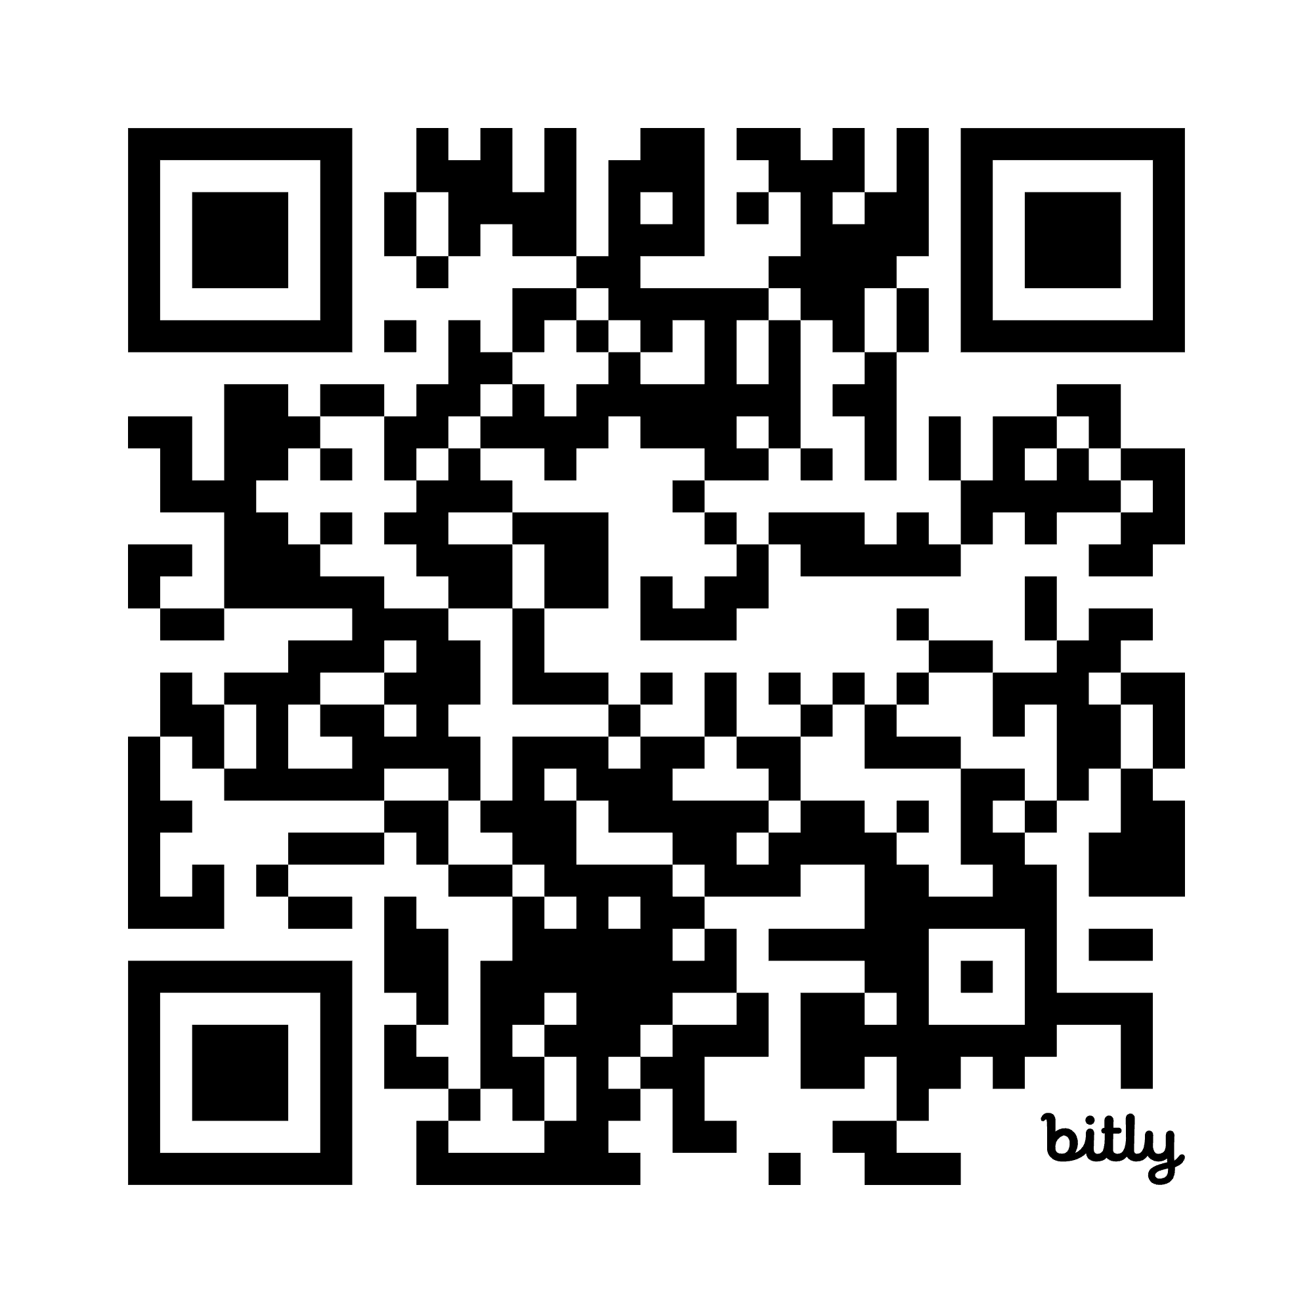
Subject leadership
bit.ly/4oR2rVE
Leading a subject can pose many challenges – what are the biggest challenges that subject leaders face?
Add your suggestions to the Padlet.
Notes:
https://padlet.com/sroberts298/challenges-of-being-a-subject-leader-dpvpm85zozt0bcgg

Slide 4
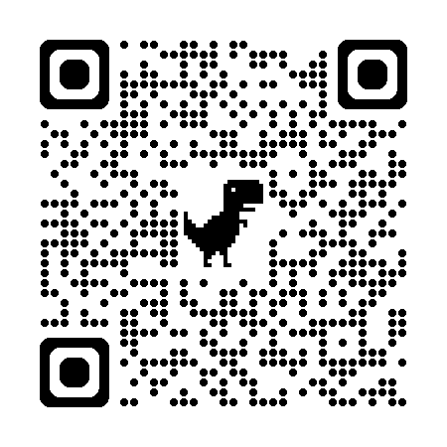
Computing Quality Framework
Framework designed to help schools develop exemplary computing provision
Eight benchmarks that define high-quality practice
Accreditation with the Computing Quality Mark
computingqualityframework.org

Slide 5
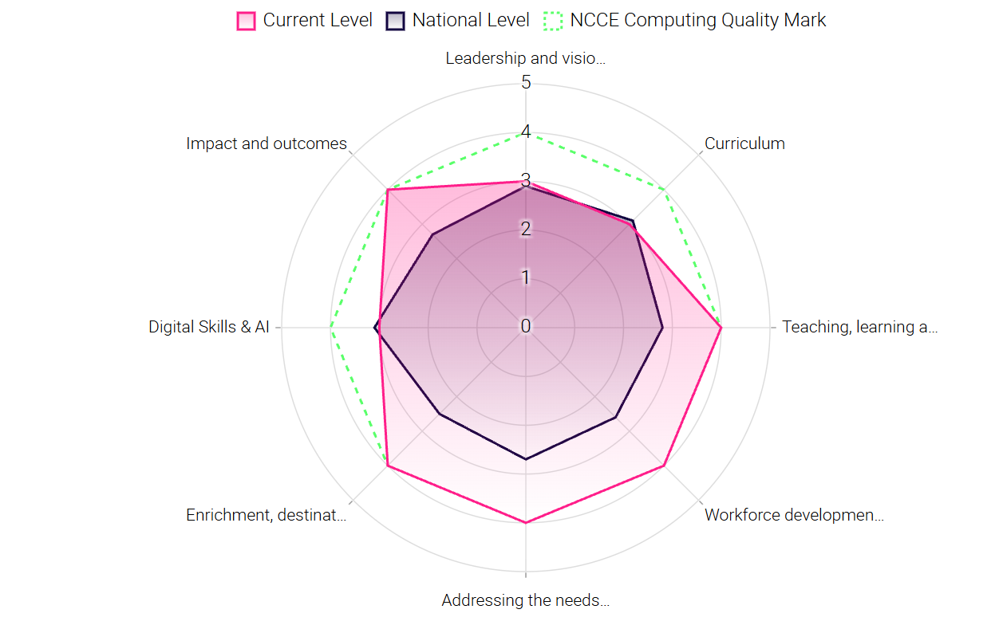

Slide 6


SME Support is available

Slide 7
The eight Benchmarks
Leadership and vision
Curriculum
Teaching, learning & assessment
Workforce development
Addressing the needs of each pupil
Enrichment & destinations
Impact & outcomes
Digital & AI

Slide 8
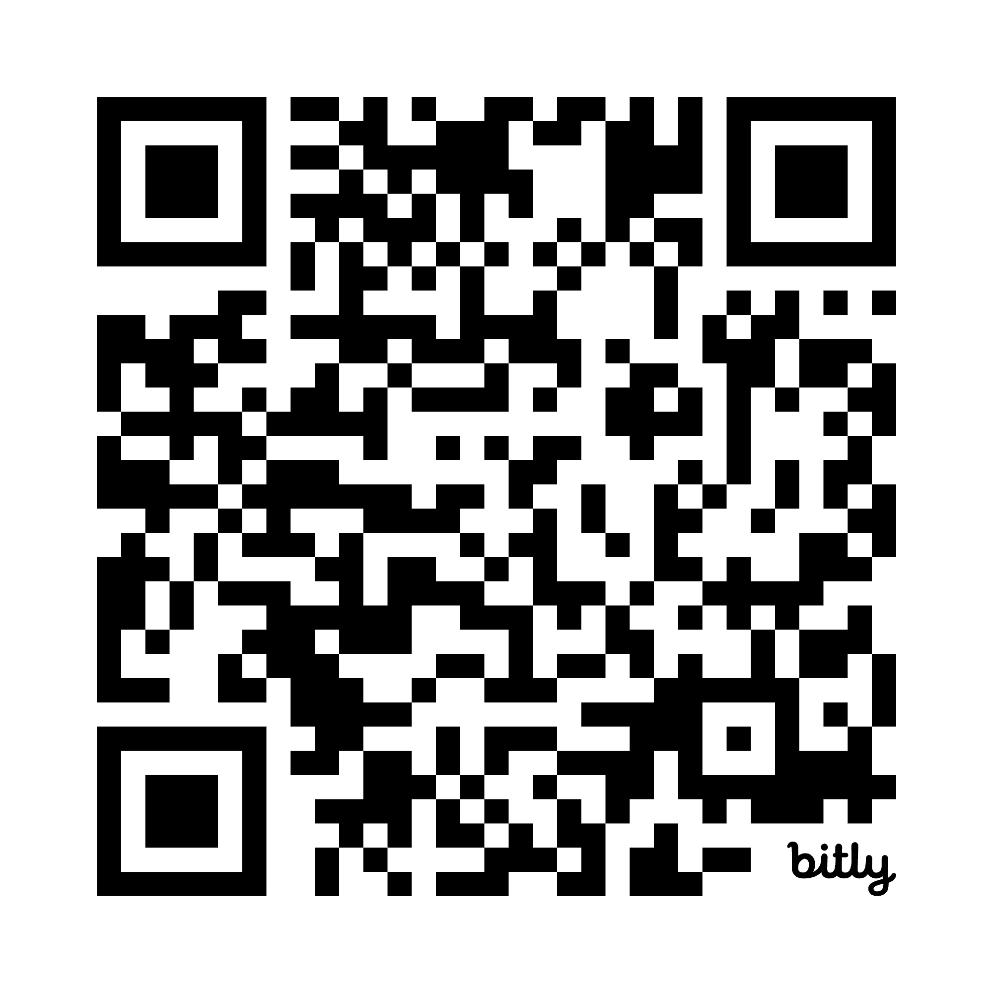
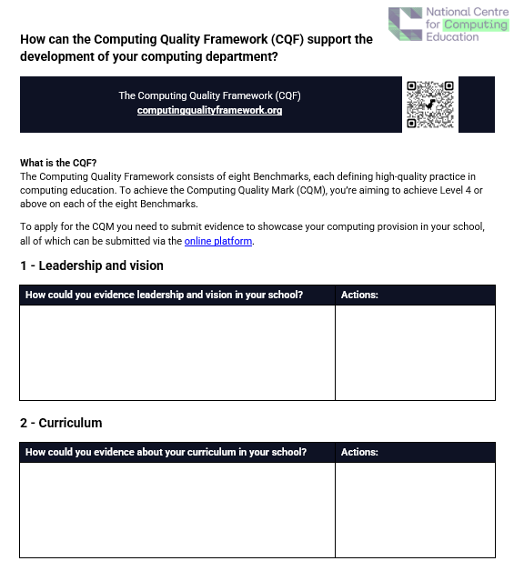
Benchmark Evidence
bit.ly/4vyrSxJ
In small groups, review the eight Benchmarks and note down how you could evidence each of them in your school setting.
Guidance has been provided from the CQF.

Slide 9
1 - Leadership and vision
Share the vision and strategic plan with all staff and stakeholders
Collaborate with other computing school and teacher networks (Local, Regional or National), including CAS Communities, STEM Ambassador hubs, Local Businesses and Universities
Computing Leader plans high quality CPD to support all computing teachers.
Consider OECDs AI Literacy Framework in your policy development

Slide 10
2 - Curriculum
Reflect and develop teaching sequences following internal research and external research using NCCE’s Teach Computing Curriculum
Ensure the curriculum offering at KS4 computing is for all learners
Join the I Belong programme
Develop a curriculum to address misconceptions using assessment for identification

Slide 11
3 - Teaching, learning & assessment
Teachers try new pedagogical models and discuss the impact and effectiveness of their experiences in STEM Learning Communities
Formative and summative assessment are used confidently in robust ways by both learners and teachers to show progression and decide steps for improvement
Use ISAAC Computer Science in structured ways and blended lessons to augment topics and allow independent practise.

Slide 12
4 - Workforce development
Join the STEM Community a community of over 20,000 teachers; technicians; TA's and governors, all involved in the STEM education of young people supporting and collaborating with each other to improve the outcomes of young people
Involve Staff from other departments in wider Digital Skills Development CPD
Gain new skills and confidence through the NPQ in Leading Teaching
Ensure all key teaching staff have gained the Teach Secondary Computing Certificate

Slide 13
5 - Addressing the needs of pupils
Department leads and SLT aware and able to discuss the data from computing and the breakdown of different groups
Become an I Belong champion in your local area or school trust
STEM Ambassador program integrated into the curriculum offering to invite diverse role models into school to talk about digital careers
Competitions and enrichment opportunities embedded in the curriculum

Slide 14
6 - Enrichment & destinations
Develop links with businesses and employers to make sure that learners see the relevance of computing in their lives after school
Develop a consistent approach to enrichment using for example STEM ambassadors, Physical Computing, Secondary Enrichment
Seek work placements that involve learners experiencing computing in the workplace
Use STEM Careers fairs for KS4 learners to sample careers materials from national employers

Slide 15
7 - Impact & outcomes
Learners engage in a range of enrichment opportunities
Teachers try new pedagogical models and discuss the impact and effectiveness of their experiences in STEM Learning Communities
Ensure all staff implement the learnings from the higher attainment in computer science - meeting the challenges of the exams course

Slide 16
8 – Digital & AI
Audit the use of digital skills across the curriculum to ensure learners have opportunities to apply them beyond computing lessons
Seek enrichment opportunities such as competitions where your students can apply their digital skills, their online saftey and or AI Knowledge
Identify key staff members to champion the development and integration of digital skills and AI within their subject or phase

Slide 17
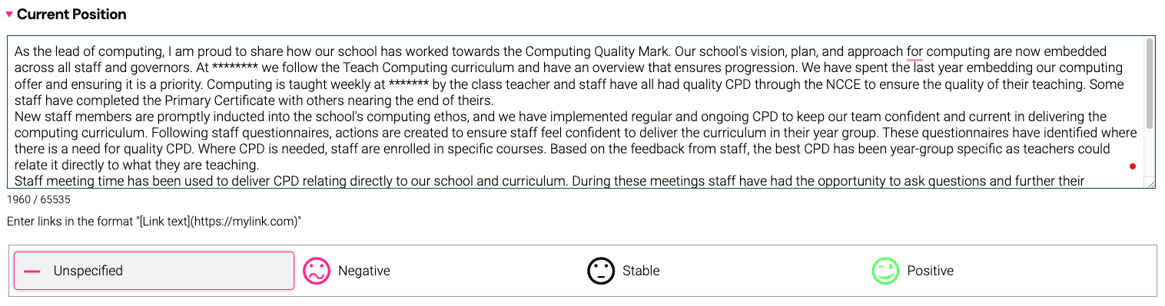
Evidencing the CQF

Slide 18
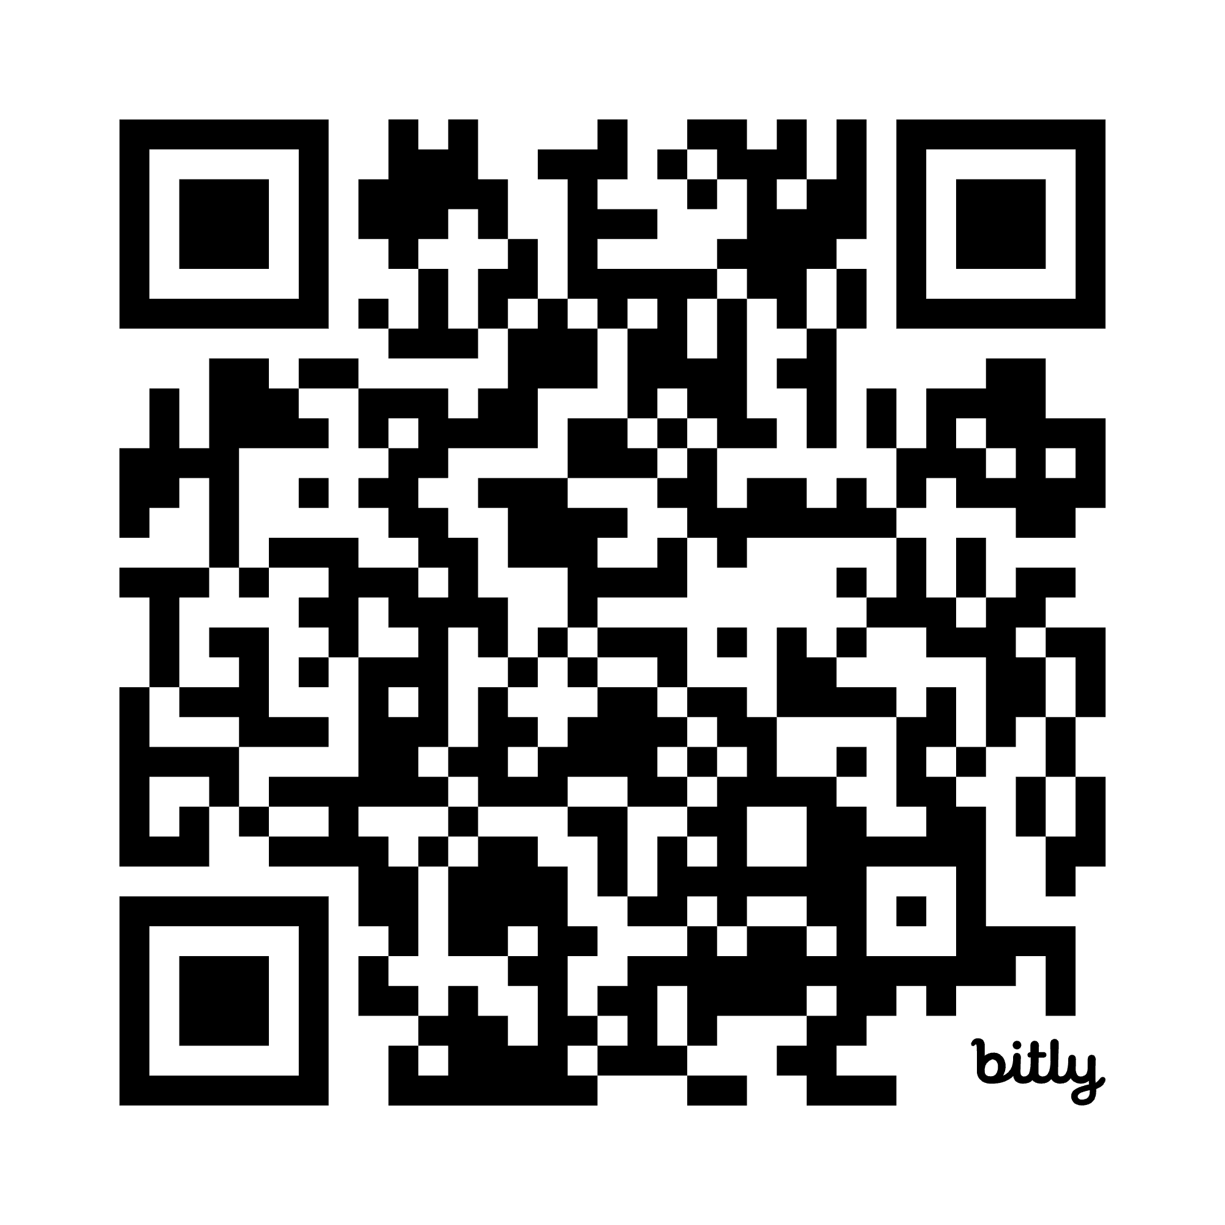
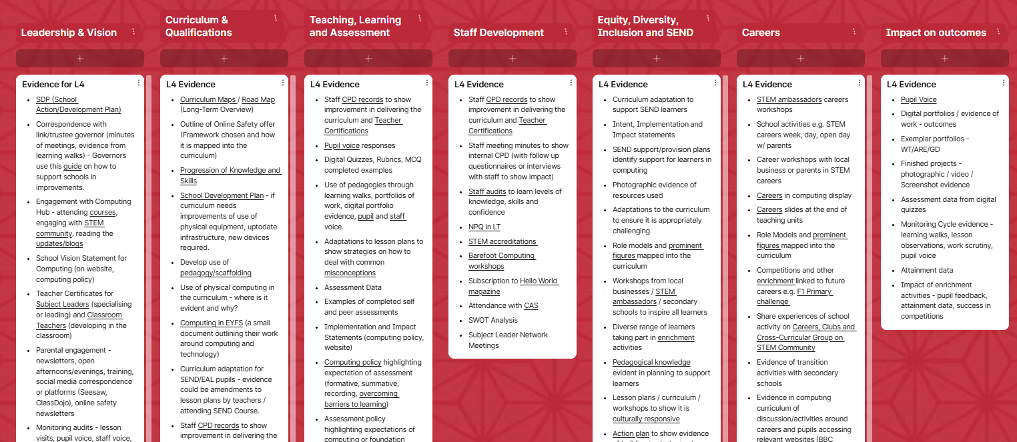
Example evidence
bit.ly/3R4JgLA
Notes:
https://padlet.com/sroberts298/cqf-evidence-simon-roberts-ccq8k8z1bg6u1ya1

Slide 19
Further Support
Up to half a day of fully funded support is available for state funded primary and secondary schools to support you with any of the CQF benchmarks.
Request your free support here

Slide 20
Any questions?
s.roberts@stem.org.uk

