Slide 1



TechFirst@dsit.gov.uk

Slide 2


TechFirst Strands
TechFirst offers tailored support for UK people at key stages in the tech talent ecosystem.
Each strand has different aims to strengthen the UK’s digital and technology sector:
TechYouth will:
TechGrads will:
TechExpert will:
TechLocal will:
Reach 1 million UK students with tech skills and careers opportunities by 2029.
Provide scholarships and support for up to 1250 domestic students each year with the passion and aptitude for a future career in tech.
Offer additional funding and industry engagement for up to 1000 doctoral researchers in frontier tech fields.
Run regional grant funds that help connect 2000 skilled people to tech jobs and create new AI degrees and graduate traineeships.

Slide 3
TechYouth
TechYouth is for young people aged 11 to 18. It aims to reach one million students in schools across the UK with opportunities to develop their tech skills, get confident with AI and gain insight into a range of potential tech careers.
Regional Activity: Delivery partners will run the programme at a local level, organising a range of opportunities for students in their area and awarding schools making strides in technology and computing education. They will work in partnership with local industry, academia and third sector orgs.
Online Learning: A platform for students and teachers, hosting Computing curriculum learning and tech career inspiration.
Competitions: Annual national competitions, including the TechFirst Girls Competition, with exciting tech prizes to be won.

Slide 4
TechFirst Membership
Collaboration with industry is key to the success of the programme. Organisations will have different ways to get involved with the TechFirst community:
TechFirst Members
TechFirst Partners
TechFirst Membership is open to any organisation who wants to get involved with TechFirst. Industry members can lend their support by engaging with local and national events, volunteering within schools and hosting summer work placements.
Industry Partners are tech employers who have made a formal large-scale commitment to TechFirst, encompassing summer work placements, volunteering hours, and event sponsorship. They will support both the successful delivery and strategic oversight of the programme.
Interested in joining the TechFirst community? Get in touch with us at TechFirst@dsit.gov.uk.

Slide 5
How to contact new regional delivery partners
East of England: TechFirst@techeducators.co.uk
East Midlands: IN4
London and South East: TechFirst@stem.org.uk
West Midlands: TechFirst@digitalinnovators.co.uk

Slide 6

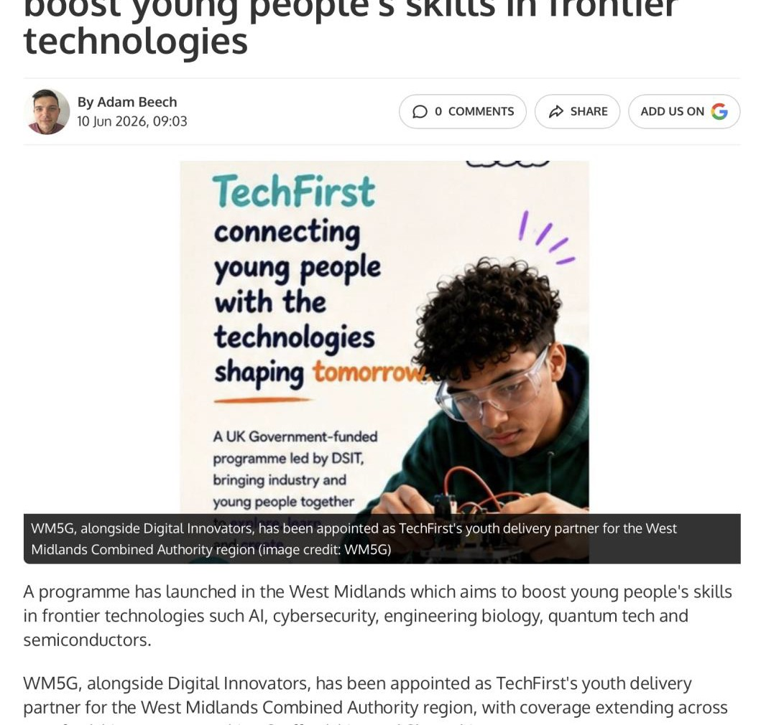
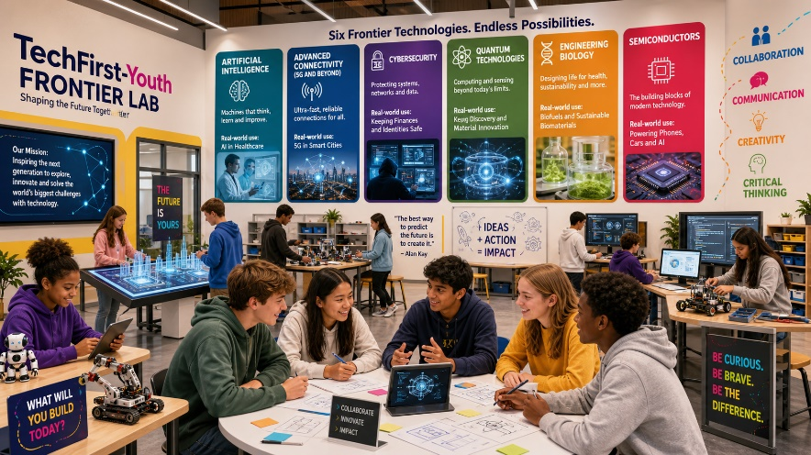
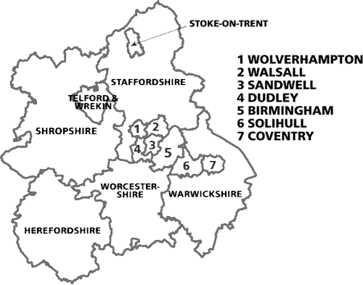
Tech First’s Youth Programme in West Midlands
Summary
Young people will:
Build digital and AI confidence
Gain hands-on experience with Frontier technologies
Explore career pathways across sectors (not just tech roles)
Engage with real-world problem solving
Access immersive lab-based experiences
Targeted focus:
Girls
Disadvantaged young people
SEND
NEET

