Slide 1

Dodona
Built for computing classrooms.
Learn better. Teach smarter.
Dodona gives every student instant, intelligent feedback on their code,
while helping teachers save valuable marking time and see exactly who needs help, right when they need it.
Start your free trial · www.dodona.be
Dodona Learning Technologies

Slide 2

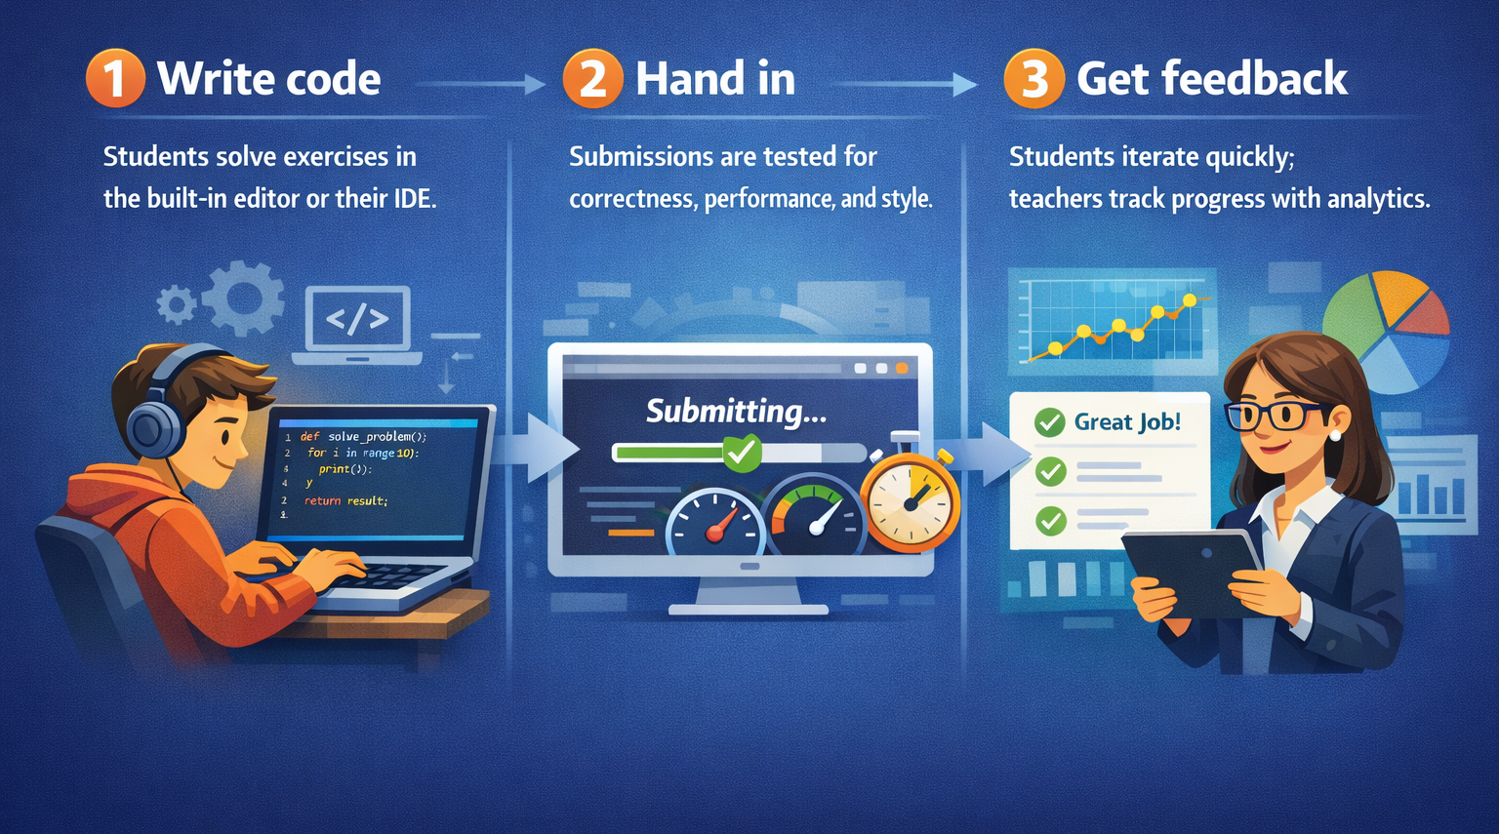
Dodona
HOW IT WORKS
From first
line of code
to feedback

Slide 3
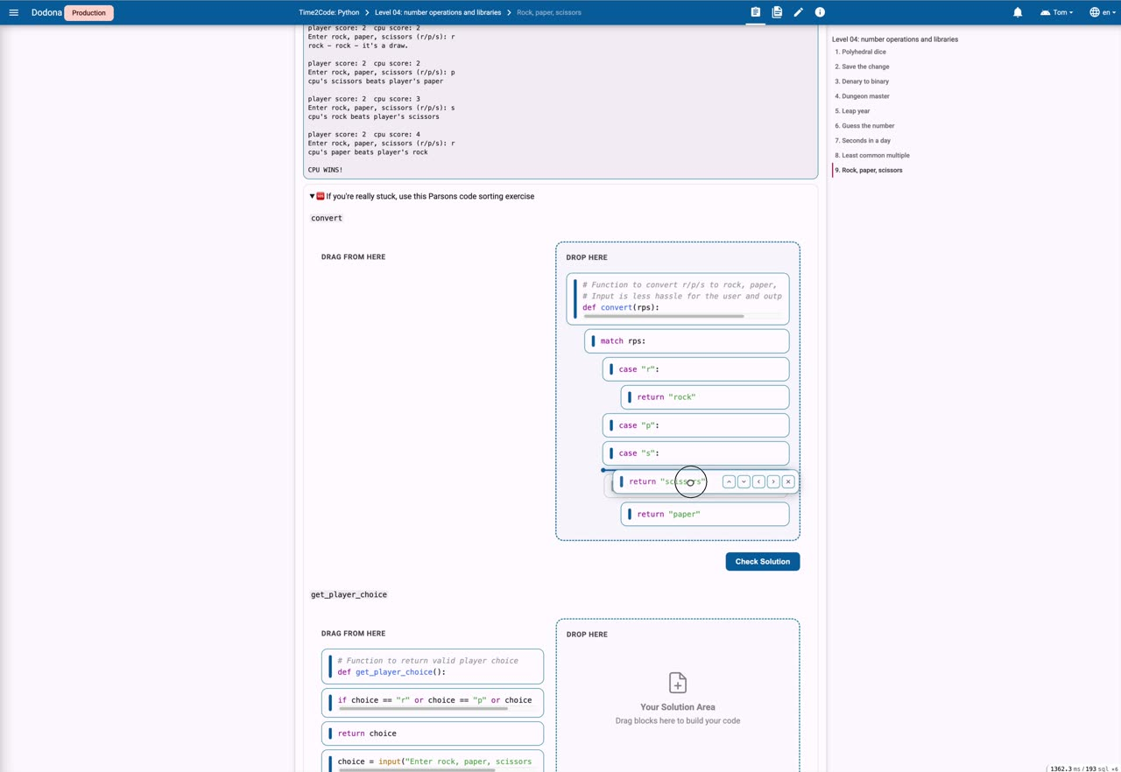
Dodona
AN EXAMPLE: CRAIG’N’DAVE’S TIME2CODE
Active learning
Watch the video to see how Dodona
works: from assignment, over Parsons’
puzzles, to instant feedback and a visual
debugger.
No installation required – everything happens
in the browser.
▶ Click the video to play it in PowerPoint.

Slide 4
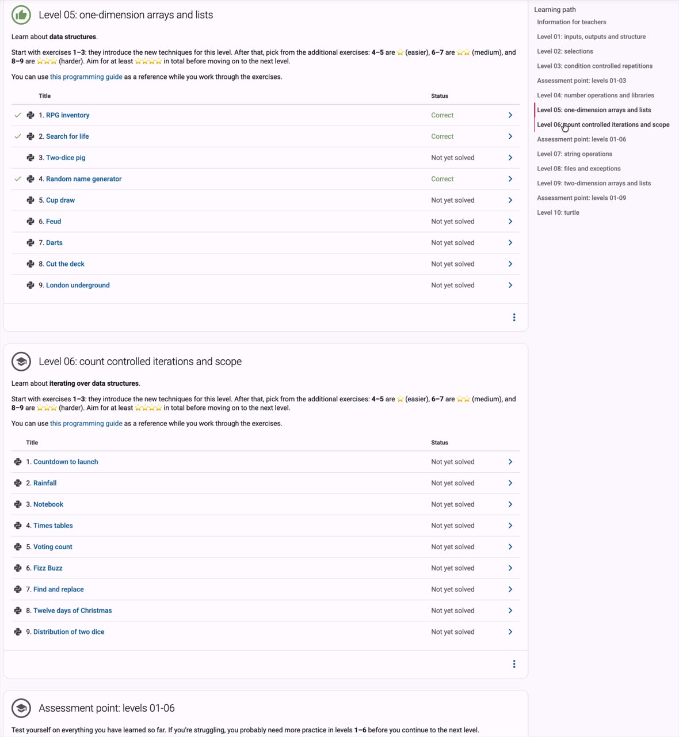
Dodona
AN EXAMPLE: CRAIG’N’DAVE’S TIME2CODE
Interactive courses
Dodona offers ready-made courses that you can bring instantaneously to your classroom. Simply copy the learning path, tailor it to your own needs, and get started with your students.
Watch the video to discover how the Time2Code
learning track looks like on Dodona. You can modify
each level, mix-and-match with your own content
and even set deadlines for your students.
▶ Click the video to play it in PowerPoint.

Slide 5
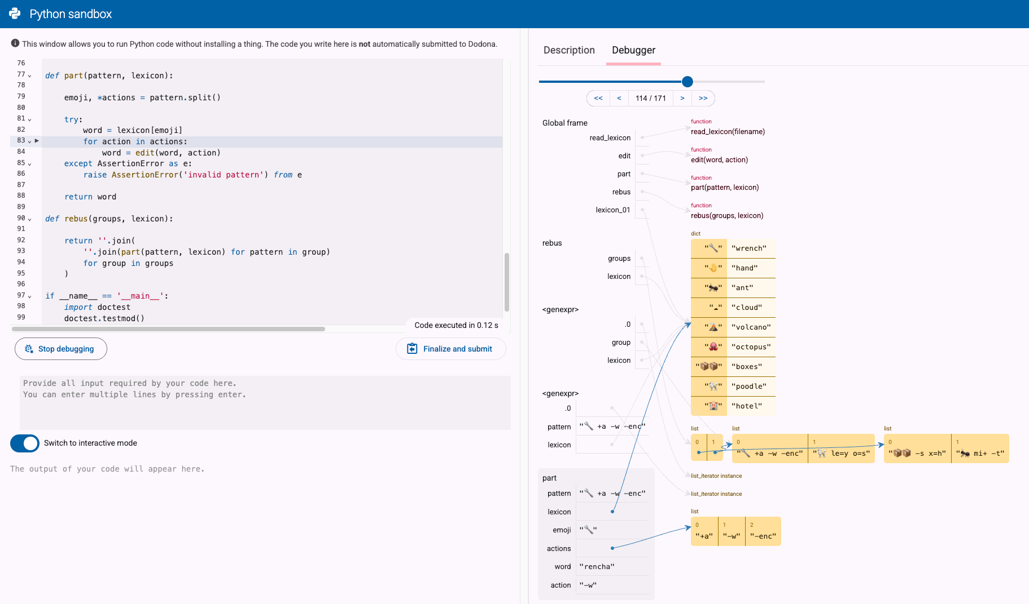
Dodona
IMMEDIATE FEEDBACK
Visual debugging, instant feedback
Dodona's automated feedback saves teachers countless hours of manual grading — so they can focus on the students who need the most support.
The visual debugger lets learners step through their code line by line to see exactly what happens.

Slide 6
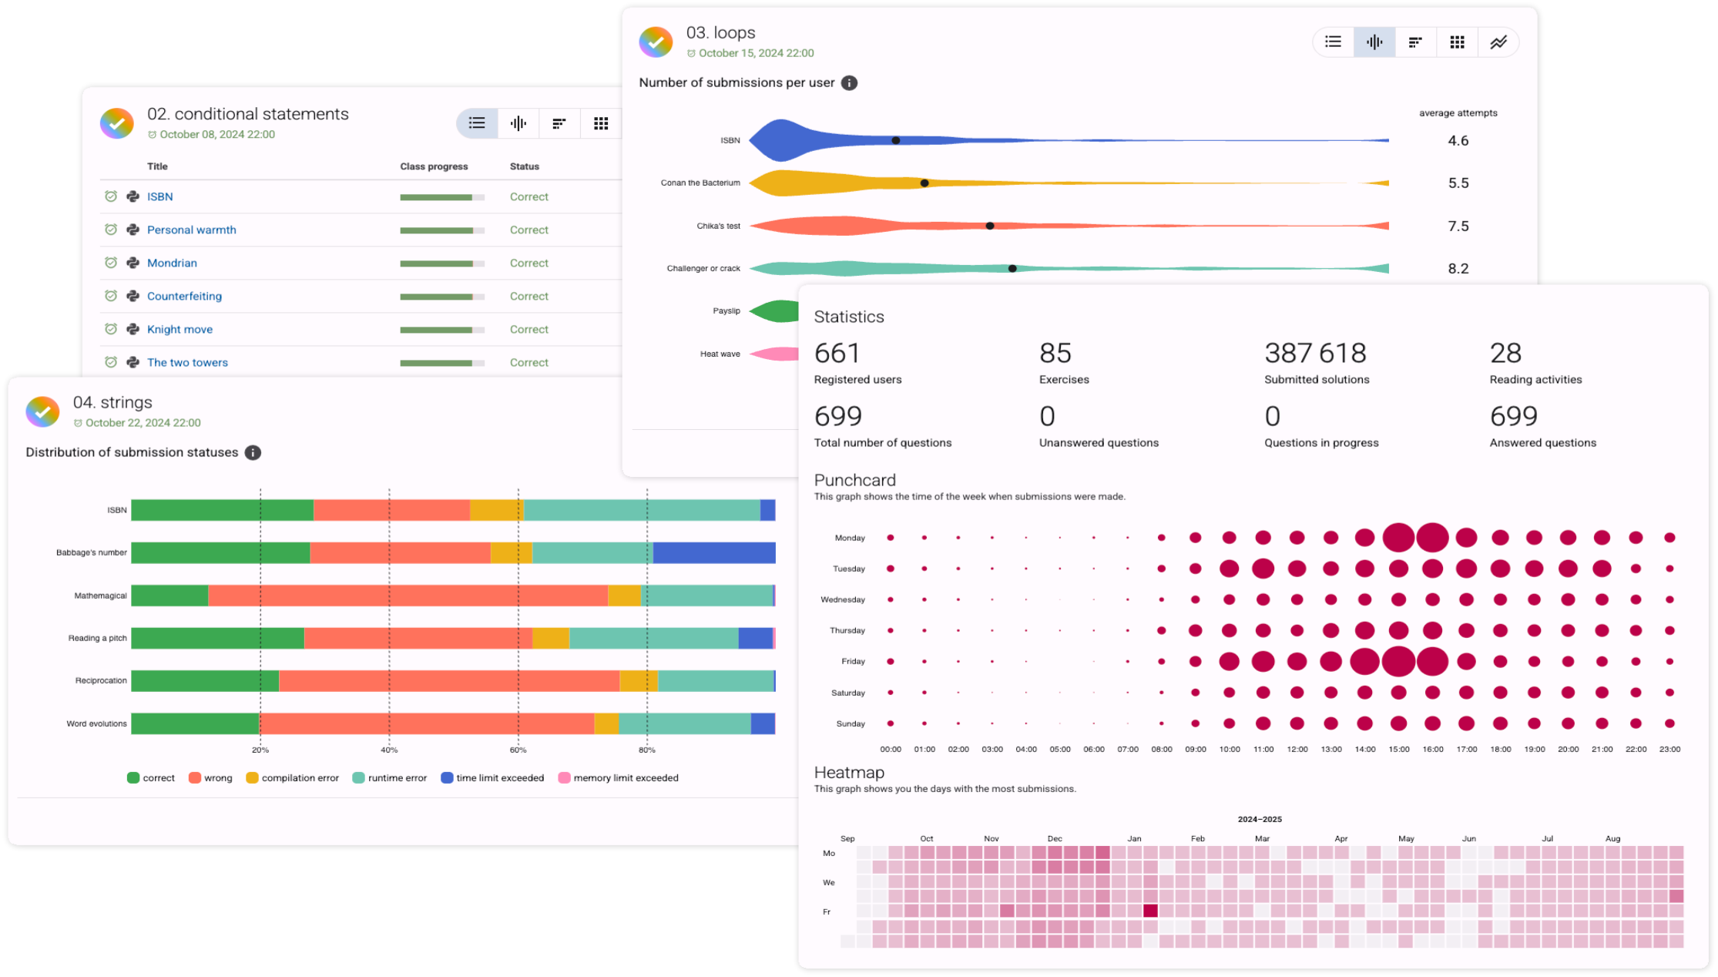
Dodona
LEARNING ANALYTICS
Powerful insights at a glance
Built-in learning analytics give instructors
real-time monitoring about how students are progressing — individually and as a group.
Submission heatmaps, punchcards and
per-exercise breakdowns make it easy to spot where a student or class is struggling.

Slide 7
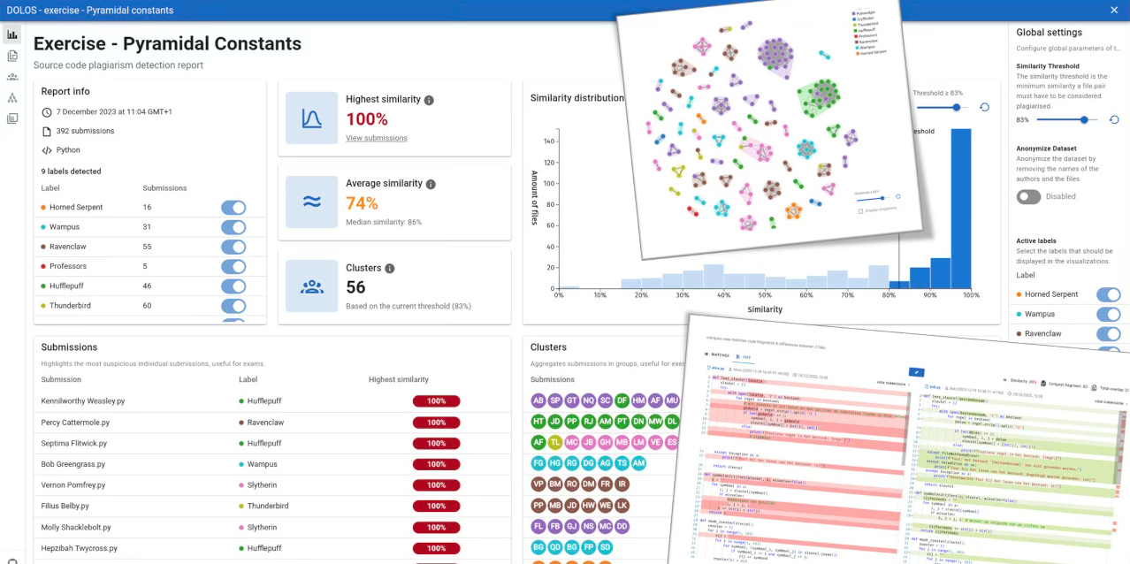
Dodona
PLAGIARISM DETECTION
Assessments with integrity
Create and assess exams and high-stakes tests directly in Dodona.
A built-in plagiarism detection tool helps
teachers monitor collaboration and safeguard academic integrity.

Slide 8
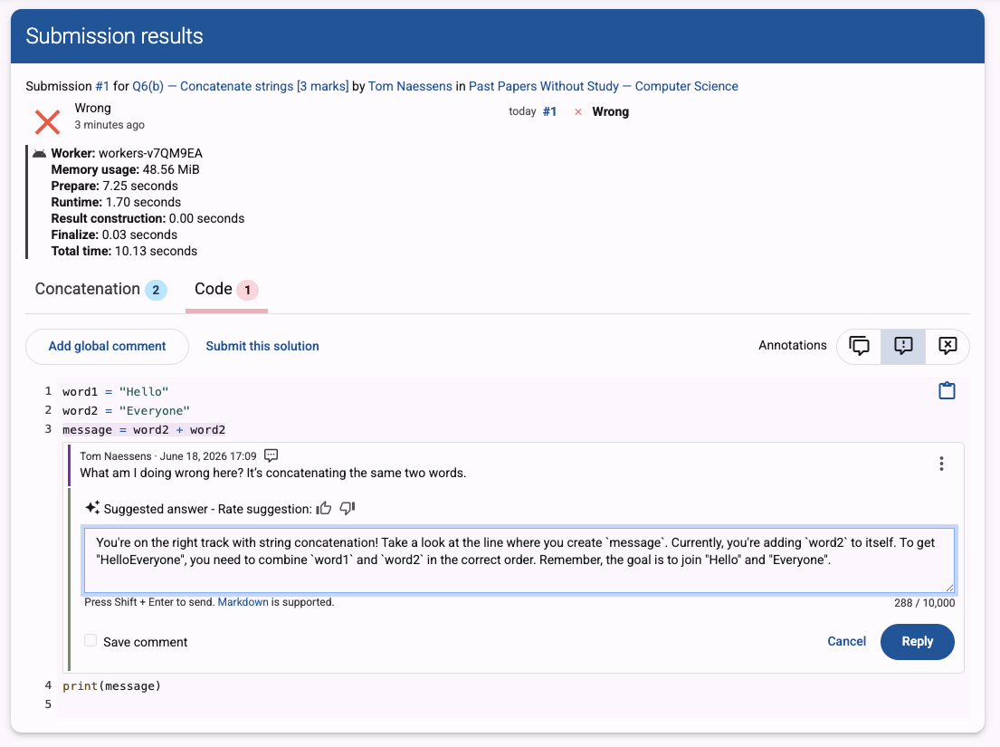
Dodona
AI ASSISTANCE
Human-augmented AI, teacher in the loop
Dodona has developed its own human-augmented AI approach that helps teachers answer students' questions more effectively and quickly — always based on the teacher-in-the-loop principle.
Privacy-first & GDPR-compliant
Rooted in university research

Slide 9
Dodona
EXPLORE DODONA
Everything you need, fully online
20+ programming languages
Ready-made content
Support for more than 20 programming languages, from Python over Java to Haskell and beyond.
A vast collection of ready-made courses and exercises you can use right away.
Your own content
No install
Create your own reading activities, programming exercises and courses for your class.
Dodona runs entirely online — no local software installation required.

Slide 10
Dodona
JOIN THE COMMUNITY
Create and share your own content
We're helping to build a UK community of educators
who design and share high-quality content together.
Interested in joining?
Built by teachers, for teachers
Reach out · info@dodona.be

Slide 11
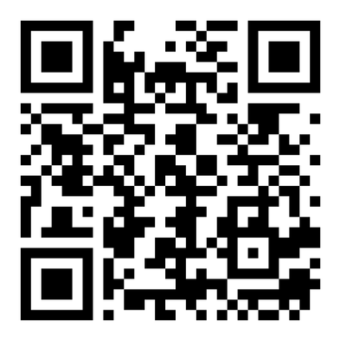
Dodona
Bring Dodona
to your classroom
Scan the code to register your interest and start your free trial.
www.dodona.be
Questions? info@dodona.be
Dodona Learning Technologies

