Slide 1
How To Train Your Dragon
Andy Colley
MrAColley@bsky.social
Who?
HOF Technology & HOD Computing @ Laurus Cheadle Hulme
AST/Lead Practitioner/CAS Master Teacher
LearningDust host

Slide 2
The biggest impact you can have as a HOD is to improve the quality of teaching in every classroom …..
….. so that all students get the best experience in their lessons.
Notes:
This is slide 3 – remember slide 3.
I will refer you back to slide 3 repeatedly.

Slide 3
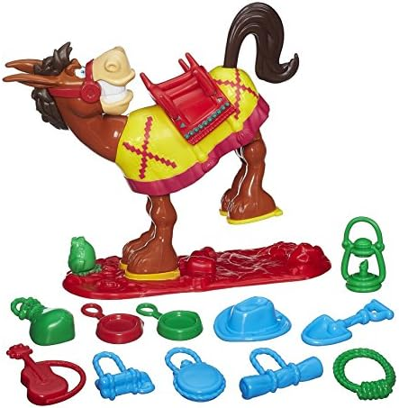
Staffing/
recruitment constraints
Subject knowledge
My vision for the dept
Advances in technology
Whole school priorities
“Because OFSTED”
Data analysis
SLT have been on a course
New course/
curriculum

Slide 4
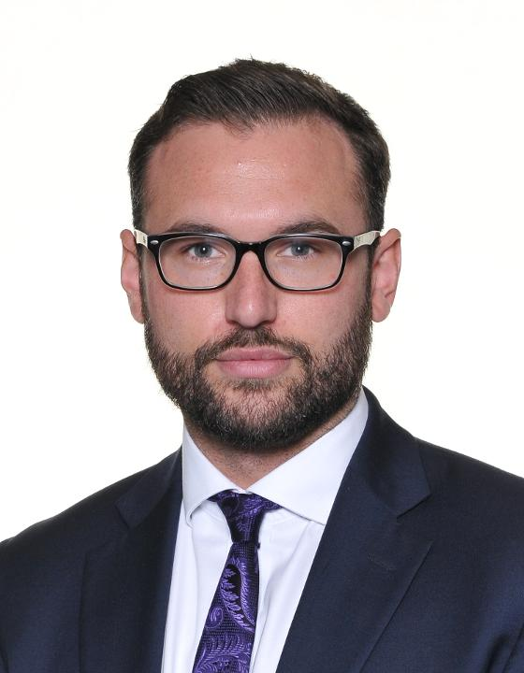
The SLT Link
Notes:
The important thing to remember is that these people work for you.
A well trained assistant head is a joyous resource to deploy.

Slide 5
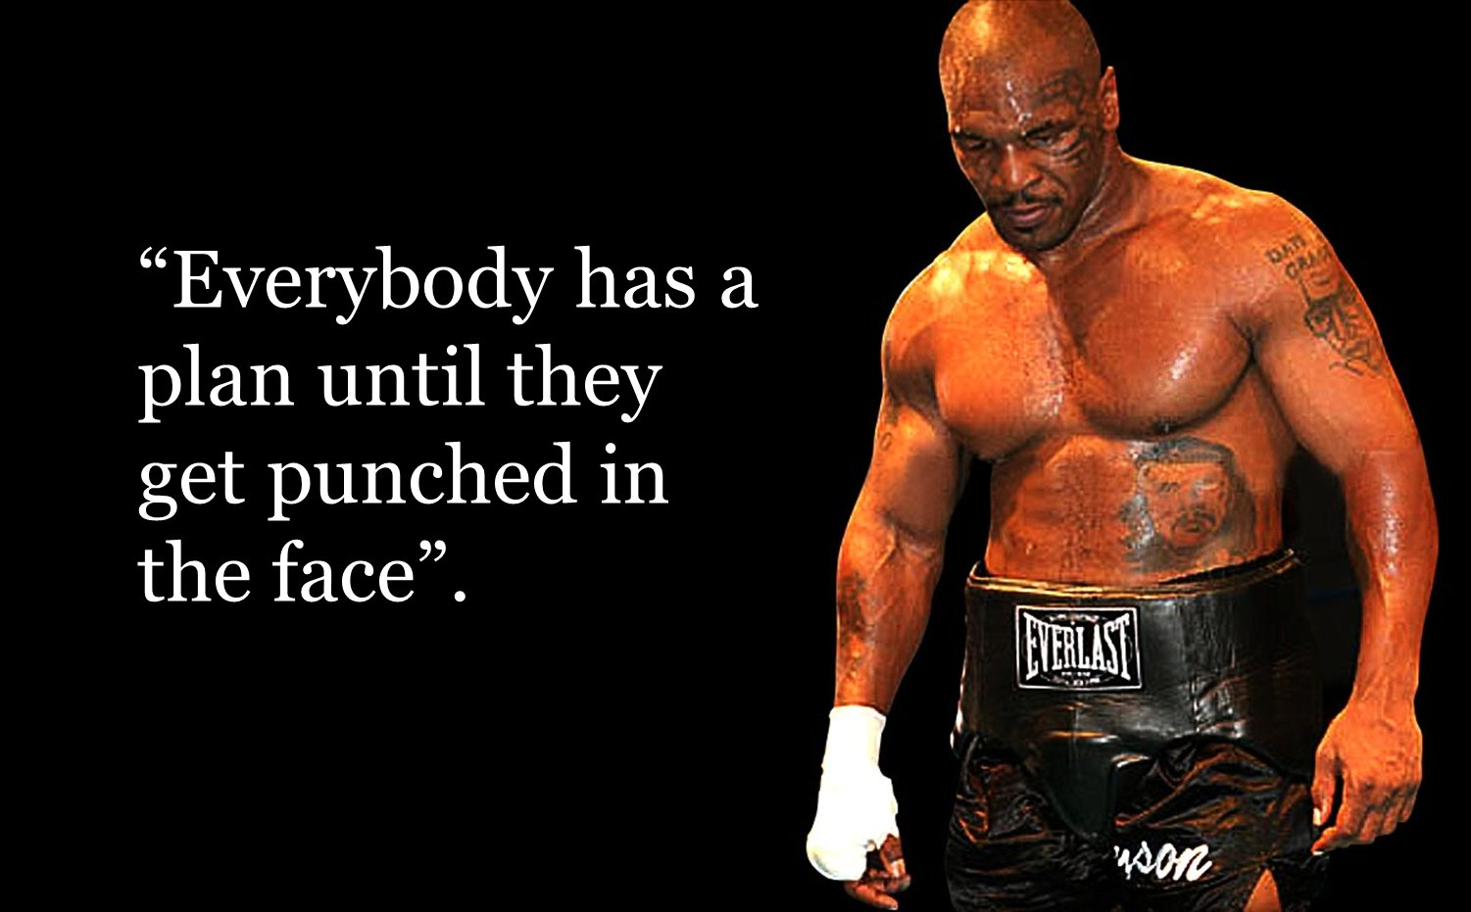

Slide 6
Deciding on a Priority

Slide 7


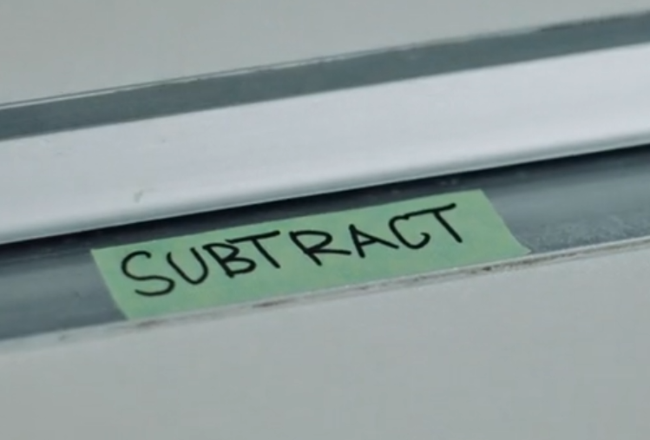
One priority
Notes:
One priority to rule them all……

Slide 8
What practical problems do we consistently face as teachers of Computing?

Slide 9
Parsing the Practice of Teaching
Mary Kennedy (2015)
Portraying the curriculum
Enlisting pupil participation
Exposing student thinking
Addressing student behaviour

Slide 10
What practical problem(s) do you want to focus your priority on?
Behaviour (behaviour, participation)
Curriculum (portraying)
  Content
  Sequence
T&L (portraying, exposing thinking & participation)
  ATTENTION
  Explanations/Subject knowledge
  Questioning
  Modelling
  Check for understanding
  Student participation
  …..
Notes:
This should feed into your action plan and form a big part of your conversations with your SLT link
Ideas for behaviour/bfl - How to pre-empt poor behaviour and avoid unnecessary confrontations in your classroom | Class Teaching (wordpress.com)
T&L -

Slide 11
What's your thing?
Notes:
One priority to rule them all……
SUBTRACT – A Chemical Orthodoxy

Slide 12
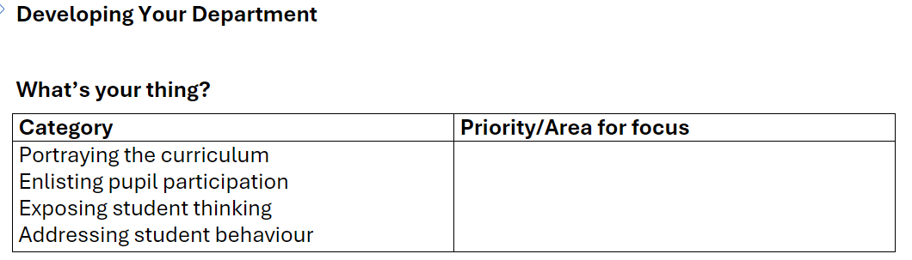

Slide 13

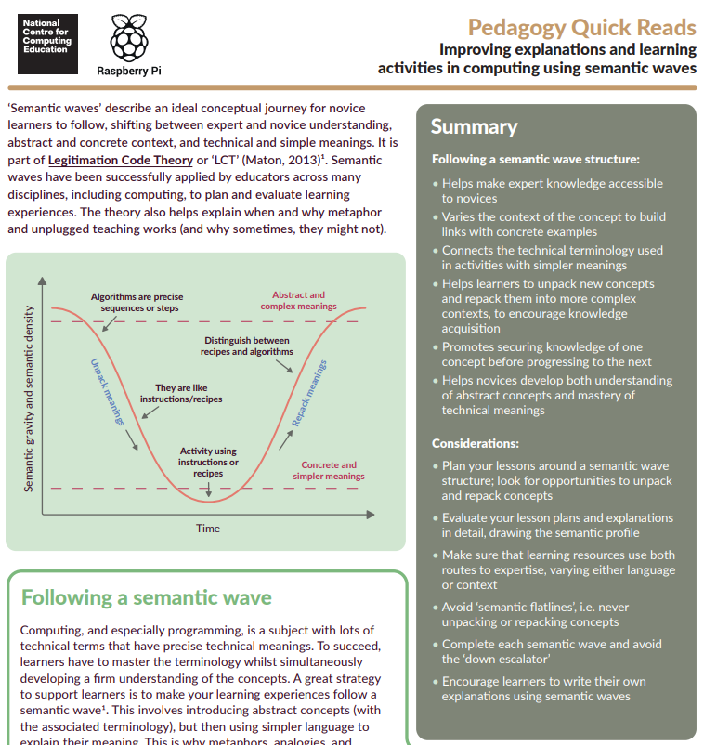
Managing up – tip #1 – deciding on priorities
SLT links love it when…..
You arrive with a clear idea of what you want to achieve
  Linked this back to a whole school priority
You help them to understand what to look for in your subject
  Give them something to read
You have a plan for a schedule of CPD that trains, monitors & reviews
You know what you want from them
Notes:
Oracy – train staff in managing pair talk to get more students discussing, cold call to give all a chance to speak, say again better to improve the quality of student talk…….

Slide 14
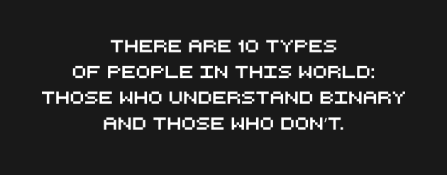

The SLT Link

Slide 15
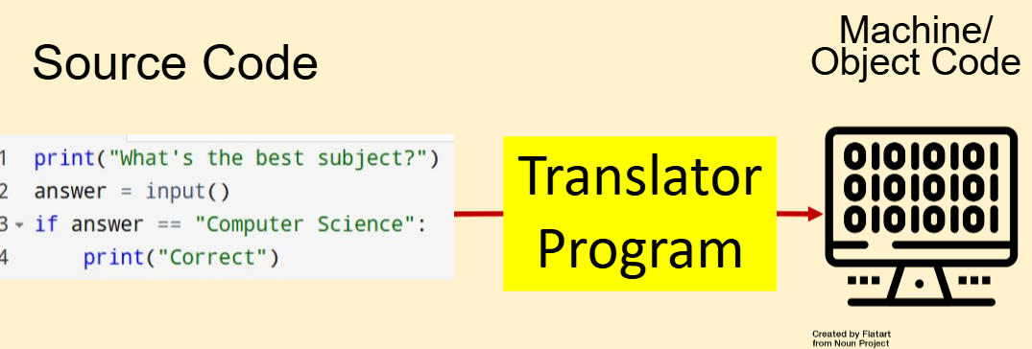
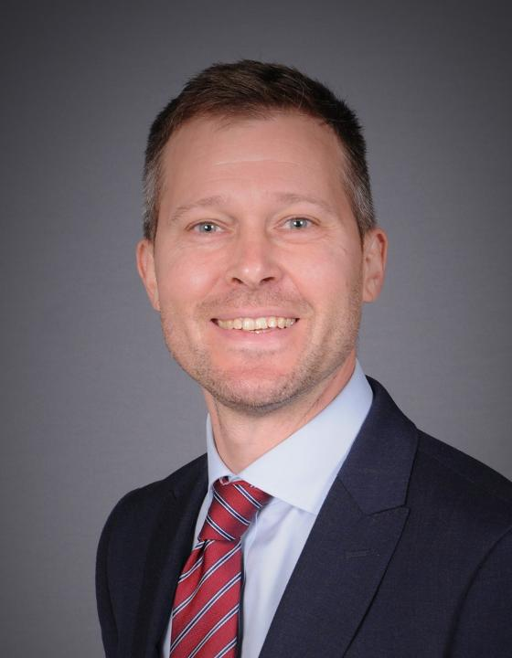
Subject Translation Tool

Slide 16
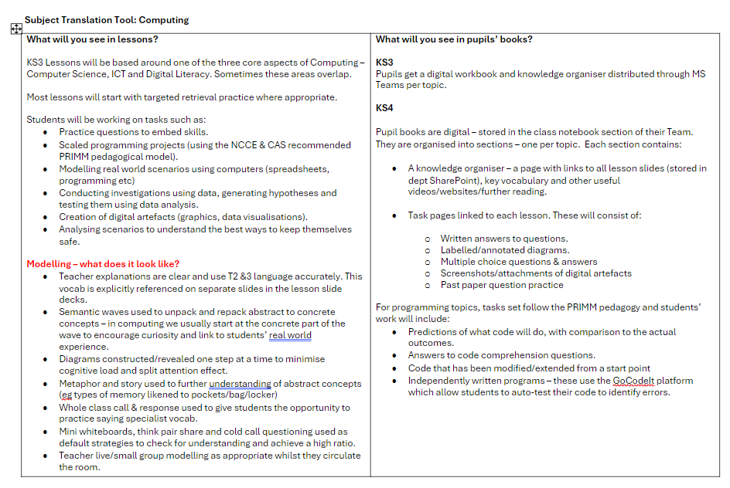
Subject Translation Tool

Slide 17
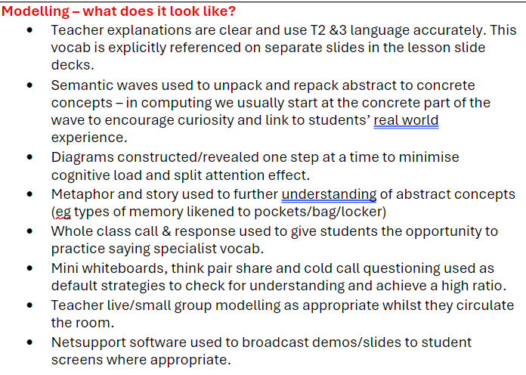
Subject Translation Tool

Slide 18
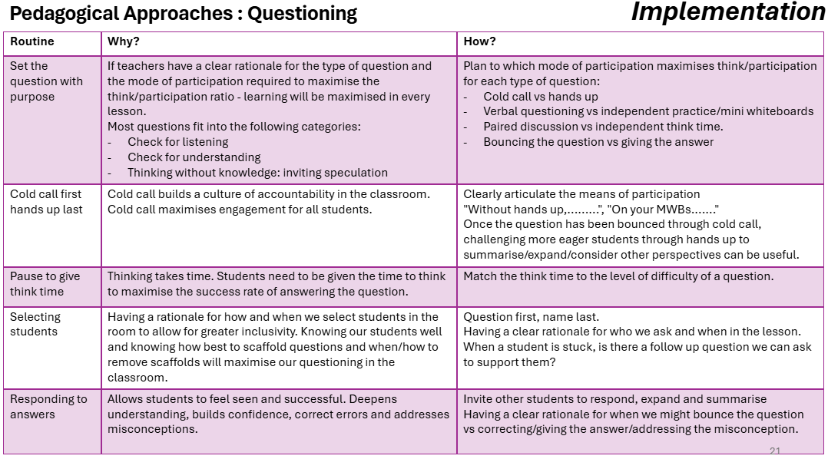

Slide 19
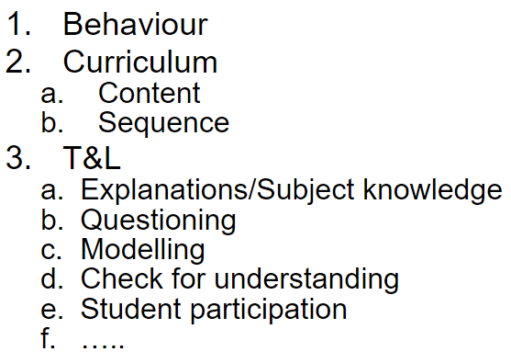
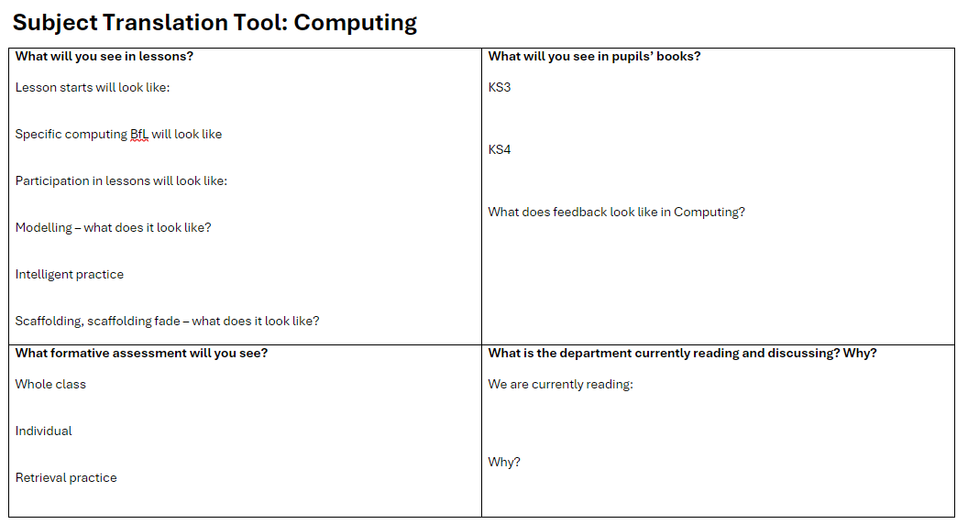
Your priority - Plan the translation tool
Notes:
This should feed into your action plan and form a big part of your conversations with your SLT link
Ideas for behaviour/bfl - How to pre-empt poor behaviour and avoid unnecessary confrontations in your classroom | Class Teaching (wordpress.com)
T&L -

Slide 20
Communicate & Train

Slide 21
Department meeting != CPD session

Slide 22
Managing up – tip #2 – running CPD sessions
SLT links love it when…..
The sessions are focused
It's part of a process, not an event
Detailed subject nerdery
They get a clear idea of what you want from them (translation tool)
They know what to look for afterwards (active ingredients)

Slide 23
Before
What are people preparing/reading/bringing?
Is there a community you are engaging with?
Is expert input needed? Who is best to provide it (in/out of dept)?
What are the ‘active ingredients’ that you want to see from your staff afterwards?
  What does the evidence look like?

Slide 24
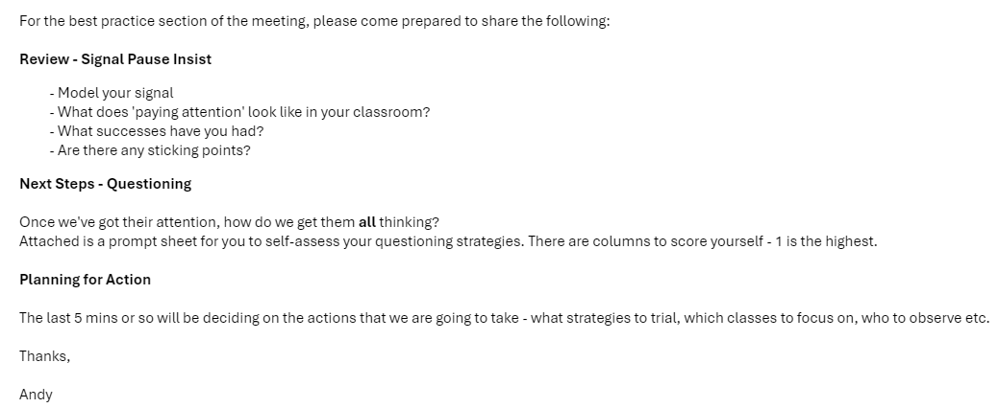

Slide 25
"Detailed Subject Nerdery"

Slide 26
Sustained subject engagement
The macro choices a department must make require continuous conversation with culture
  What substantive knowledge?
    (technical knowledge; factual content; practical skill)
  What disciplinary thinking?
    (computational thinking; maths skills; analysis; problem-solving)

Slide 27
Sustained subject engagement
The micro choices a department must make require continuous reflection on the efficacy of content positioning
  How do we ensure this element here makes possible that element there?
  What do they already need to know/do/understand to be able to access this?
  Why this. Why now?
We could call this the proximal role of knowledge.

Slide 28
Sustained subject engagement
Teaching needs to be enlivened by passion and enthusiasm. The teacher needs a relationship to the content being taught.

Slide 29
How good is our sequencing rationale for the following elements:
  Units of data, memory & storage
  Computer hardware, networks and data
2. What are the core knowledge, concepts and vocabulary at KS3 for computer hardware:
  What are the key parts of our explanations? Who does it best?
  How will students practice this? Written? Verbally?
3. A couple of staff are suggesting that we should deliver an AI ethics unit in Y9 instead of e-safety:
  What might be the advantages and disadvantages in such a switch in terms of the skills you would want pupils to access later (at GCSE, A Level)?
  What earlier topics might show their impact on pupils more readily in this unit than they would in e-safety?
  How might this consolidate and provide new reflection on topics typically covered in GCSE & A Level computing?

Slide 30
Plan it.......

Slide 31
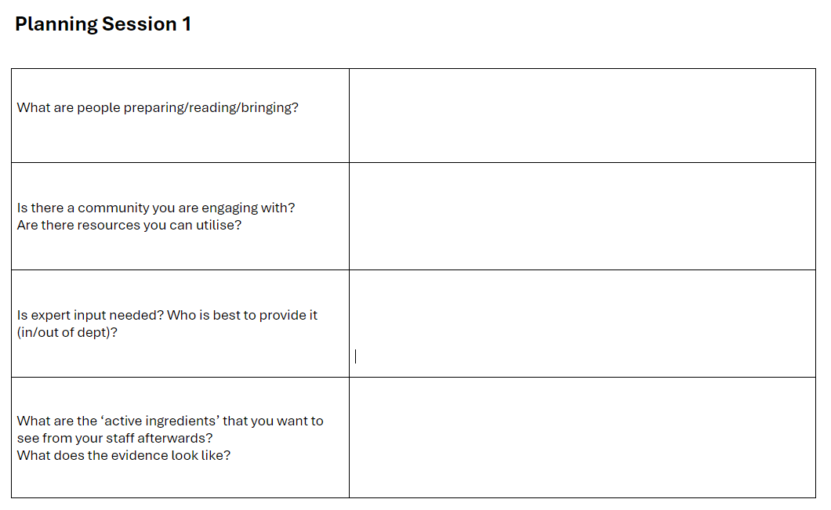

Slide 32
Where do we end up without this?
A lack of thoroughness in teaching, resulting in low expectations for in-lesson formative assessment
Moving on just because some students have displayed some attribute once, instead of over-learning to fluency.
Practicing the skill of analysis, answering the 8 markers, rather than the range of rich knowledge encounters or wider reference points that sit underneath this accomplishment
A ‘what can we get away with culture’ “They don’t need to do that in GCSE answers, so don’t bother teaching it…”
A fear of, or failure to, nurture robust curriculum debate within departments
Running a department meeting like a checklist, rather than valuing the subject/curricular discussion itself and the new shared meanings that result
A deficit model of engagement. Engagement is imported rather than a property of the content itself

Slide 33
During
Get your SLT link there
Feed back good stuff that you’ve seen
Modelling
Practicing – yes really!
Working on/refining/collaborative planning - question banks, subject knowledge, explanations.......
Really, really good discussions
Notes:
An SLT link with a really clear picture of what your priority is and what you are working on can be a goldmine
Use them to
Support you on obs/learning walks/work scrutinies etc.
Feed back to you from their drop ins
Help keep you honest – are you walking the talk?

Slide 34
During
Be clear about the active ingredients?
  Observable on learning walks?
  Work in books?
  Lesson resources
  Impact on test scores
Take away actions – ALWAYS the last 5 – 10 minutes
  New technique – have they practiced this?
  Who to observe? Which classes to focus on? What parts of lessons?
  By when?
Notes:
A culture of professional challenge – we’re all looking for this from everyone

Slide 35
After – Gather Evidence
What?
  Active Ingredients
    Fidelity – are people doing it?
    Are they doing it well?
When?
  Best time to observe?
  Teaching? Deploy the SLT link
Revisit
How does this feed into next session?
Notes:
You are changing habits – this takes TIME
Observing something once != habit
Get out there – get your SLT link out there
Praise in public, challenge in private
“Thanks for letting me drop in, can I just give you a bit of feedback”
Next CPD session – more work on this needed?

Slide 36
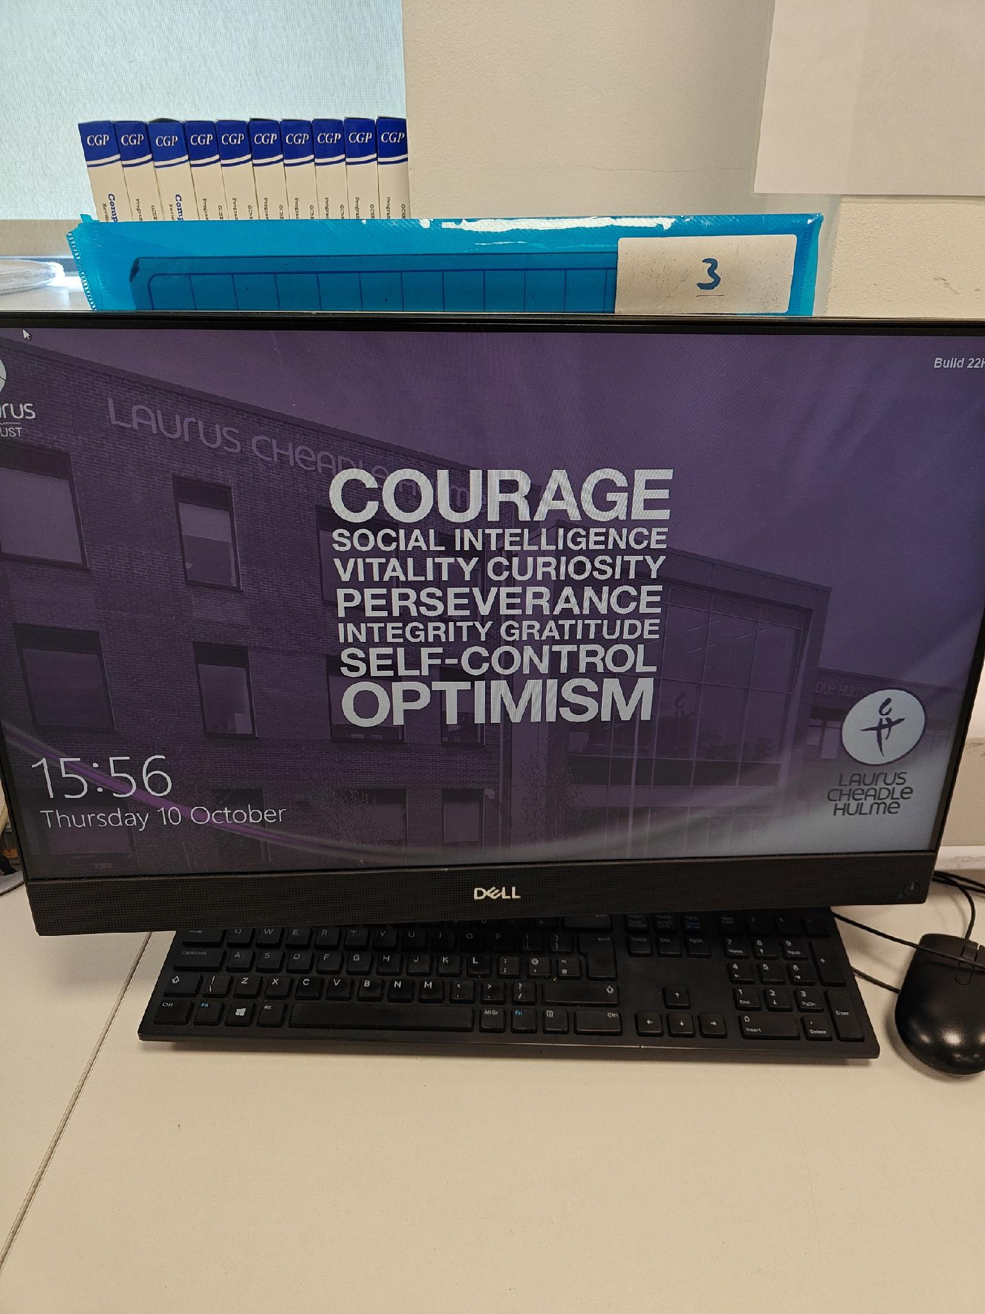
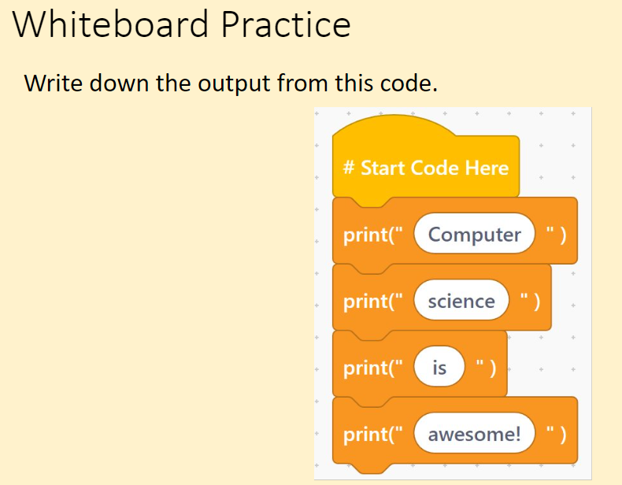
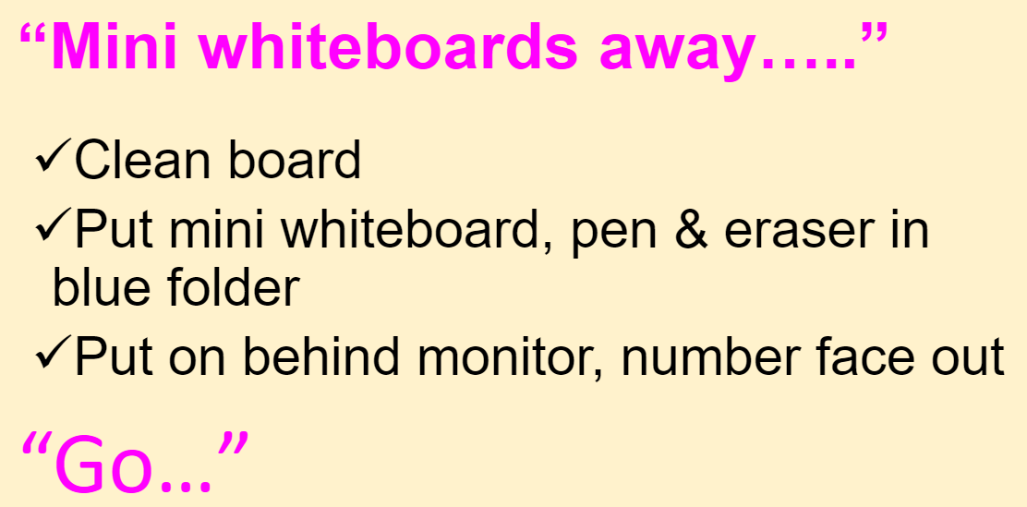
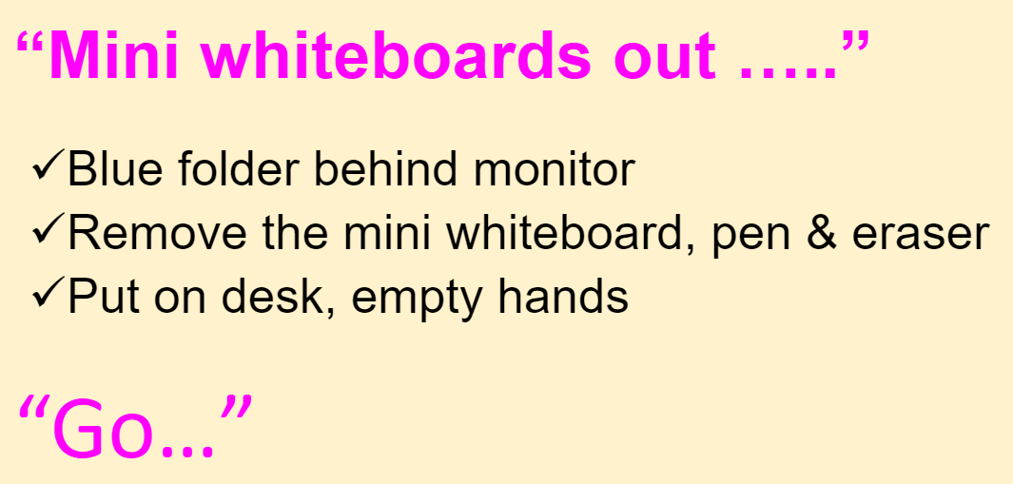
After
Notes:
Just because I taught him doesn’t mean he learned it.
Equally true of staff. Is this REALLY being implemented well?
We wanted to improve student participation and checks for understanding.
Bought MWB packs for every classroom.
Planned routines around MWBs – using 3,2,1 show me

Slide 37
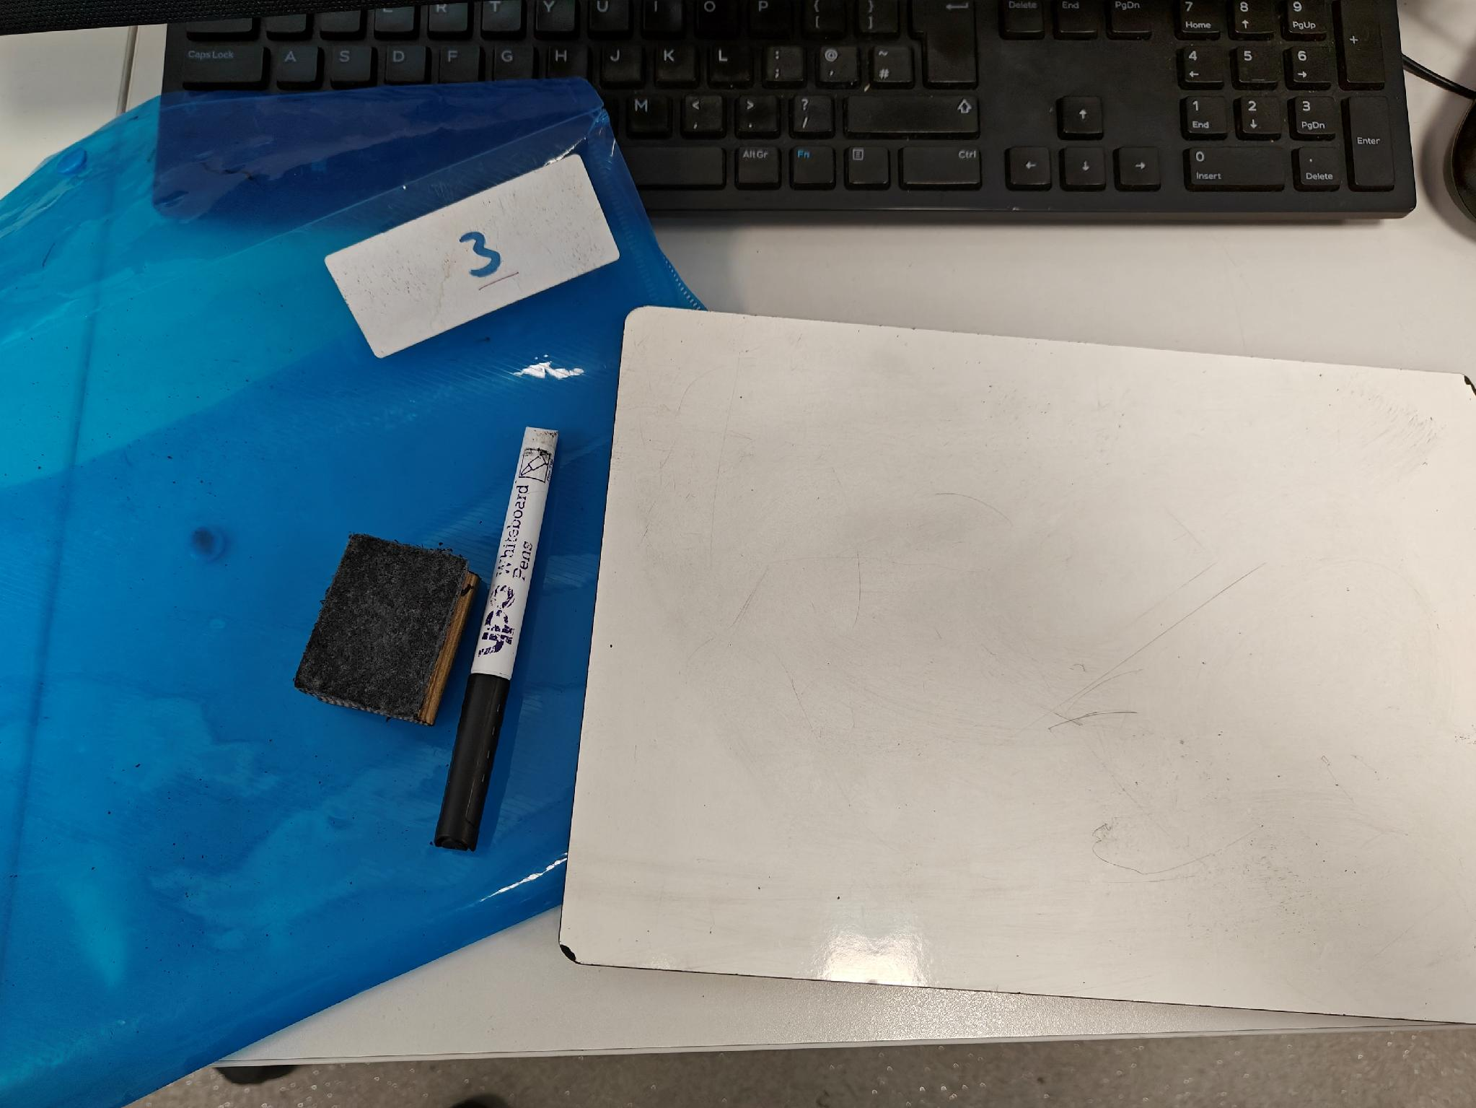
After
Notes:
Just because I taught him doesn’t mean he learned it.
Equally true of staff. Is this REALLY being implemented well?
We wanted to improve student participation and checks for understanding.
Bought MWB packs for every classroom.
Planned routines around MWBs – using 3,2,1 show me

Slide 38
Next Steps
What are you going to do/try in relation to your problem this week?
Fine detail on your priority
Meet with SLT link
Arrange time with non-specialists
Complete translation tool
Plan a CPD session
Plan when/what/who to monitor
Portraying the curriculum?
Enlisting pupil participation?
Exposing student thinking?
Addressing student behaviour?

Slide 39
