Slide 1
Build a 3D world in seconds with Flock XR
Dr Tracy Gardner & Rebecca Franks
Notes:
Rebecca welcome and intro herself
Passes to Tracy for brief intro

Slide 2
Spatial computing
Key vocabulary
“Spatial computing integrates the physical and digital worlds to build extended realities.”
Notes:
Tracy
What is spatial computing?

Slide 3
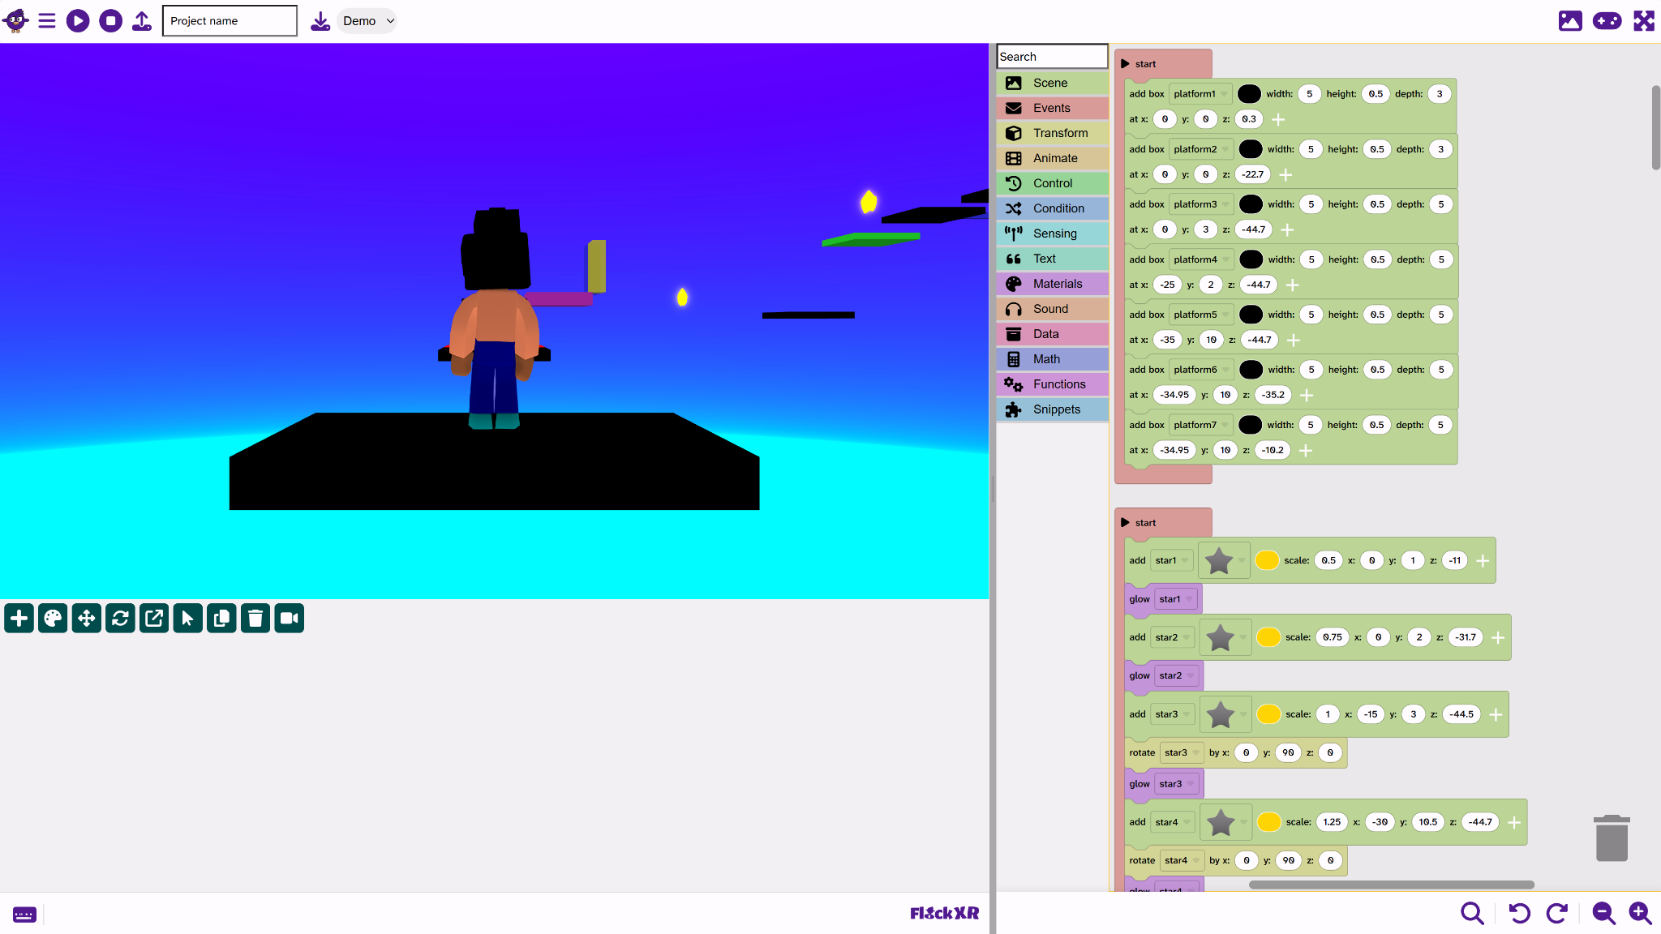
Notes:
Tracy
What is Flock XR?

Slide 4
Classroom setup
Flock XR is free and open source
No logins or subscriptions
Use directly in the browser
Can be downloaded as a web app for use offline
Get app.flockxr.com allow-listed by your technicians
Save and open files directly on the device
Share files on tools like Google classroom

Slide 5
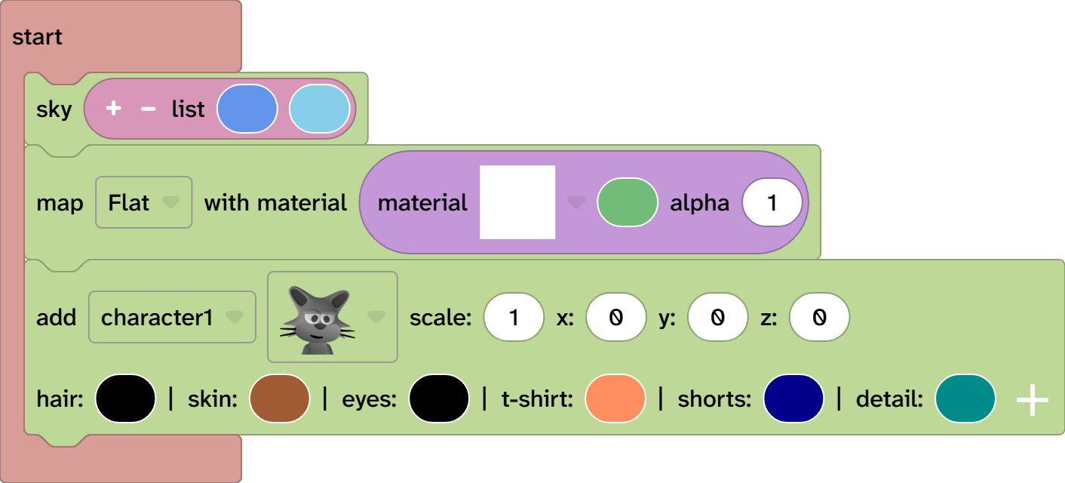

Using Flock XR with SEND learners
Visual blocks with lots of room for personalisation
Gizmo tools and colour picker
Reading age considered when designing blocks
Colour contrast friendly with themes to choose
Keyboard controls with more accessibility features on the way

Slide 6
Using Flock XR with SEMH learners
Learners with Social, Emotional and Mental Health needs found the tool engaging from the start.
The visual nature of the tool meant it was quick to personalise projects.
Learners enjoyed designing their own characters.
“Flock XR is a great application to work with learners with SEMH needs in upper primary and secondary schools, being engaging and easily customisable.”
Catherine Moore,
SEND in Computing Expert
https://sheffieldclc.net/programming-3d-worlds-in-flock-xr-with-students-with-social-emotional-and-mental-health-needs/
Notes:
Link to blog post: https://sheffieldclc.net/programming-3d-worlds-in-flock-xr-with-students-with-social-emotional-and-mental-health-needs/

Slide 7
Build a 3D world in seconds!
Notes:
Pass to Rebecca

Slide 8
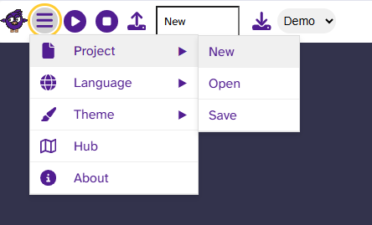
Find Flock XR
Go to flockxr.com
Click the Create with Flock XR button
Click the burger menu
Choose Project > New
Notes:
Rebecca gets everyone setup and runs through the first 3D world session
Gradient sky
Map
Character
Animate
Talk
Duplicate / await
Gizmos
Glow
Particle effect

Slide 9
Where it fits in the curriculum
Wherever you are teaching programming with Scratch you can teach with Flock XR
Perfect for key stage 2 and 3, ages 7 to 14+
Great for SEND and beginner programmers at key stage 4 & 5, ages 14-19
Go beyond coding!
Not just another block-based coding tool
Create 3D environments
Data visualisations
Spatial computing
Create 3D models for 3D printing
Science simulations
Creative projects

Slide 10
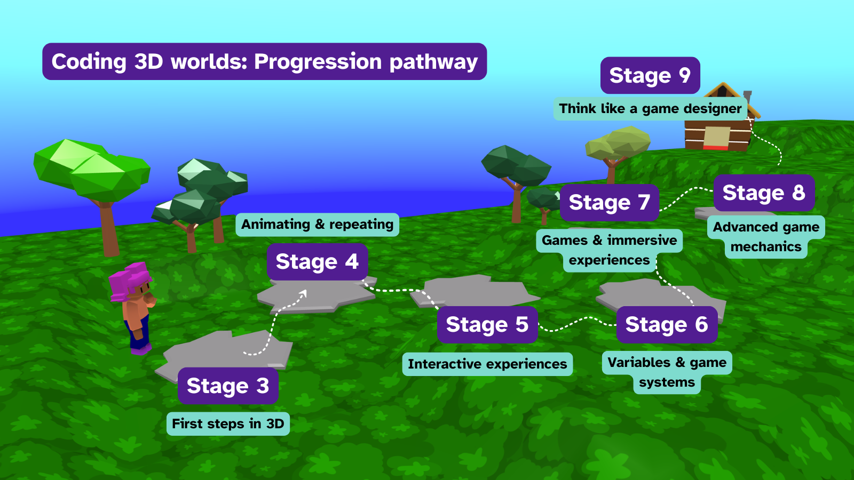
Notes:
Rebecca lets everyone know that there is a tried and tested ready to teach coding 3D worlds curriculum

Slide 11
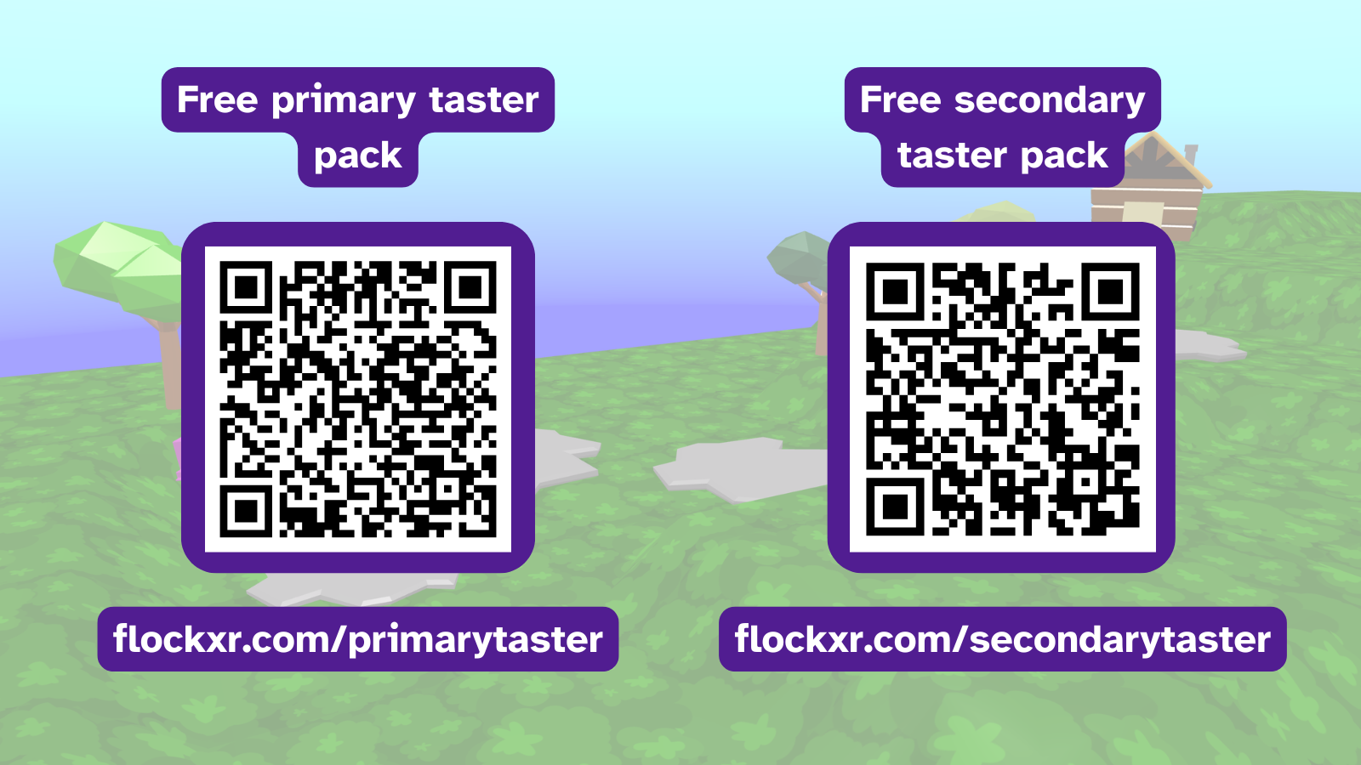
Notes:
Rebecca, here are the taster packs

Slide 12
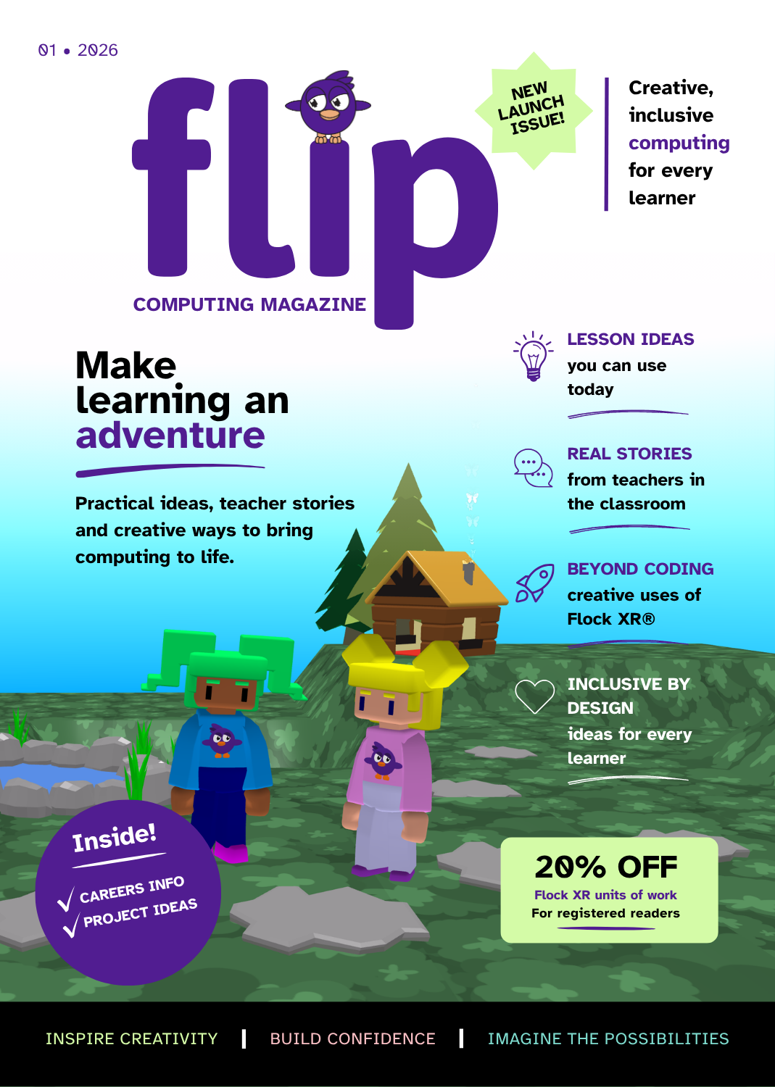
Flip computing magazine
Register today and receive an exclusive physical copy!
Register and receive 20% off our units of work.
flockxr.com/register

Slide 13
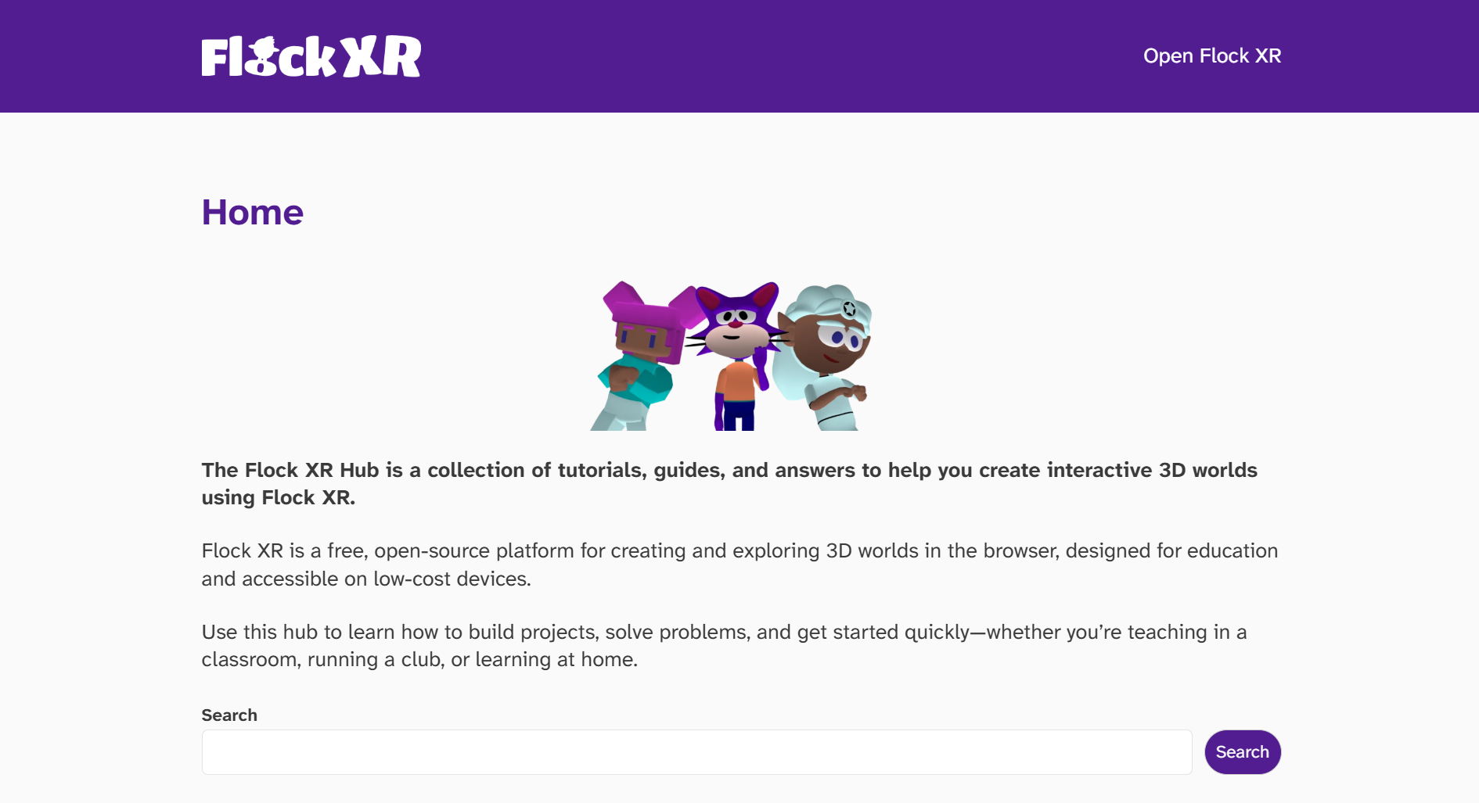
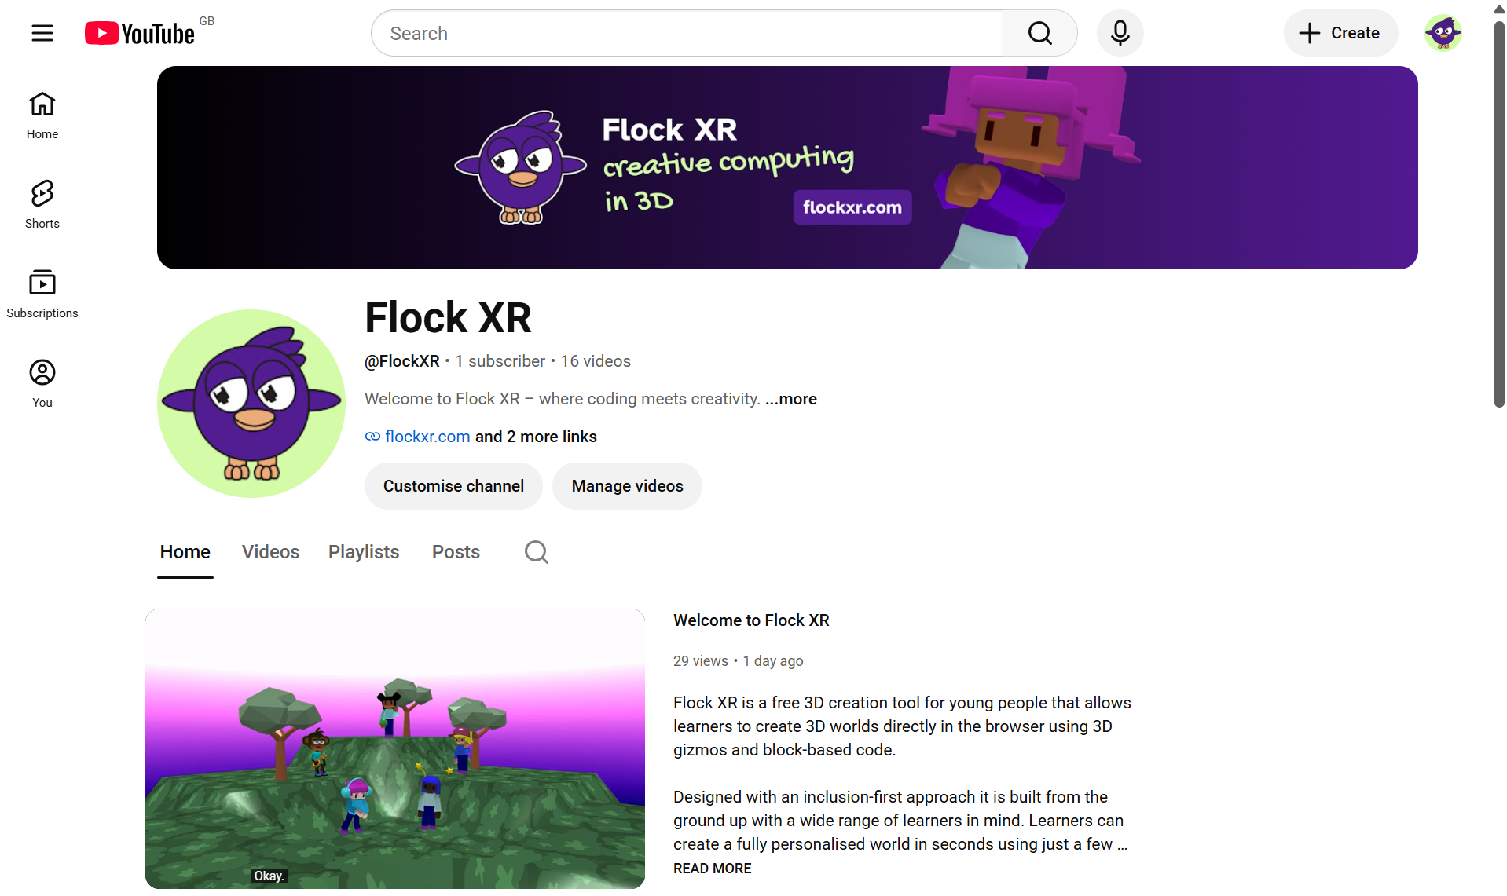
Support when you need it
The Flock XR Hub
hub.flockxr.com
The Flock XR YouTube channel
@FlockXR

Slide 14
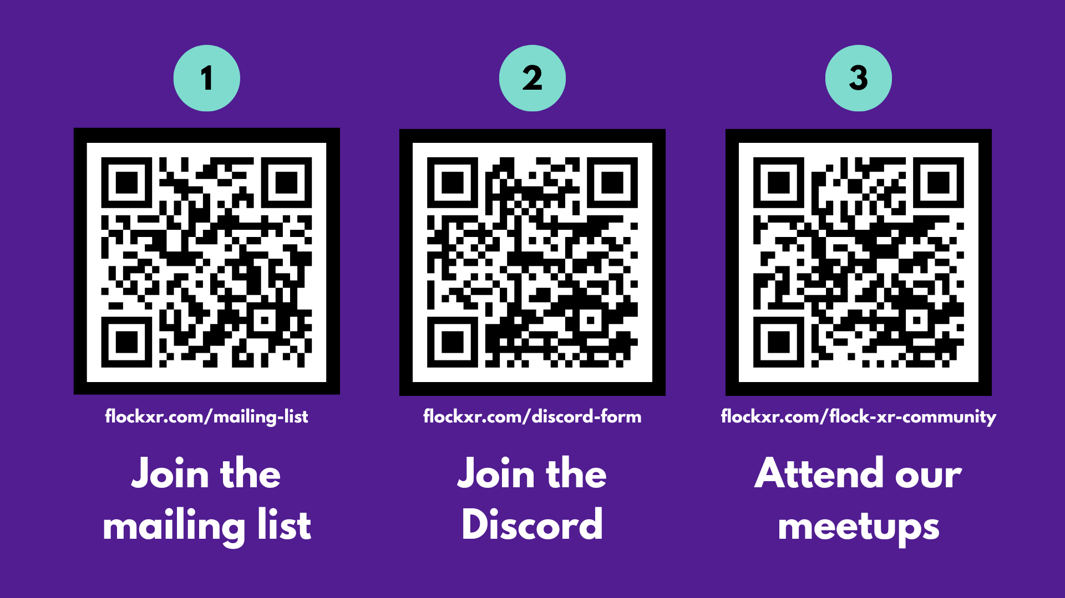

Slide 15
Thanks for supporting us!

