Slide 1
Inspiring &
Engaging Learners
in Computing
Alan O'Donohoe
Specialist Leader in Education, Exa Networks Ltd
Festival of Computing, July 2026

Slide 2
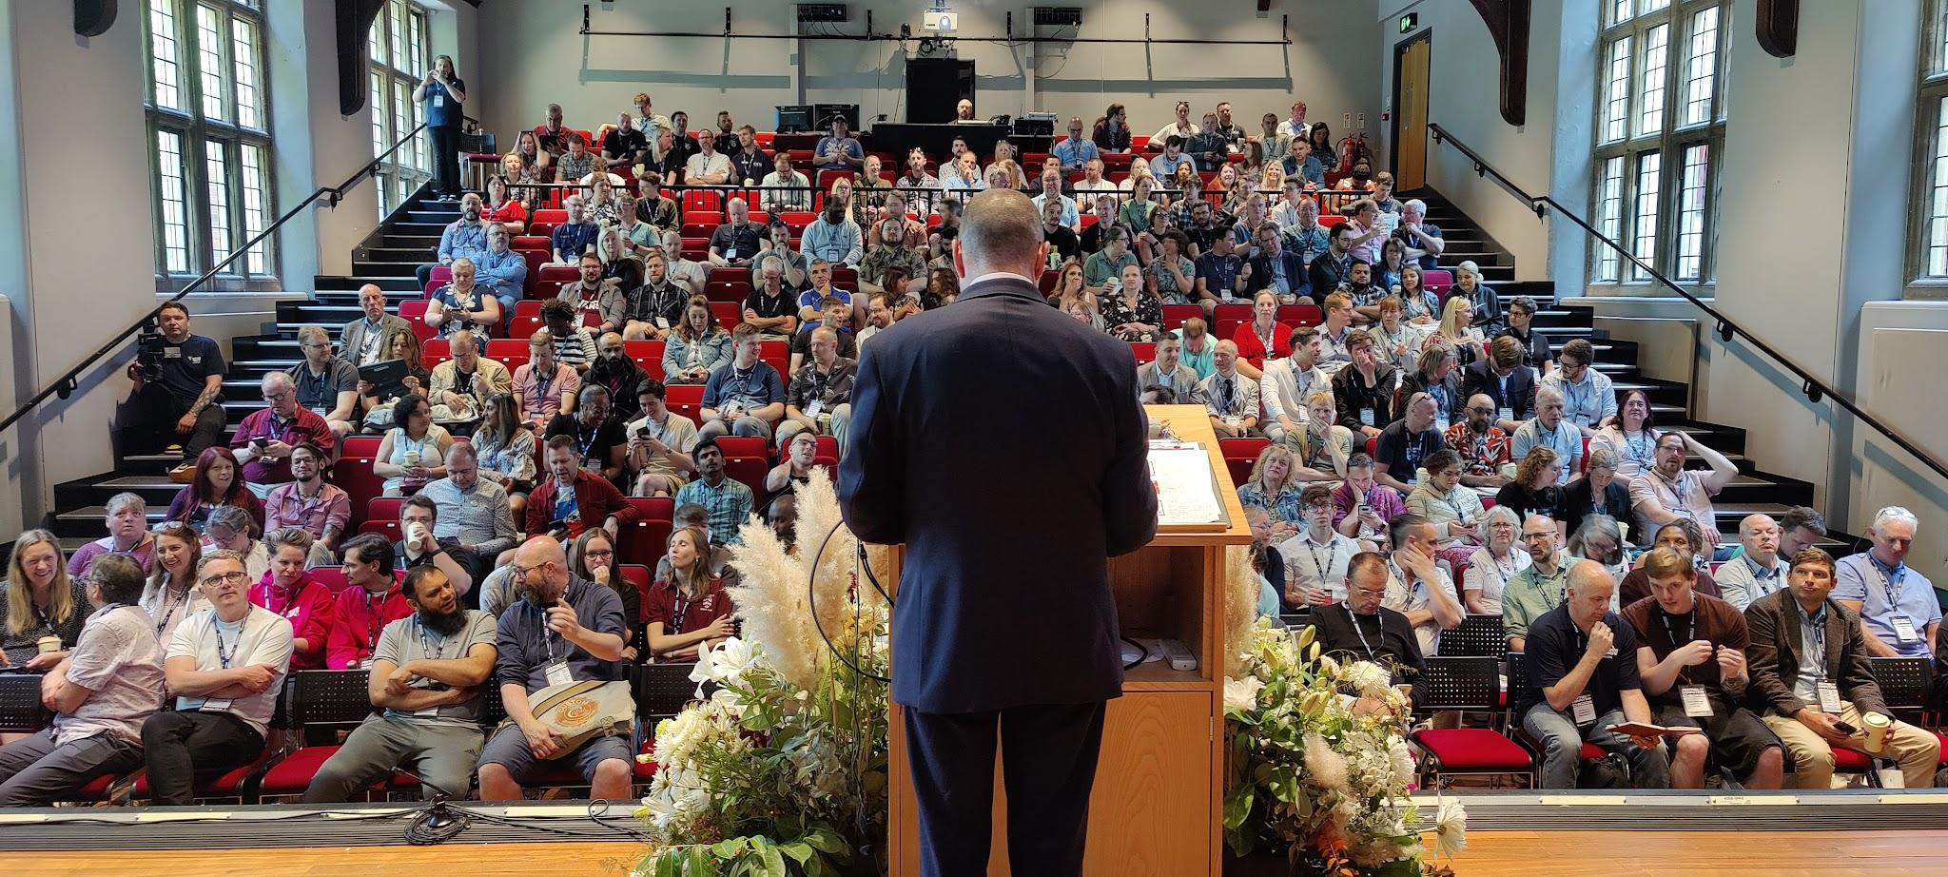
Getting To Know You

Slide 3
Resources:
These slides: http://exa.is/foc26
Free STEM events http://exa.is/ekoevent
The Exa Foundation http://exa.foundation

