Slide 1

Computing, AI and All Things Digital in the New Ofsted Framework
Notes:
This is not really a talk about technology. It's about what kind of adults we're preparing children to become in a world shaped by AI.

Slide 2
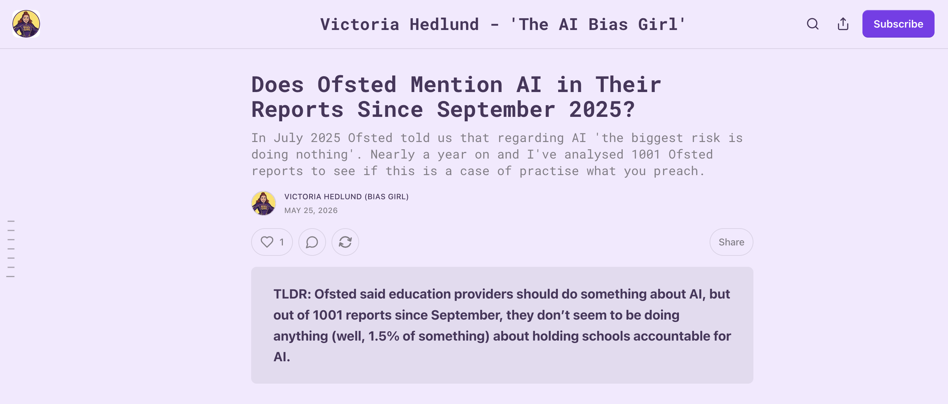

Slide 3
Does Ofsted Mention AI in their reports?
(Victoria Hedlund found)
AI appears surprisingly rarely in reports.
Most references relate to online safety.
Little discussion of leadership, governance or strategy.

Slide 4

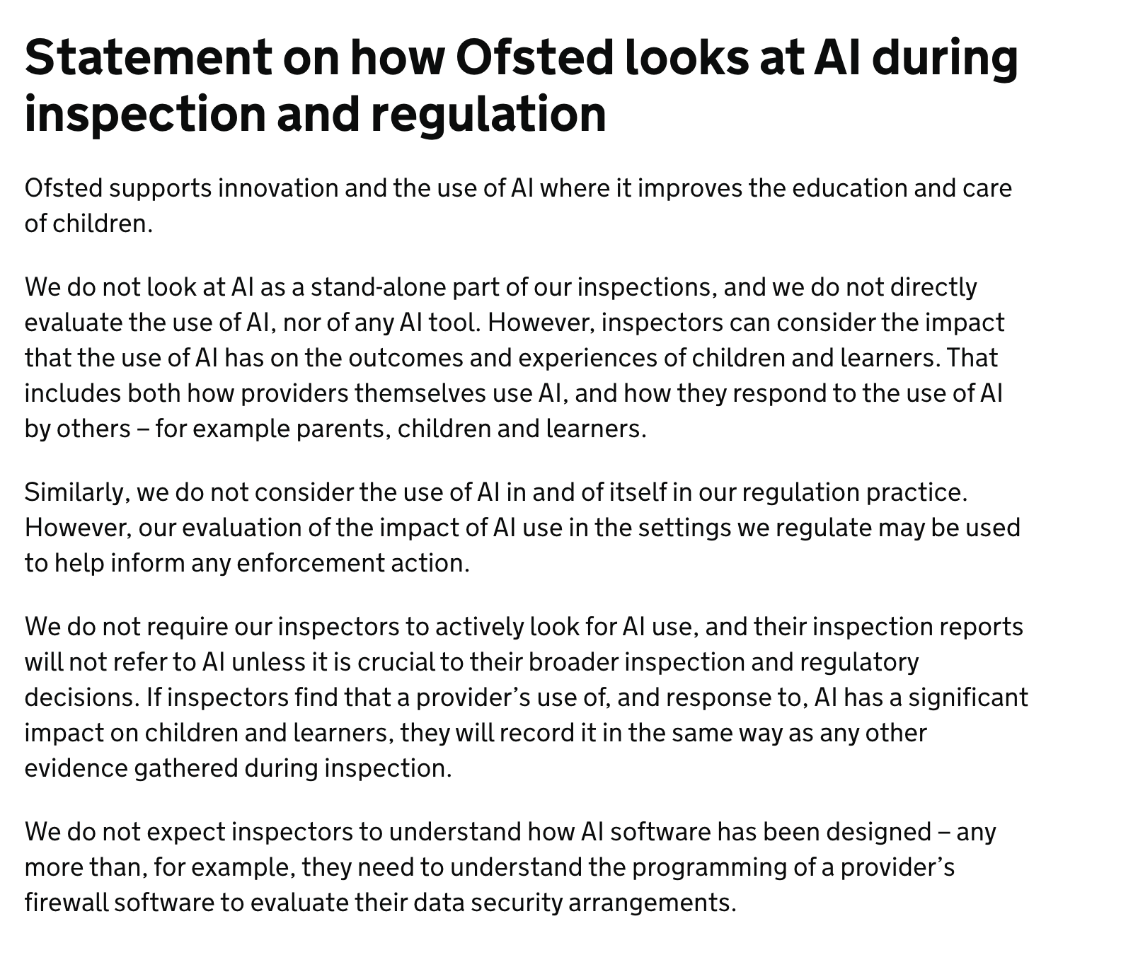
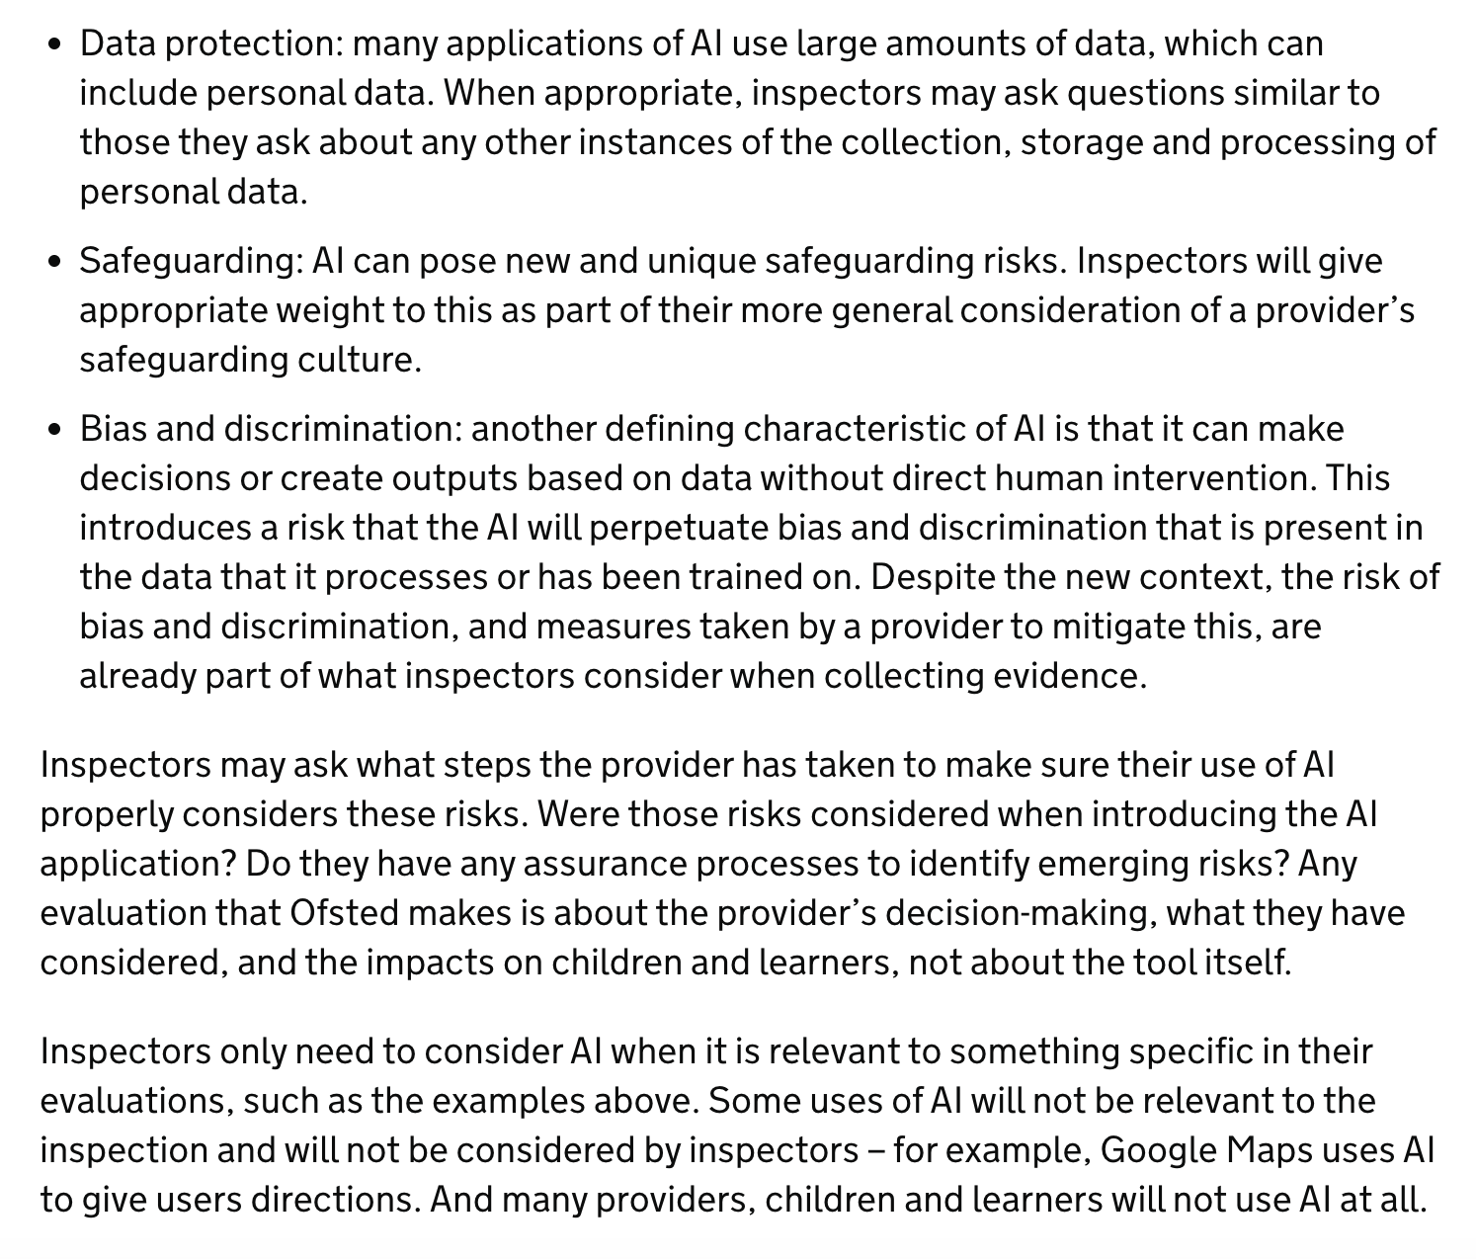
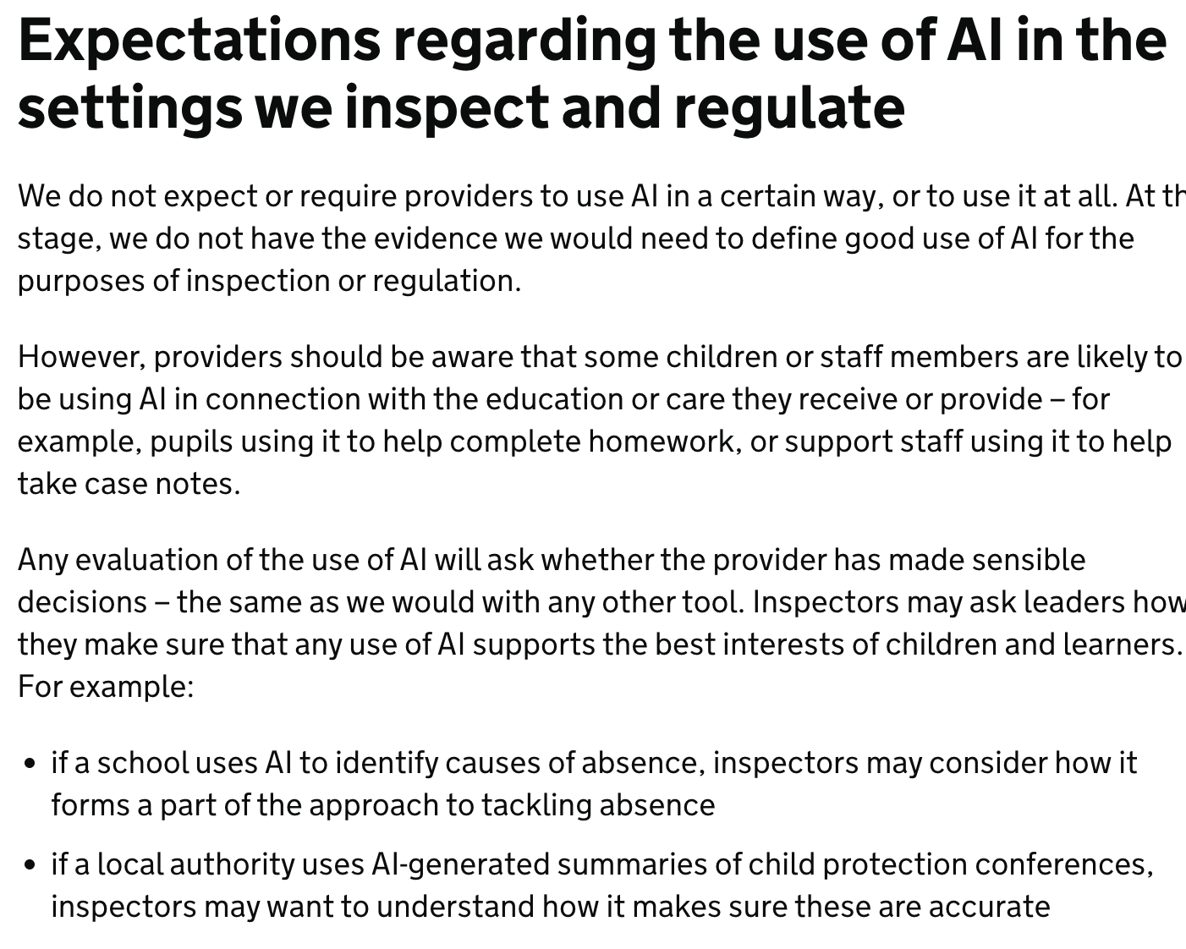
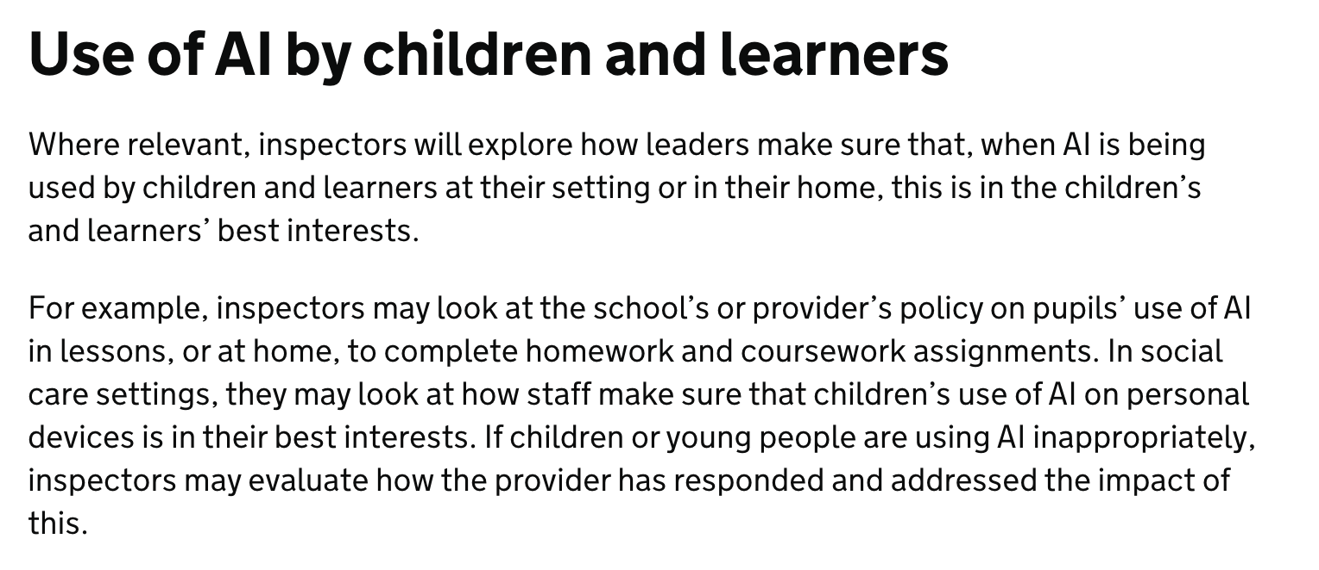

Slide 5
What Has Changed?
Technology now sits inside everything.
Achievement
Inclusion
Personal Development & Wellbeing
Attendance & Behaviour
Leadership & Governance
Safeguarding
Notes:
Technology now sits inside everything rather than it being considered a discrete element of school … it doesn’t have its own section. It would be like having an interactive whiteboards specific aspect of an ofsted inspection.

Slide 6
Ofsted and AI
Ofsted does not inspect AI directly
Does it improve outcomes?
Is it safe?
Is it inclusive?
Is it ethically managed?
Educational judgement matters.

Slide 7
The Three Questions Hidden Inside the Framework...
(that you need to be prepared for moving forward)
1. Are children safe?
2. Are children included?
3. Are children prepared?

Slide 8
Over to you…
The Ofsted Lens
What would Ofsted be concerned about? Why?
1. AI-generated homework A Year 9 pupil submits a high-quality history homework assignment. When questioned, they explain they used ChatGPT to generate a first draft, then edited it to include examples from class. The teacher is unsure whether to praise the effort, question the authenticity of the work, or treat it as a learning opportunity.
2. AI-written reports A primary school introduces an AI tool to help teachers draft end-of-year reports. Teachers save several hours of work, but some parents comment that the reports feel generic and don't fully reflect their child. Leaders argue that staff now have more time to focus on teaching and pastoral support.
3. Deepfake image A pupil creates an AI-generated image of a teacher that spreads quickly around school. Although it is clearly fake, several pupils believe it is real before staff intervene. The school removes the image and sanctions those involved.

Slide 9

There wasn't one "AI question" in any of those scenarios...
Every discussion came back to
Safeguarding – Is this in pupils' best interests?
Leadership – Have leaders thought this through?
Inclusion – Who benefits and who is left behind?
Achievement – What is the impact on learning?
Personal Development – Are pupils becoming thoughtful digital citizens?
Governance – Are risks understood and managed?
The new Ofsted framework doesn't ask, "Do you use AI?"
It asks,
"How are children experiencing education in a world where AI exists?"

Slide 10
What will Ofsted be concerned about?
Achievement
Inclusion
Personal Development & Wellbeing
Attendance & Behaviour
Leadership & Governance
Safeguarding
Technology now sits inside everything.
Notes:
Technology now sits inside everything rather than it being considered a discrete element of school … it doesn’t have its own section. It would be like having an interactive whiteboards specific aspect of an ofsted inspection.

Slide 11

UK policy has moved beyond a binary of
AI is Great vs AI is Bad
The Government's position is neither 'AI is the future' nor 'AI is a threat'. It is that AI has significant potential to improve education.
But only when its use is guided by educational purpose, robust governance, and the best interests of children.

Slide 12
Inspection Frameworks
Can See: attendance, behaviour, outcomes.
Can't easily see: student voice, digital identity, authorship, algorithmic influence.

Slide 13
Cultural Capital in an AI world
Books, museums, theatre, academic language.
Also, Algorithms, AI evaluation, information literacy, digital participation.
Notes:
Digital cultural capital is no longer about knowing how to use technology. It is about knowing how to understand, question and sometimes resist it.
How are invisible systems shaping children's experiences?
Children increasingly experience the world through algorithms.
Algorithms determine:
what information appears
what news is seen
which videos are recommended
what AI suggests
which answers seem most plausible
The danger isn't simply misinformation.
It's becoming unaware that these systems are shaping our choices.
Critical digital literacy therefore becomes less about spotting fake news and more about recognising that technologies actively mediate experience.
Ofsted link
Safeguarding
Inclusion
Personal Development
Critical thinking

Slide 14
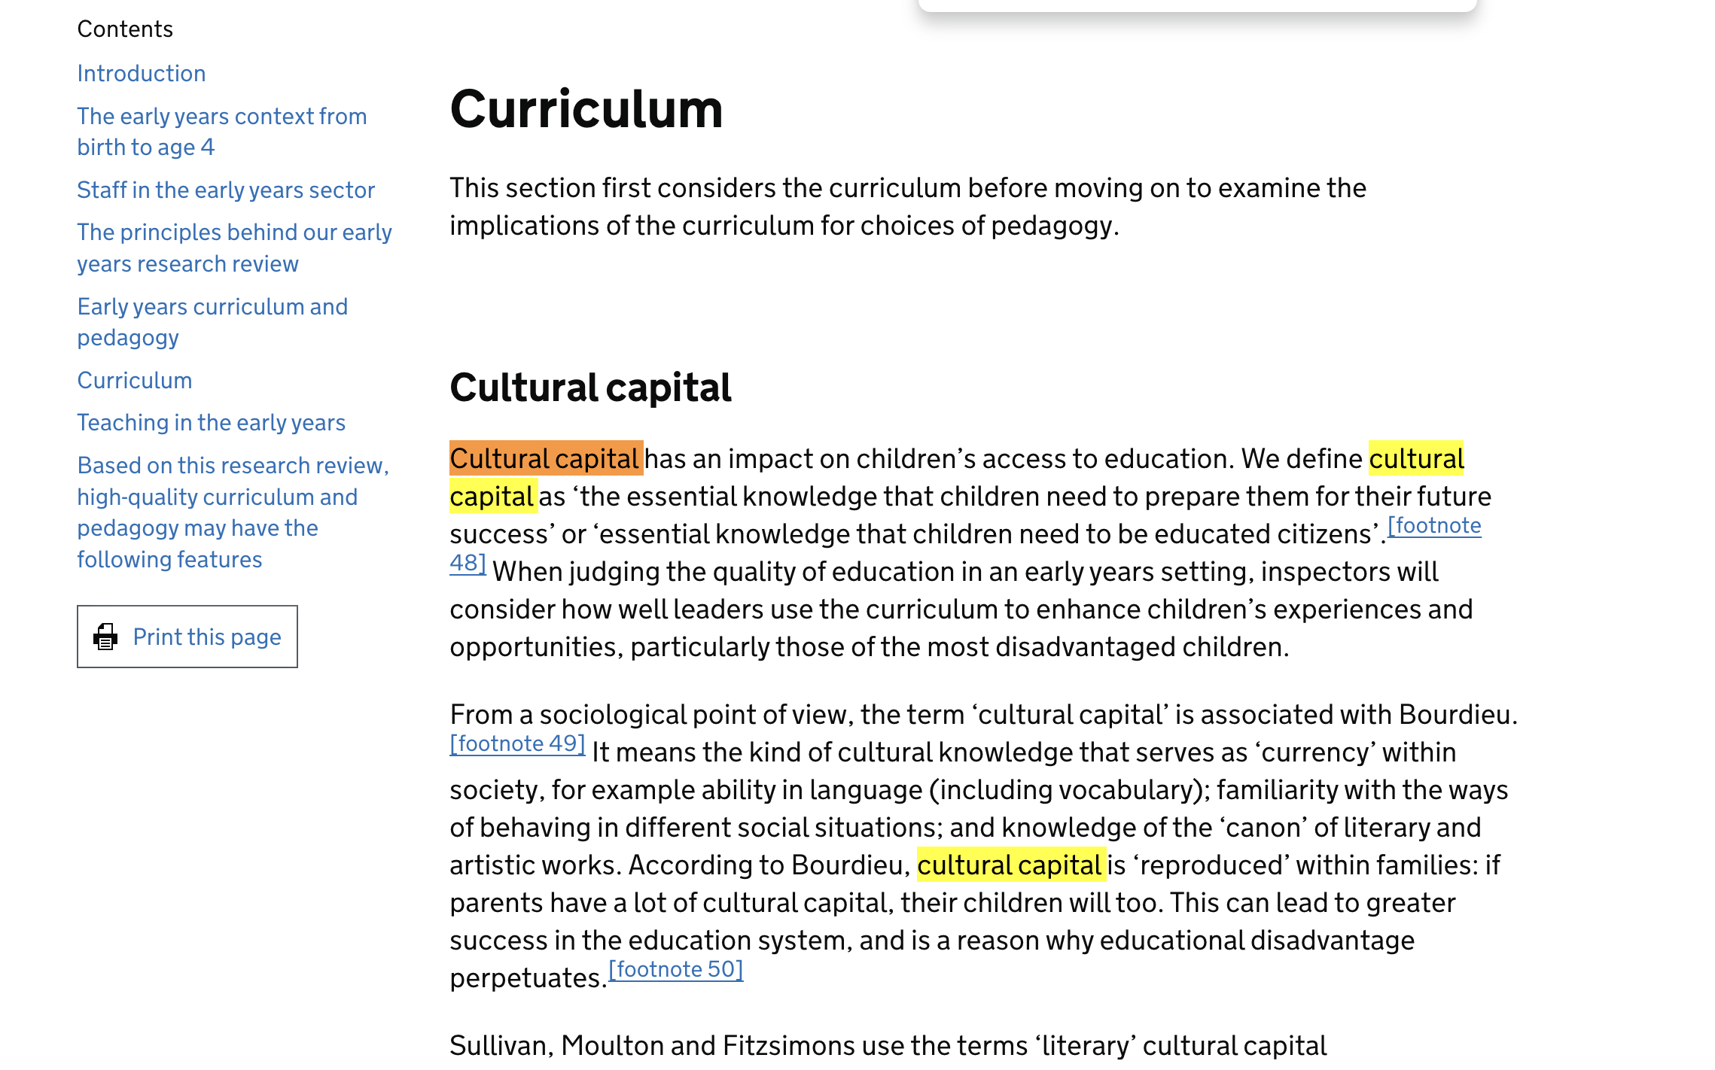
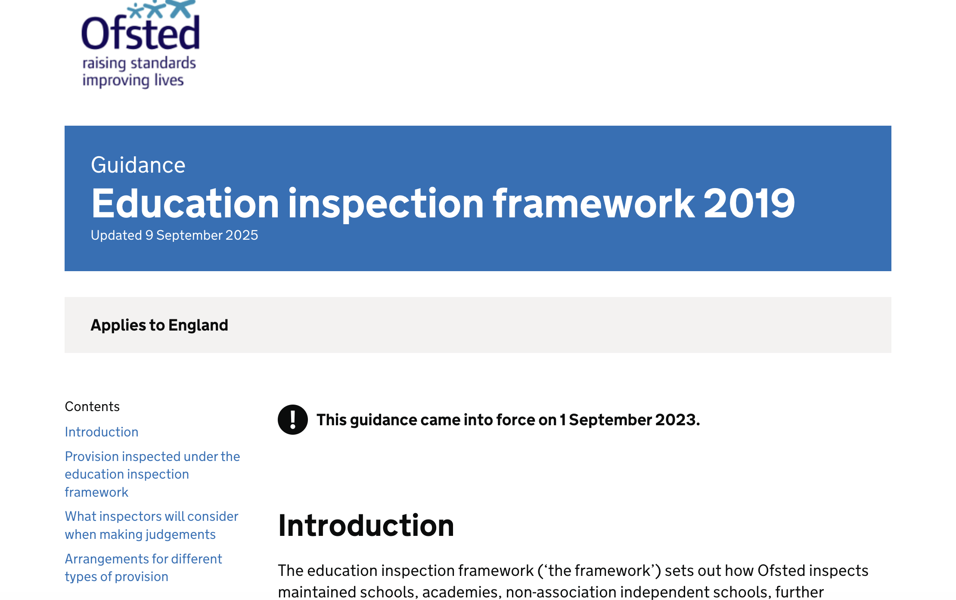
How Ofsted Inspects Cultural Capital
Inspectors assess cultural capital as a core component of the Quality of Education judgement in both schools and early years settings. They look for…
Curriculum Intent: How well leaders design the curriculum to go beyond just passing exams, actively broadening horizons and teaching pupils about the wider world.
Access and Equity: How the school removes barriers so that all children, regardless of background, can engage in enriching experiences.
Preparation for Adulthood: Equipping students with the practical knowledge to navigate society and their future careers,

Slide 15
New Digital Cultural Capital
Can pupils challenge AI outputs?
Spot misinformation?
Understand bias?
Protect data?

Slide 16
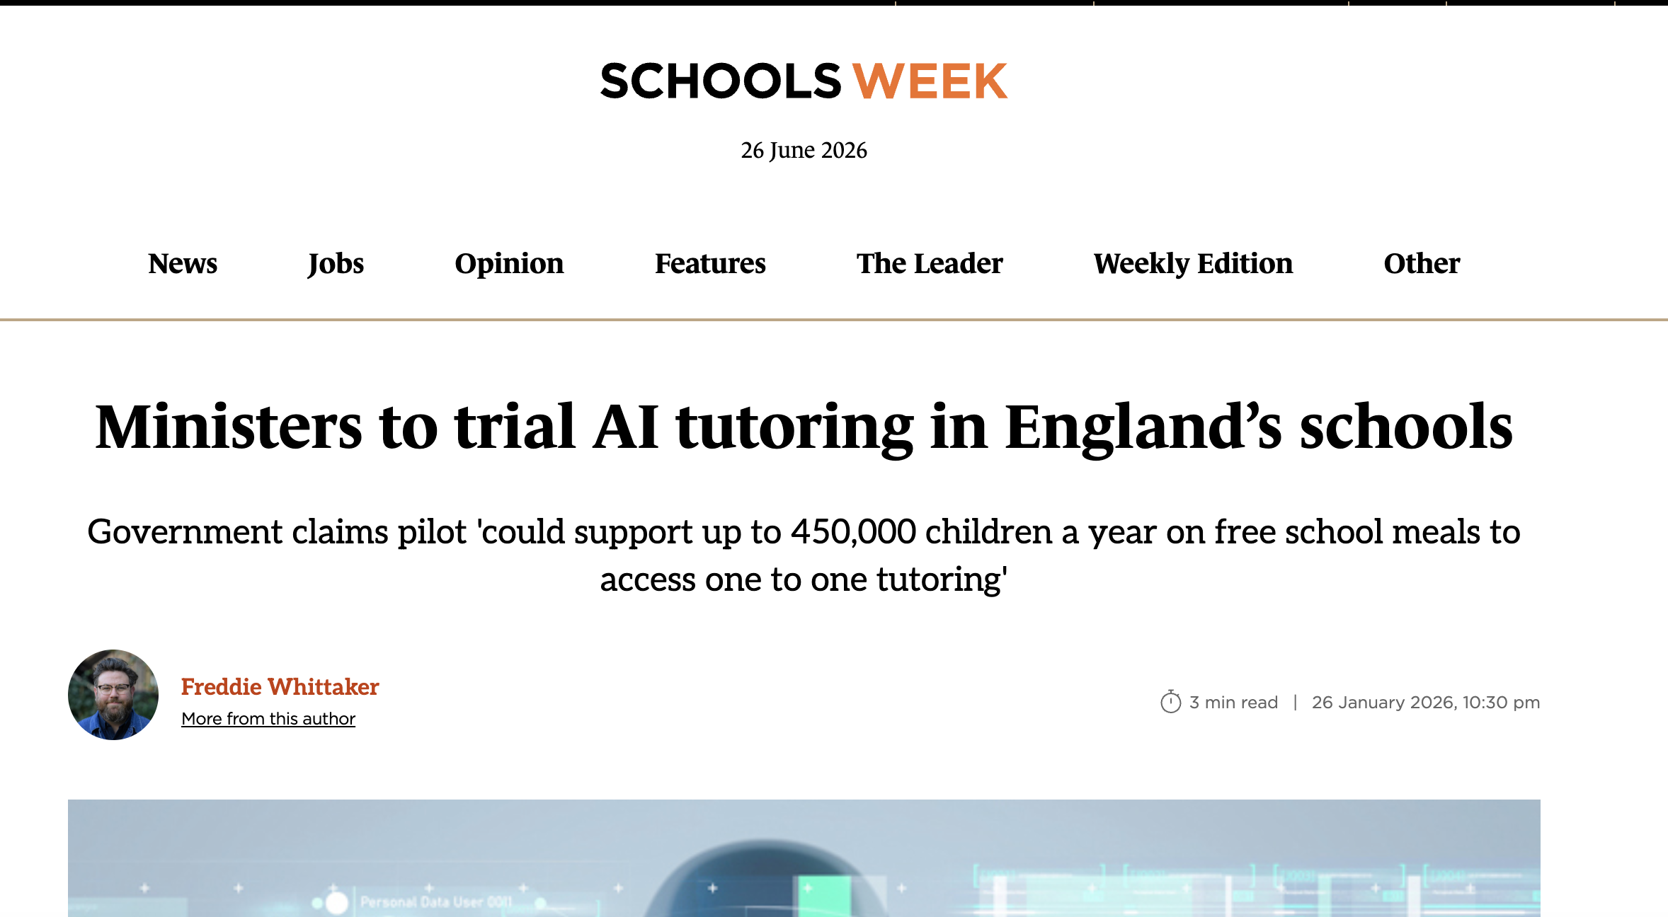
AI tutors?
How should schools evaluate AI tutors in the best interests of children?
If the problem is…
"Teachers don't have enough time to provide individual feedback” then AI tutoring might genuinely improve learning.
If the problem is…
"We want to save money by replacing human interaction” that's a very different proposition.
Notes:
https://schoolsweek.co.uk/ministers-to-trial-ai-tutoring-in-englands-schools/

Slide 17

Instead of asking "Do you have an AI tutor?"
Ofsted questions become …
Outcomes = Is it improving learning? How do we know?
Experiences =How are pupils experiencing it? Do they feel more confident? More independent? More motivated?
Inclusion = Is it reducing or widening existing inequalities?
Best interests = Does it complement teaching or gradually replace opportunities for human interaction?
Governance = How have we evaluated it? What evidence are we collecting? How do we monitor unintended consequences?
Notes:
Notice how none of those questions are really about AI. They're about educational leadership.
The government increasingly views AI tutoring as an equity strategy. The reasoning is fairly compelling. Only relatively affluent families can usually afford regular one-to-one tuition. If AI can provide high-quality personalised support at scale, then pupils who currently receive no additional help might gain access to something much closer to personalised tutoring. That's the rationale behind the planned programme for disadvantaged pupils. That aligns beautifully with Ofsted's focus on inclusion.
But... If AI tutoring becomes widely available... what exactly are we hoping children gain from it? Just higher grades? Because if education is about:
judgement
dialogue
confidence
appearing in the world
developing one's own voice
then we also have to ask: Which parts of learning should remain fundamentally human? That isn't an argument against AI tutoring. It's an argument for being clear about what we think tutoring is for.

Slide 18
Reflection
How clearly is that purpose articulated in your school when it comes to its use of technology ?
If Education is to help young people participate in, question and change the world, then…

Slide 19

AI simply changes the conditions under which children now learn, develop relationships, form identities and participate in the world.
The challenge for schools is not keeping up with technology.
It is making sure that, as technology changes, we do not lose sight of the educational experiences that matter most.

Slide 20
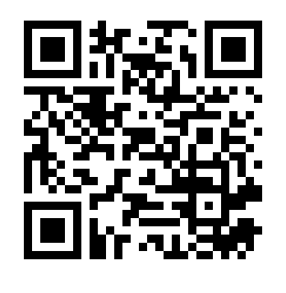
Notes:
app.riffbot.ai/v/2810/386

Slide 21
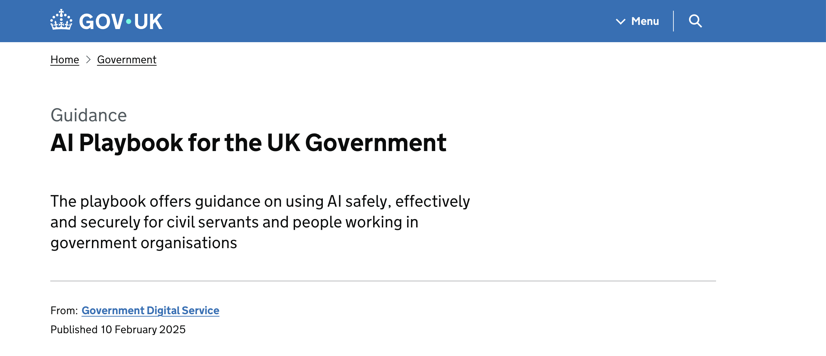
https://www.gov.uk/government/publications/ai-playbook-for-the-uk-government

Slide 22
The 10 core principles for the safe, responsible, and effective use of artificial intelligence (AI)
IN SCHOOLS
1. Understanding Capabilities and Limitations Schools must recognise that AI systems are not guaranteed to be accurate and currently lack reasoning and contextual awareness. Educators should be aware that outputs, such as lesson plans or student feedback, are "statistically informed guesses" rather than verified facts. Avoid over-reliance on AI for professional advice or critical educational judgments.
2. Safeguarding and Data Protection Schools handle sensitive personal data, making compliance with UK GDPR and the Data Protection Act 2018 paramount. Before implementing a new AI tool, schools should conduct a Data Protection Impact Assessment (DPIA) to identify risks to students' privacy. Be extremely cautious with biometric data (like facial recognition), which is considered a "special category" of data requiring enhanced protection and additional safeguards.
3. Ethical Use and Bias Mitigation AI models are trained on data that may contain historical or social biases, which can lead to unfair or derogatory representations of specific groups. In a school, this could manifest as biased grading suggestions or discriminatory filtering of educational resources. Conduct regular user research with a diverse sample of students and staff to identify if any groups are being unintentionally excluded or negatively impacted.
4. Meaningful Human Control Decisions that significantly impact a student’s future—such as admissions, grading, or disciplinary actions—should never be fully automated. Humans (teachers and administrators) must remain in the loop to validate outputs and intervene if the AI makes an error. Implement "human-in-the-loop" processes for any high-risk applications to ensure clinical or educational safety.
5. Security and Cyber Resilience Schools are targets for cyber-attacks, and AI can exacerbate risks like phishing or data leakage. Staff must be trained not to enter sensitive student information (official-sensitive) into public, unverified AI tools. Educate the school community on "prompt injection" (hacking a tool to make it behave unexpectedly).

Slide 23
6. Transparency and Accountability Schools should be open with parents and students about where and how AI is being used. If a chatbot is used to answer student queries, it must be clearly labelled so users know they are interacting with an automated system. Establish a clear Senior Responsible Owner (SRO), such as a Headteacher or IT Lead, who is ultimately accountable for the school's use of AI.
7. Governance and Continuous Monitoring AI tools can "drift" or become less accurate over time as data environments change. Schools should maintain an AI systems inventory to keep track of every tool in use, its purpose, and its associated risks.Set up an AI review process or committee to evaluate tools regularly against the school’s ethical values and educational goals.
8. Skills and Training Building an "AI-ready" culture requires upskilling staff. Teachers need the skills to use AI tools effectively and safely, while leaders need to understand the strategic and ethical implications for the school. Provide "sandboxes" or safe spaces where staff can experiment with AI technology without risking student data.
9. Choosing the Right Tool AI is not a "silver bullet" and may not be the best solution for every educational problem. Schools should evaluate whether a task is better solved through traditional technologies or human intervention.Start with a clear problem statement (e.g., "reducing teacher admin time") rather than starting with the technology itself.
10. Commercial and Vendor Management When buying AI tools, schools should work with commercial experts to ensure contracts include protections for intellectual property and data privacy. Check if model providers use sustainable practices, as AI training and deployment can have significant environmental impacts.

Slide 24
Non- negotiable professional boundaries
1. Never paste identifiable pupil information into public AI tools. Pupil names, SEND information, behaviour records, assessment data, medical information, parent details, attendance records
2. Never upload safeguarding records. Never upload CPOMS records, MyConcern records, Child Protection information, disclosures, safeguarding referrals. AI should never analyse safeguarding records.
3. Never allow AI to make safeguarding decisions. AI must never decide whether abuse has occurred , whether to make a referral, the level of risk, whether concerns should be escalated. Professional judgement always comes first.
4. Never use AI as your final assessor. AI may support drafting feedback, identifying patterns, suggesting improvements. Teachers remain responsible for assessment, grades, feedback, moderation, professional judgement.

Slide 25
Non- negotiable professional boundaries
7. Never use unapproved AI tools Only use AI systems that your school has: risk assessed, considered for GDPR and cybersecurity
8. Never upload copyrighted resources without permission. Do not upload textbooks, published worksheets, commercial resources, examination papers, Copyright law still applies.
9. Never ignore bias. Always review AI outputs for stereotypes, Discrimination, Inaccuracies, inappropriate language
10. Never hide significant AI use. Schools should have clear policies about, Transparency, Governance, appropriate staff use, responsible use with pupils

