Slide 1

Misconceptions & Errors in Computing
How to ‘beat’ the examiner!

Slide 2
Which exam board are you using?
Go to:
www.menti.com
Enter the code:
4603 0434
OR
paullong.net/cnd-conf

Slide 3


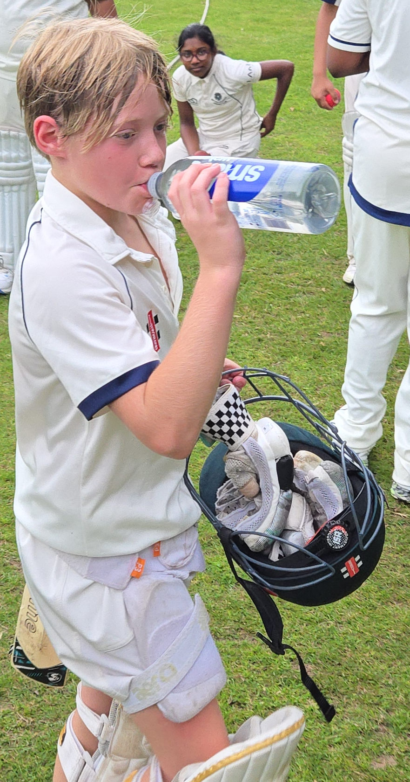
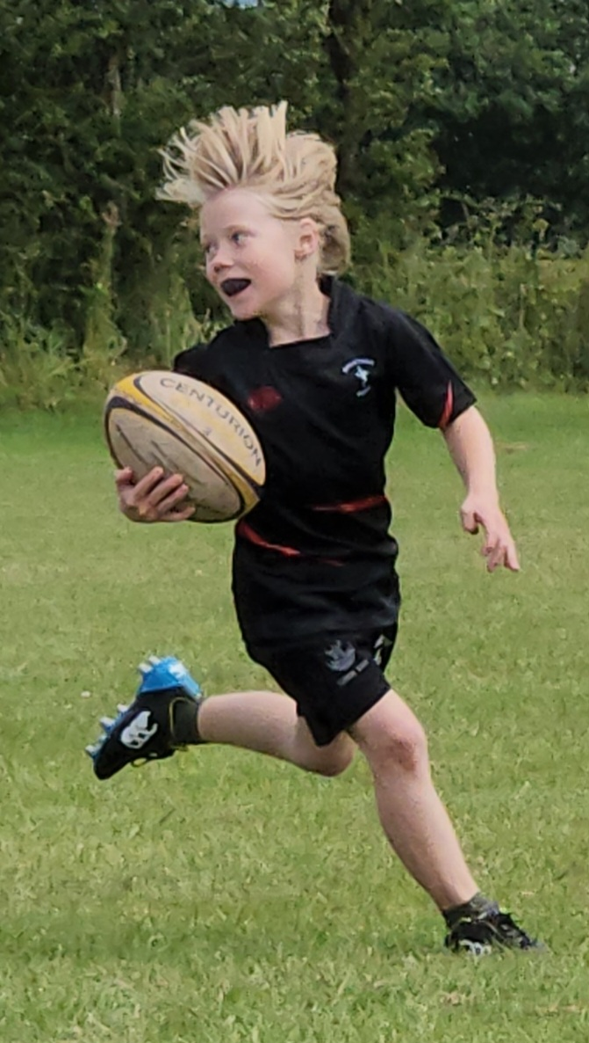
Who am I?
Paul Long
  Started Teaching 30 years ago
  Former head of computing
  Former Principal examiner & spec writer
  Textbook author
  Ofqual Subject Expert
  STEM Improvement Leader
  Pearson Credible Specialist
  Self-employed
    Resources for schools
    Revision sessions
    Training for teachers
    Freelance training
  Three interesting things about me:
    Married to Catherine with our 11 year old son Caleb and 9 year old daughter Naomi
    We go to Real Life Church in Sutton Coldfield
    We enjoy playing modern board games

Slide 4
Starter
© paullong.net 2026
You only need to answer question eight.
What does RAM stand for?
What is 0011 x 2 in binary?
What is the denary equivalent of the binary number 0011?
What is the hexadecimal value of the binary number 1100?
A plain ASCII text file has 5 letters. How many bytes of storage are needed?
Name one component of the Central Processing Unit (CPU).
How many bytes are there in a kilobyte?
Stand up when you have finished, but only if you have finished.
Have you read all the instructions yet?
Why are you answering this question?

Slide 5

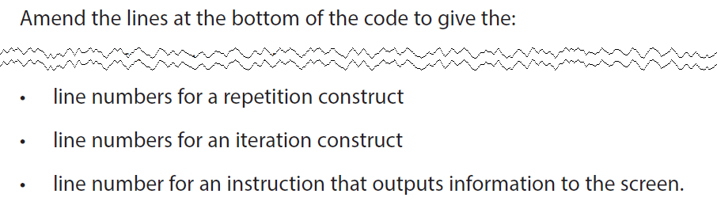
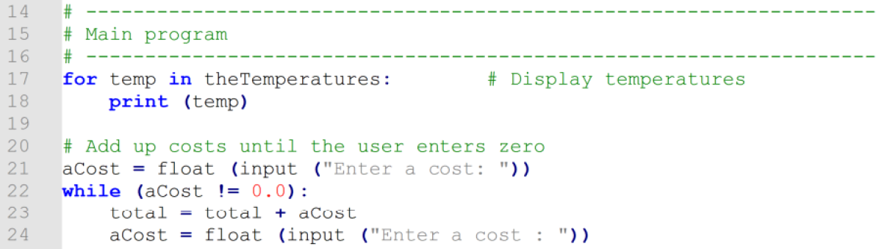
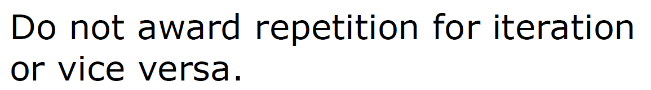
2023 P2 Q1
Which line for repetition?
Which line for iteration?

Slide 6
Specification Misconception
Misconception:
  “Iteration” is used to only mean iteration of data structures
  “Repetition” is a separate term used for loops
Correct definition:
  Iteration applies to loops, not just data structures

Slide 7

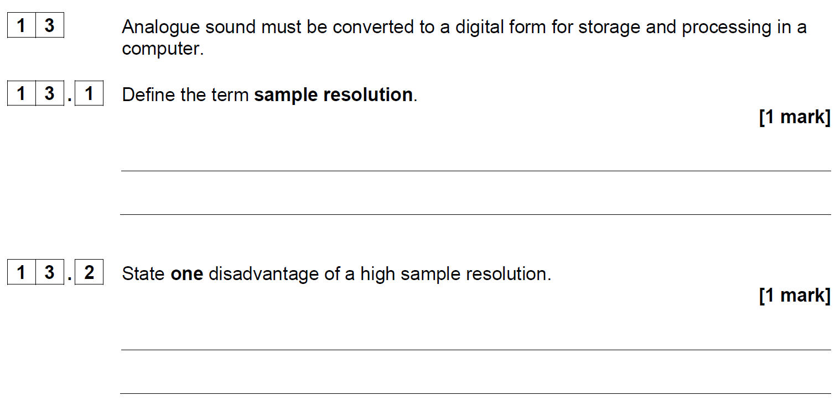
2024 P2 Q13
Answer the question
✓
  (number of) bits per sample
  Bit depth

Slide 8
Specification Misconception
Misconception:
  “Sample resolution” is used instead of “bit depth” for sound
  Sample resolution has evolved over time
  Sample resolution now has no precise definition
Correct definition:
  Bit depth is the industry standard definition

Slide 9

Specification Misconception
Misconception:
  “Erroneous” test data has been defined as different to “invalid” test data
  guidance column suggests erroneous data is data of the incorrect type
  guidance column suggests invalid test data is always of the correct type but outside boundaries
Correct definition:
  they mean the same thing

Slide 10
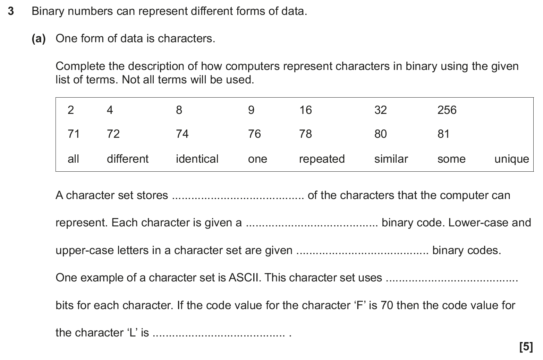

2023 P1 Q3a
What answer goes in the red highlighted part?
Now what answer goes there?

Slide 11
Specification Misconception
Misconception:
  ASCII is 8 bits
Correct definition:
  ASCII is 7 bits
  Extended ASCII is 8 bits

Slide 12
8-bit ASCII – watch out
ASCII 7-bit only uses 128 characters:
  English alphabet
  numbers
  basic symbols
  control codes
8-bit Extended ASCII provides for 256 characters:
  some foreign characters
  additional symbols
OCR use 8-bits when referring to ASCII. That’s wrong, but what you need to do.
Notes:
The term ‘Extended ASCII’ does NOT need to be remembered
All exam questions will use 8-bits for ASCII

Slide 13
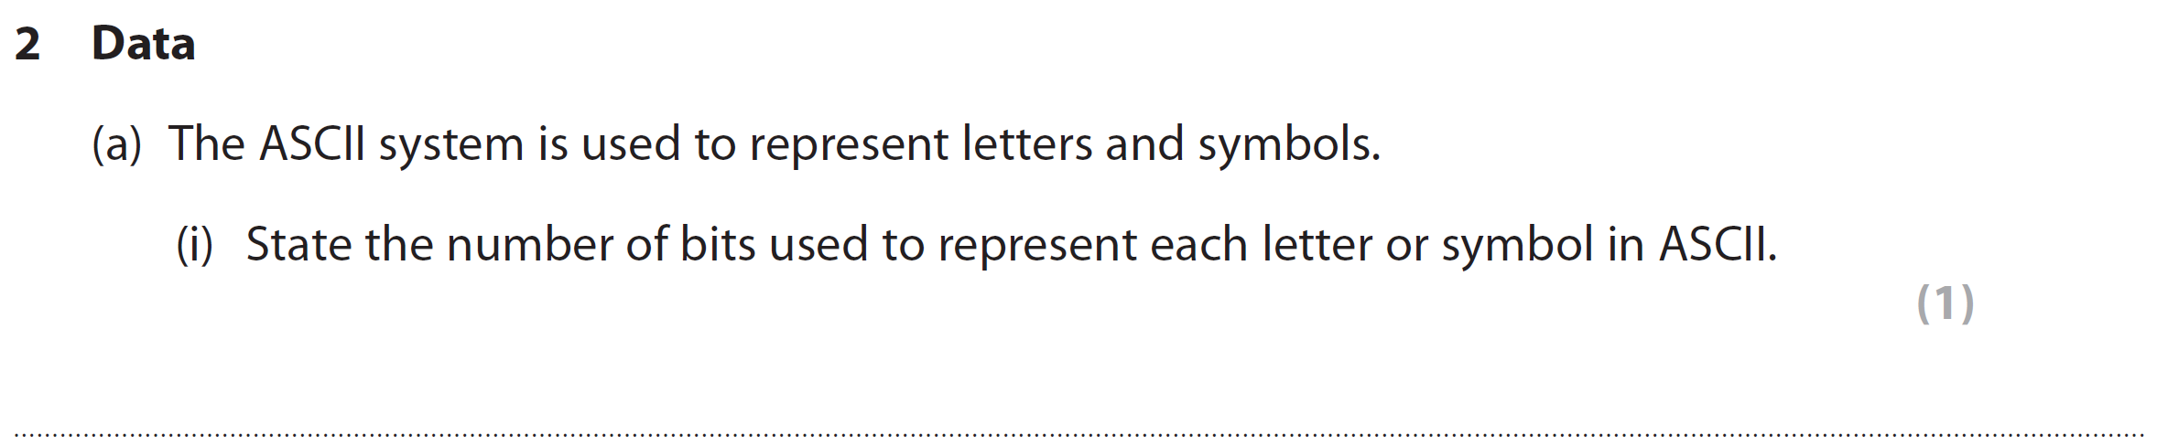
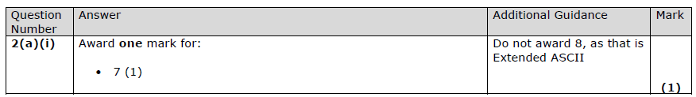
2024 P1 Q2ai

Slide 14
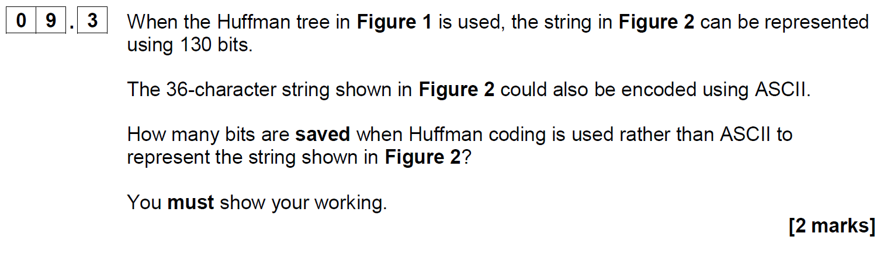
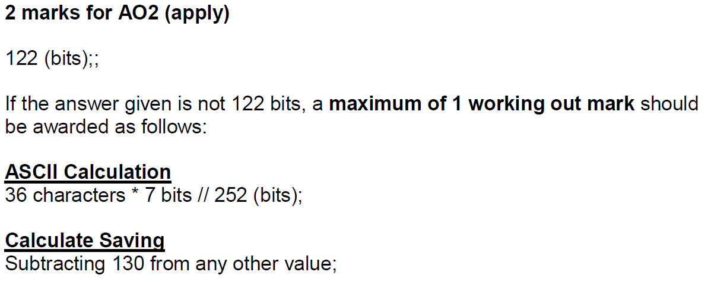
2020 P2 Q09.3

Slide 15

Most important tips in an exam
Highlight important parts of a question
  Slows you down to ensure you are taking in the question
  Helps you ensure you are answering the question the examiner has asked, NOT the question you think you should be answering
  Helps identify ‘gotcha’ words
Always give an example if appropriate, even if not asked for
  If there’s a scenario, give an example related to the scenario
  Use words from the question itself, e.g. “the employee”
Answer the questions you CAN answer to maximise your marks
  Leave questions you can’t answer until the end
  BUT there are usually one or two easy marks in most practical and programming questions

Slide 16
Highlighting & gotcha example
  This is NOT a real question from an exam, but typical of ‘gotcha’ style questions.
  A text file is 2 kilobytes in size.
  Calculate how many bits are used by the text file. [2]
  Which words would you highlight?

Slide 17
Using an example
B | B | W | B | B | W
W | W | B | B | B | W
W | B | B | W | B | W
W | B | W | W | B | W
Using the example, explain how a bitmap image is stored on a computer. [5]
Which word(s) would you highlight?
How many examples should you give?
  Give at least 5 options, e.g. 7
  Examiner will mark until:
    End of question
    OR 5 marks awarded

Slide 18
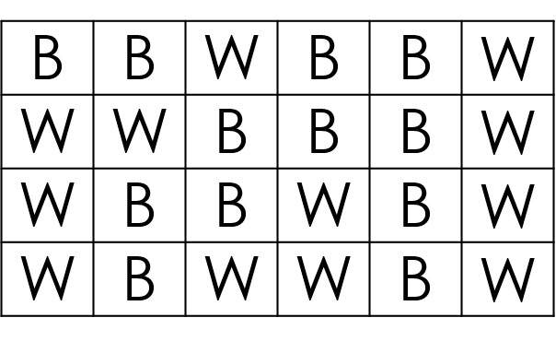
How the image is stored
Explanation | Example
Image is made up of pixels | e.g. 24 pixels in this image
Each pixel can be one colour | e.g. black or white
Each pixel is stored as a bit | e.g. 1 for black and 0 for white
Binary numbers are stored in sequence in a file | e.g. first row would be 110110
Metadata about the image is also stored | e.g. width of 6 pixels
Click to Reveal
Click to Reveal
Click to Reveal
Click to Reveal
Click to Reveal

Slide 19
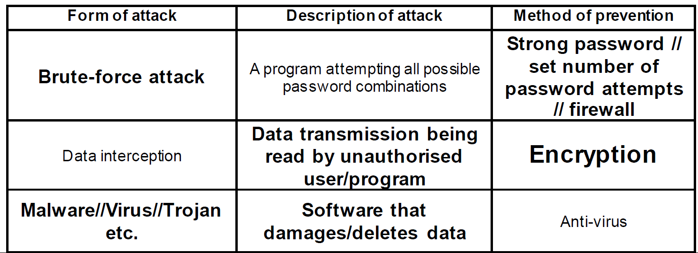
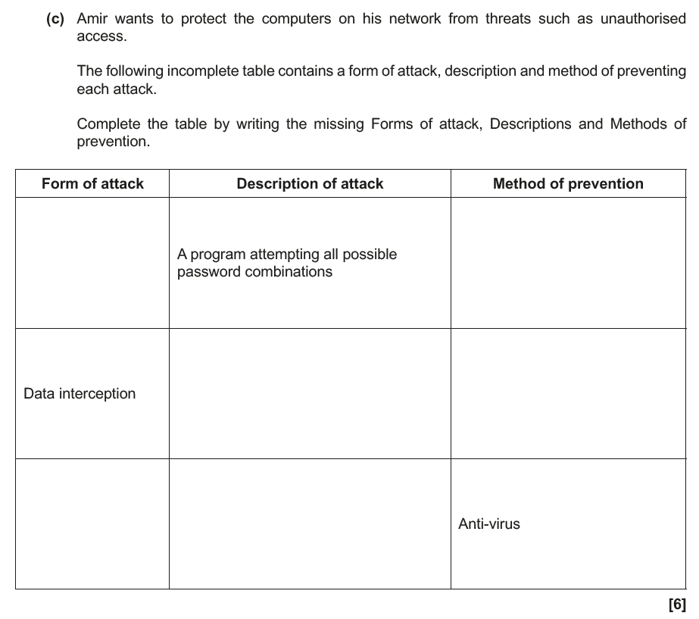

What has this student done wrong?
What has this student done wrong?
Are the mistakes clearer now you can see the mark scheme? Vote on the answers given.
Brute Force
Password
✓
Strong password
Read by an unauthorised user/program
Encryption
Data is read while being transmitted
Firewall
Malware that encrypts data until a user pays a ransom
Ransomware
✓
✓

Slide 20


EXAMPLES
E
D
A
g
M
xample
riven
answers
et
arks

Slide 21
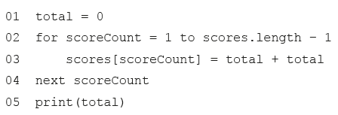
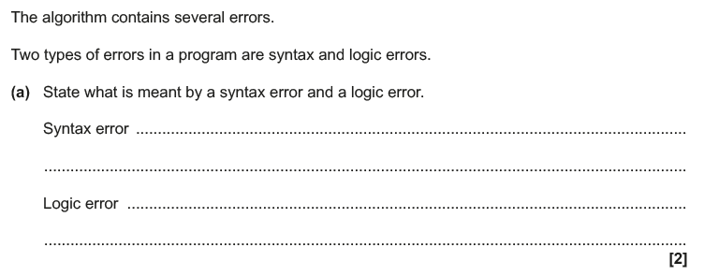
2023 P2 Q2a
  What are your thoughts on this question?
Question is clumsy – they are two separate questions
There is no syntax error in the question to use as an example
  (apart from undefined scores, but it’s only ERL)

Slide 22
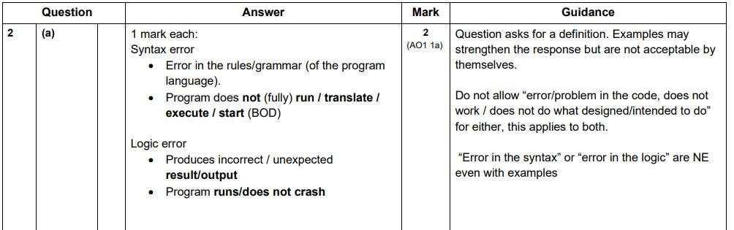
2023 P2 Q2a
  Does the mark scheme surprise you?
Recommended full answer for logic error:
  The program runs but produces unexpected results
  E.g. the total is added twice in line 3 instead of adding the score to the current total

Slide 23
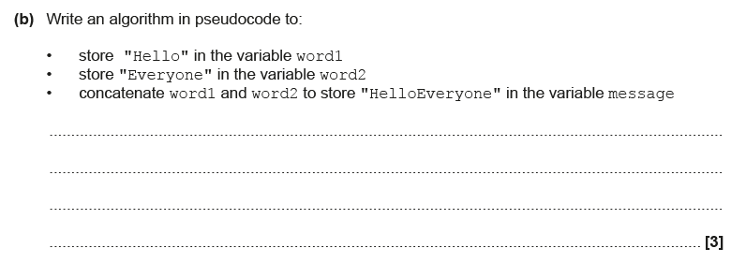
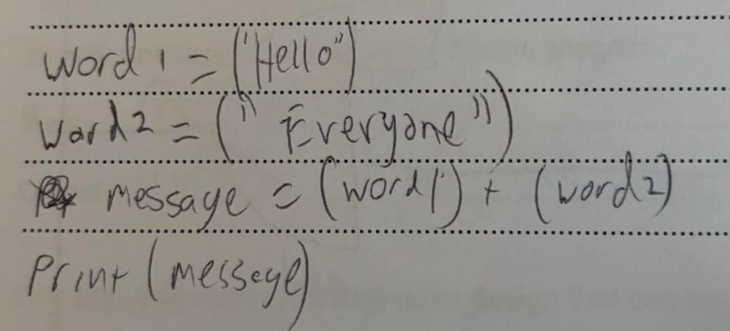
2024 P2 Q6b
What’s wrong with the answer?
Part (b) of a question but has nothing to do with part (a)
No problem with the question itself, but mark scheme is unfair

Slide 24
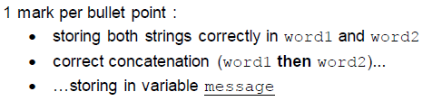
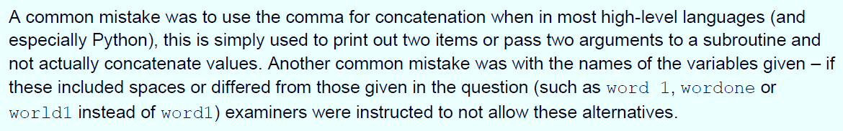
2024 P2 Q6b
Mark scheme itself is NOT an issue, BUT guidance given to examiners was
to not award mark if more than a finger space between “word” and 1 or 2
  how big is a finger space?
  Should spaces matter in pseudocode?
Recommended full answer:
  word1 = "Hello"
  word2 = "Everyone"
  message = word1 + word2

Slide 25
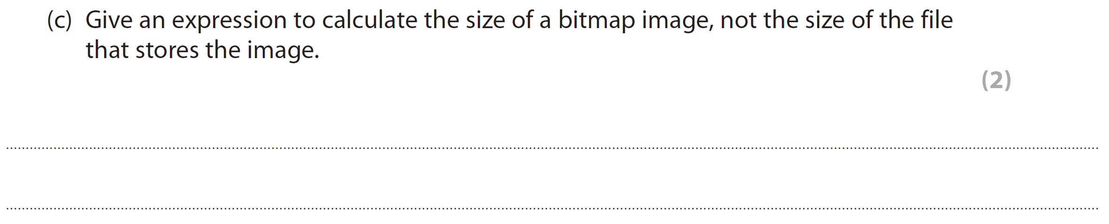
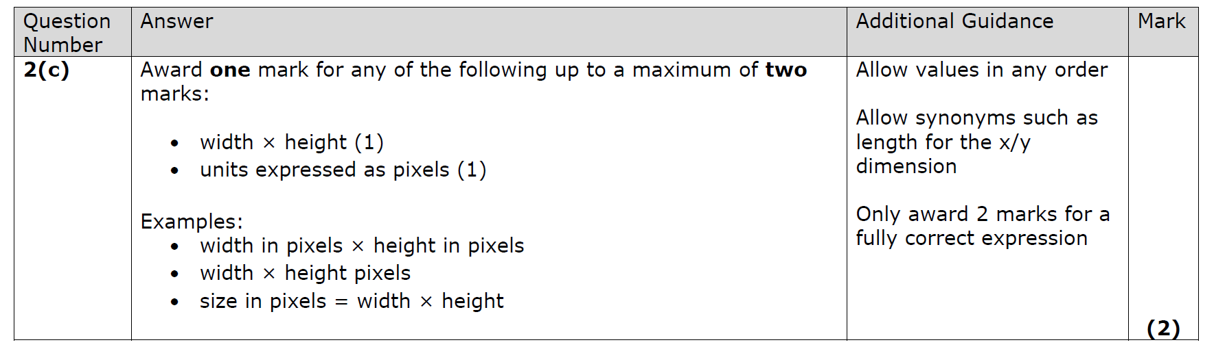
2024 P1 Q2c
  Answer the question
  What surprises you in the mark scheme?

Slide 26
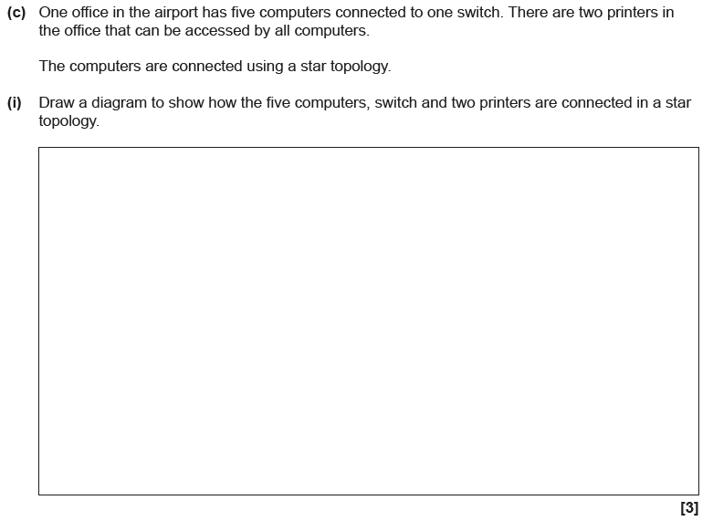
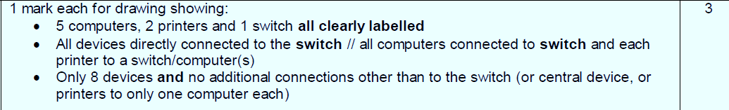
2024 P1 Q9c
How many marks?
Printer
PC
PC
PC
S
PC
PC
Printer

Slide 27
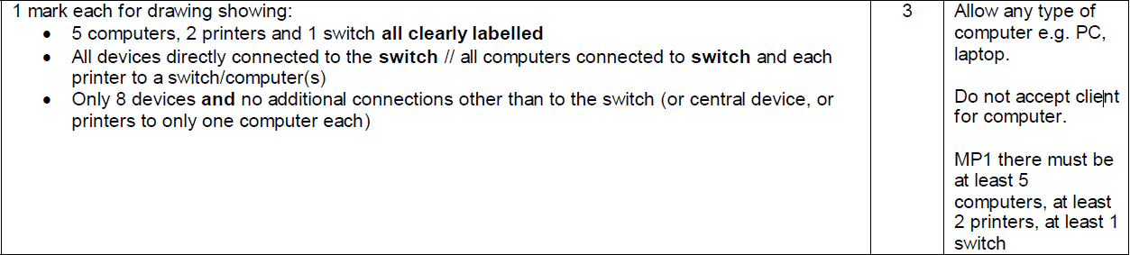
The mark scheme
Switch is in bold which means it MUST exist. If it’s not labelled, it doesn’t exist.
Not labelling the switch means 0 marks for both bullet points 1 and 2
Including too many computers means no mark for bullet 3
  fortunately, in this mark scheme it did not affect bullet 1

Slide 28

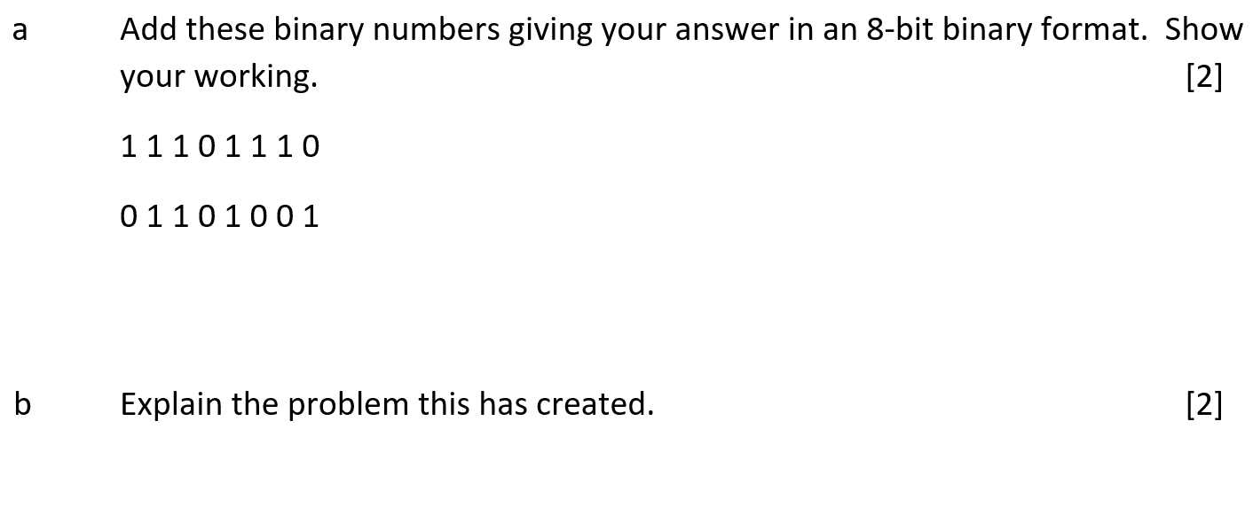
An old OCR Question
How many marks?
1 0 1 0 1 0 1 1 1
1
1
1
1
1 mark per nibble
Only one mark for first nibble if 5 bits
OCR have since improved the MS

Slide 29
Overflow example
2⁷ | 2⁶ | 2⁵ | 2⁴ | 2³ | 2² | 2¹ | 2⁰
128 | 64 | 32 | 16 | 8 | 4 | 2 | 1
OVERFLOW ERRROR
Problem:
Only 8 bits available (one byte)
9th bit is not available
Data is lost giving unexpected results
Real Solution:
Need 2 bytes
00000001 01010111
Expected solution:
01010111 (no mark if 9th bit included)
does NOT test binary addition
tests overflow TWICE
1 1 1 0 1 1 1 0
+ 0 1 1 0 1 0 0 1
X
0
1
0
1
0
1
1
1
1
1
1
1
Notes:
You could get students to do each calculation as you go along

Slide 30
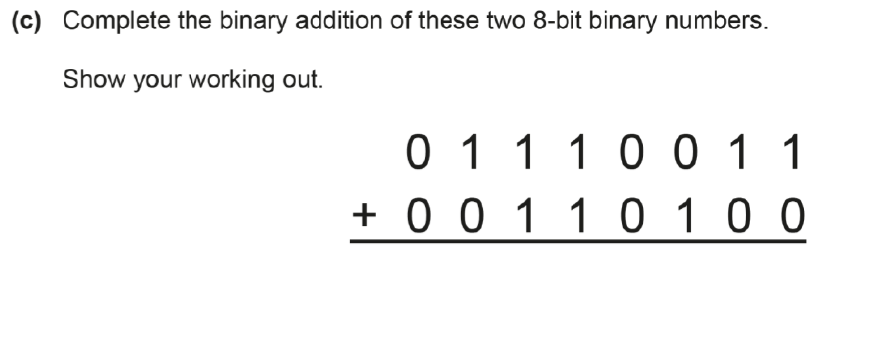
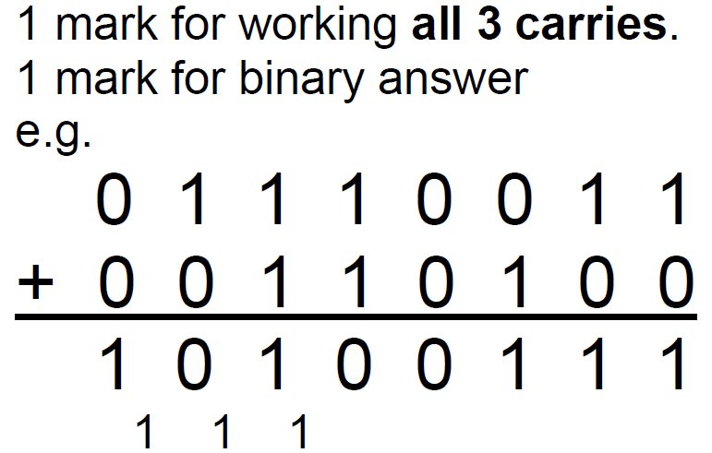
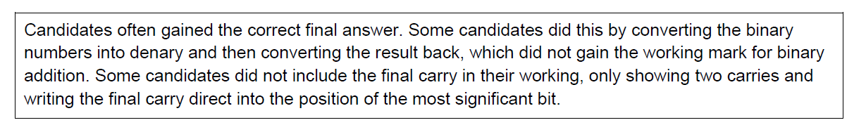
2025 P2 Q5c
1
1
1 0 1 0 0 1 1 1
How many marks?
(out of 2)

Slide 31
Do you want to learn more?
Book me for a
revision masterclass
at your school
www.paullong.net/revision
Answering questions in context using examples
How to enhance answers with examples
Structuring answers to higher mark questions
Checking the question asked has been answered
Showing stages of working when performing calculations or showing stages of a method
Completing trace tables successfully
Creating effective flowcharts
Writing effective code
Using diagrams appropriately
Responding to command words (e.g. identify, describe, explain, define, state, discuss, outline)
Responding to key words (e.g. reasons, advantages, implications, purpose, differences, impact)

Slide 32
Decomposing an algorithm question
An appointments system allows appointments to be booked in blocks of 15 minutes. For example, an appointment for 2 hours and 45 minutes would be allowed but an appointment for 1 hour and 17 minutes would not be allowed.
Complete the algorithm below which implements this restriction.
    userinput = input(“enter time in minutes: “)
    hours = userinput DIV 60
    minutes = userinput MOD 60
    if minutes _______________ 15 == 0 then
    print(“allowed”)
    ______________
    print(“not allowed”)
    end if
77
77
= 1
77
=17
MOD
else

Slide 33
Explain the use of DIV in line 2
It divides the number of minutes by 60 (1)
To give the whole number of hours in the appointment (1)
e.g.
  The user inputs 165 minutes
  165 is divided by 60 which is 2 remainder something
  The remainder is ignored
  This leaves 2 hours in the appointment

Slide 34
Decomposing a coding question
Write a program using ERL or a HLL to authenticate a login. The correct password should be “letmein”. The user will be asked to enter their password. The computer will display “Welcome” if the password is correct, but if it is incorrect it will display
“Password wrong. Try again.” The user will be asked repeatedly for the password until they give the correct password or they input “0” to end the program. [6]
DECOMPOSE this problem before writing the algorithm
  Inputs
  Process
  Outputs
  Selection
  Iteration

Slide 35
Question decomposed
password = “letmein”
Repeat
  Ask user for password
  If password = “letmein” display “Welcome”
  If password is wrong display “Username and password wrong. Try again”
Until password is correct or password is “0”
while NOT ( )
password is correct or password is “0”

Slide 36
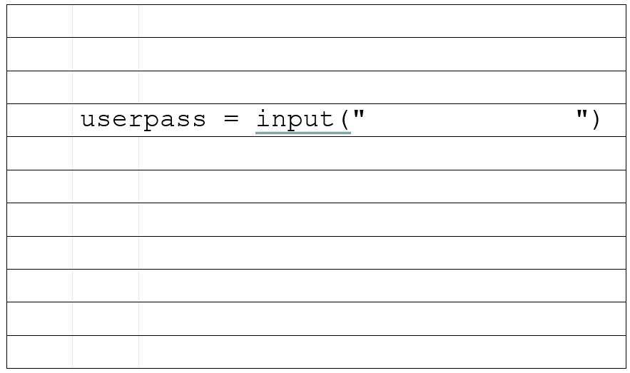
Draw feint pencil indentation lines

Slide 37
Where to start?
Start a few lines down so you can add code if needed
Start indented so you can add a loop if needed

Slide 38
SQL Questions
CountryName | Population | Area (km²) | PopulationDensity (/km²) | LastUpdated
Monaco | 33,000 | 1.95 | 16,923 | 2013
Vatican City | 826 | 0.44 | 1877 | 2009
United Kingdom | 62,041,708 | 243,610 | 255 | 2010
France | 62,793,432 | 551,500 | 114 | 2010
Sweden | 9,366,092 | 449,964 | 21 | 2009
A student has attempted to write an SQL query to find the country name and population of all the countries with a
population density of at least 250 km²
SELECT CountryName
FROM countries
WHERE Population Density > 250 km²
and Population
The student has made 4 errors.
Identify the 4 errors. [4]

Slide 39
Binary Search
EXAMPLE – find G
[B, D, F, G, P, Q, R, S, Y]
  Middle value = P
  G < P
  Keep [B, D, F, G]
    Middle Value = D
    G > D
    Keep [F, G]
      Middle Value = F
      G > F
      Keep [G]
        Middle Value = G
        G = G
        Found G
K
C
eep
ind middle
ompare
F

Slide 40



Remembering logic gate symbols
N T
AN
O R

Slide 41
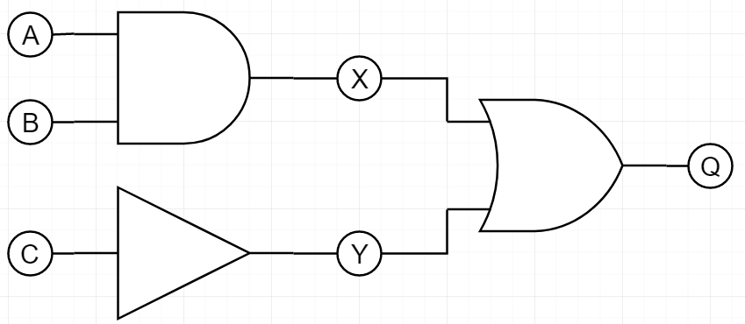

Truth tables
A and B are inputs to an AND gate with an output of X:
X = A AND B
C is an input to a NOT gate with an output of Y:
Y = NOT C
X and Y are inputs to an OR gate:
Q = X OR Y
INPUT |  |  | INTERIM |  | OUTPUT
A | B | C | X = A AND B | Y = NOT C | Q = X OR Y
0 | 0 | 0
0 | 0 | 1
0 | 1 | 0
0 | 1 | 1
1 | 0 | 0
1 | 0 | 1
1 | 1 | 0
1 | 1 | 1
0
1
1
0
0
0
0
1
1
0
0
0
0
1
1
0
0
0
1
1
1
1
0
1

Slide 42
What’s wrong?
Define a bitmap image.
Answer:
  A bitmap image is made up of dots
  A bitmap image contains pixels

Slide 43
Benefits – what to avoid
Explain three benefits of using a SSD instead of a HDD in a laptop. [6]
it‘s “faster”
what is it faster than?
why is it faster?
it‘s “cheaper”
what is it cheaper than?
what makes it cheaper
it‘s “more robust”
what is it more robust than?
why is it more robust?
it‘s “smaller”
what is it smaller than?
why is being smaller an advantage?

Slide 44
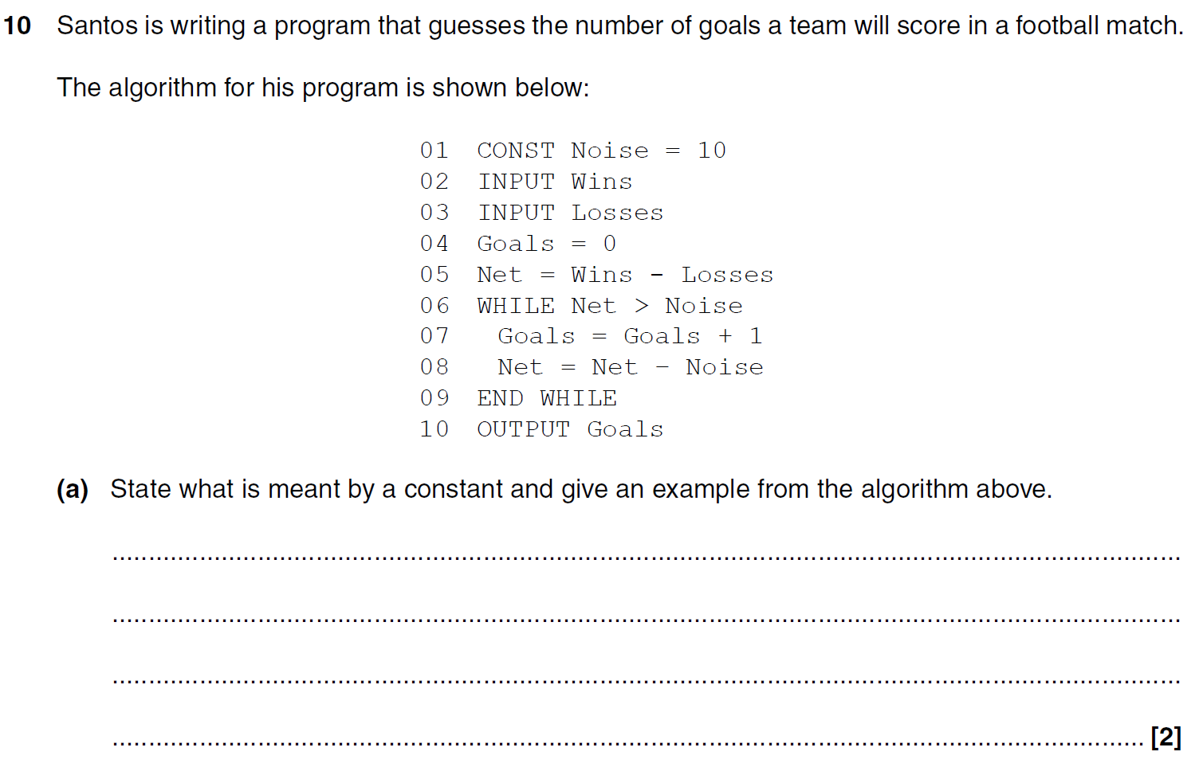
A451 2014 P1 Q10a
An identifier whose value does not change (while the program is running)
e.g Noise
An variable whose value does not change
✓
e.g. 10
✓

Slide 45
Secondary storage
Allowed
Not allowed
Long term storage of data / files
Non-volatile storage of data / files
External storage of data / files
Permanent storage of data
Non-volatile (on its own)
Long-term storage (on its own)

Slide 46
What’s wrong?
Identify a suitable storage device for transferring homework files to and from school.
Answer:
  a USB
  a USB stick
  Hard disk drive

Slide 47
Answering one mark per description
A school has a Local Area Network.
Describe what is meant by a local area network. [2]
Description | Example
Connects computers to each other | for example, computers in a classroom are connected using cables and a switch
Uses dedicated cables | for example, only the computers in the school use the cables
It’s restricted to a local geographical area | for example, it only operates on the school campus

Slide 48
How to answer an explain why question
The security code for an alarm system is a long binary number which begins 10001111100101111011 …
The technicians prefer to use hexadecimal to enter the security code.
Explain why the technicians prefer to use hexadecimal. [2]
0 marks without the explanations
Examples needed to improve these answers
Reason why | Explanation
It’s easier to convert hexadecimal than denary to binary | because each hex digit only needs converting to 4 bits
It’s a easier to remember / quicker to input / less susceptible to error | because it’s less digits(1 hex digit for every 4 binary bits) and more varied than a pattern of just 1s and 0s

Slide 49
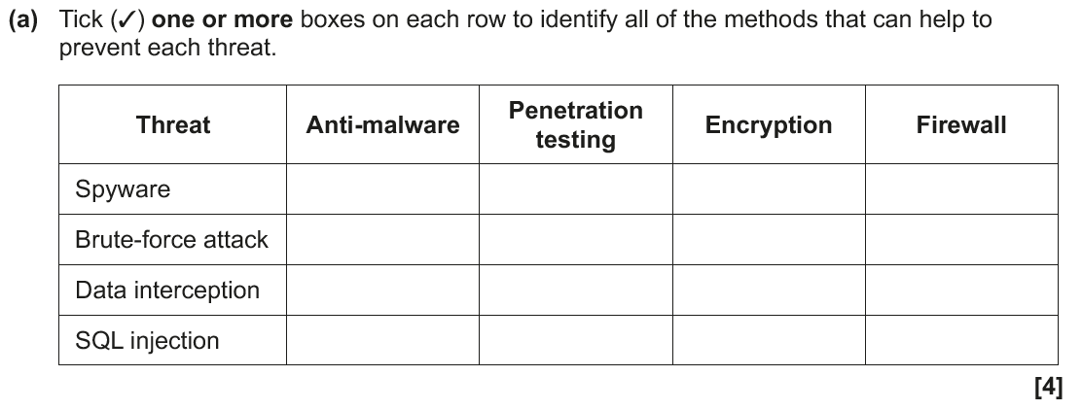
2023 P1 Q4a
✓
✓
✓
✓

Slide 50
2023 P1 Q4a – alternative?
✓
✓
✓
How about this answer?
✓

Slide 51
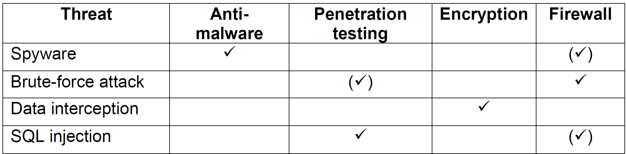

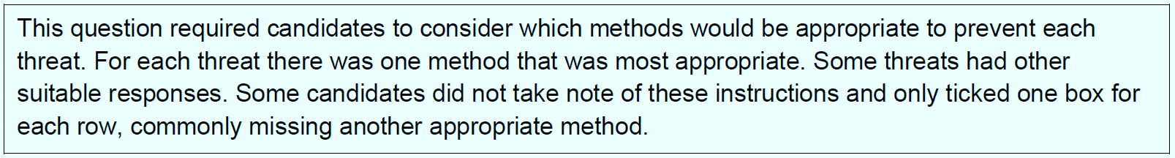
The Mark Scheme & Examiner’s Report!

Slide 52


Further information
www.paullong.net
Full detailed evaluation of the GCSE CS specifications for each exam board
  Interactive spreadsheet for comparing specification coverage
  Transition guides for AQA, Edexcel and OCR from old to new specifications
Detailed statistical review of each exam series

Slide 53

The Ultimate GCSE CS Textbook (online and printable)
The Ultimate GCSE CS Animated Presentations each with engaging content and elegant animations
100s of walkthrough examples
100s of student activities (worksheets)
100s of links to carefully selected engaging videos
100s of exam style questions
Extension work for high ability learners
100s of answers to activities and exam style questions
100s of Python programs linked to examples, activities and exam style questions

Slide 54
Step-by-step guide to answering each question in an exam
The thought process involved in answering a question
Deliberate mistakes which are then corrected whilst answering the question
A deep dive into exam technique
What command words mean
Tips from an experienced examiner including:
  which parts of the question are important to highlight
  what the mark scheme is likely to be looking for
  what ‘naughty examiners’ do to ‘catch them out’
An optional extra to see how the mark scheme is applied to each question

